Slide 1

ALARM FATIGUE IN NICU Understanding the Risks and Solutions to Improve Patient Safety
Hamideh nikzad
Nidcap certified
1404
مرکز آموزشی درمانی الزهرا -تبریز

Slide 2

Auditory intervention
The uterine environment protects the developing fetus from loud and high frequency sounds
But in the NICU this protection is lost and harsh clinical environment is replaced

Slide 3
دسی بل | میزان صداهای ثبت شده در NICU
45 تا60 | صداهای پس زمینه ای محیط
60 | صحبت کردن معمولی پیرامون بستر نوزاد
65 تا 70 | آلارم پمپ انفوزیون
86 | پالس اکسی متری
75 | گریه نوزاد
80 | زنگ تلفن
80 تا 90 | ضربه انگشتان به انکوباتور
62 تا 87 | حباب درون لوله های ونتیلاتور
100 تا 135 | بستن درهای انکوباتور

Slide 4
Effect of noise on preterm infants
Crying
Behavioral disturbances
Autonomic changes
Language or auditory disorders
Apnea
Sleep deprivation
Tachycardia
ICH
Hypoxia

Slide 5

Auditory interventions consist
Sound levels should not exceed an average of 45 db.
Quiet conversations at baby’s bed
Avoiding use of headphones/ mobile phones
Handling doors and carts gently
Silencing alarms promptly
Maternal live singing (is beneficial)

Slide 6

What is Alarm Fatigue?
When caregivers are exposed to many alarms
that they become desensitized
slower to respond
or start ignoring alarms

Slide 7

Effects on Nurses
Increased stress and anxiety
Decreased job satisfaction
Burnout and compassion fatigue
Impaired focus and teamwork

Slide 8
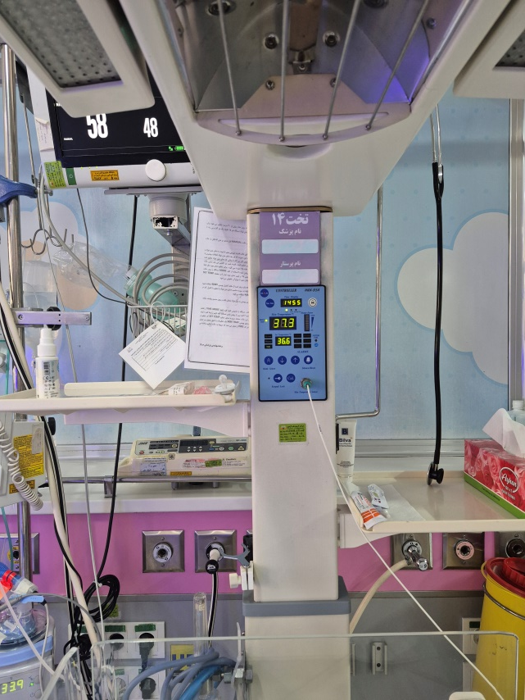
Effects on Patients and Families
Interrupted sleep and rest
Increased stress for infants and
families
Delayed response to true
emergencies
Potential for adverse outcomes

Slide 9
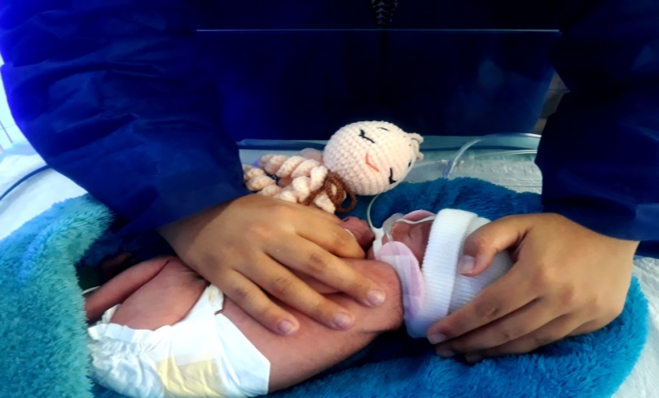
Why Focus on the NICU?
Neonates are high‐risk
physiological changes rapid
monitoring essential
Alarm fatigue undermines patient safety.

Slide 10

Magnitude of the Problem in NICU
In a study in a NICU before intervention, only 31% of alarms were “true alarms” and 69% non‐actionable; after an Alarm Management Program, true alarms rose to 57% and non‐actionable fell to 43%.

Slide 11
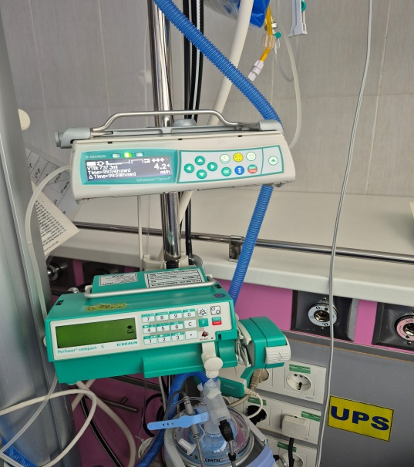
Studies: Up to 85–95% of alarms are non-actionable in NICUs
Average: >150 alarms per infant per day

Slide 12
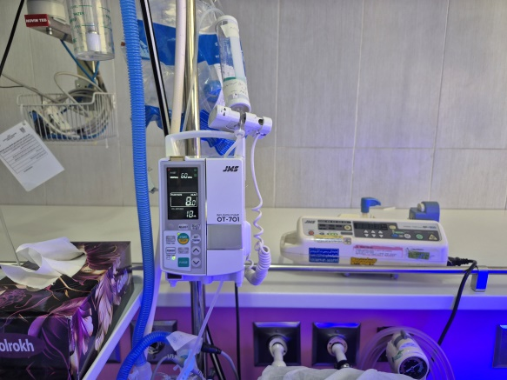
Contributing Factors
Sensitive alarm limits
Lack of standardization
Poor alarm customization
Equipment malfunction or artifact
High patient acuity and workload

Slide 13
Causes of Alarm Fatigue in the NICU
High frequency of false or non-actionable alarms
Overlapping alarms from multiple devices
Sensitivity settings not tailored to individual patients
Environmental noise
Staffing constraints and workload pressure

Slide 14
Cause | Description | NICU Examples
High Frequency of Alarms | Too many alarms in a short time; staff exposed to constant alerts | Multiple monitors per patient; 80–90% non-actionable alarms
Low Specificity / Poor Clinical Relevance | Alarms triggered by minor or irrelevant events | Baby movement; sensor displacement; temporary SpO₂ drops
Inadequate Alarm Settings | Default thresholds too sensitive; lack of patient-specific adjustments | Pulse oximeter alarms set to narrow range for all neonates
Environmental & Workflow Factors | Noise, overlapping alarms, poor escalation systems | Open-bay NICU with simultaneous alarms; high ambient noise
Staff-Related Factors | Fatigue, stress, high workload reduce responsiveness | Long shifts; high nurse-to-patient ratio; delayed alarm response
Equipment Factors | Malfunctioning or inconsistent devices; confusing alarm sounds | Old monitors producing false alarms; multiple tones hard to distinguish

Slide 15
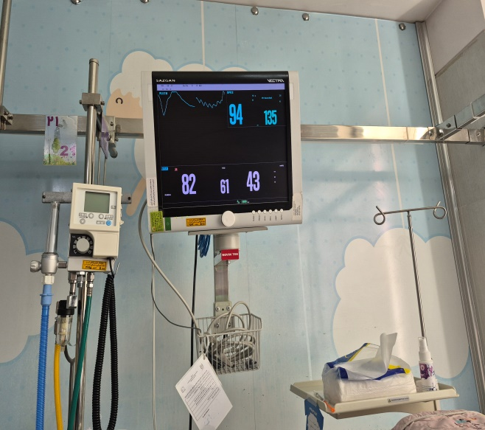
Delayed or missed responses to critical alarms
Increased risk of adverse events

Slide 16
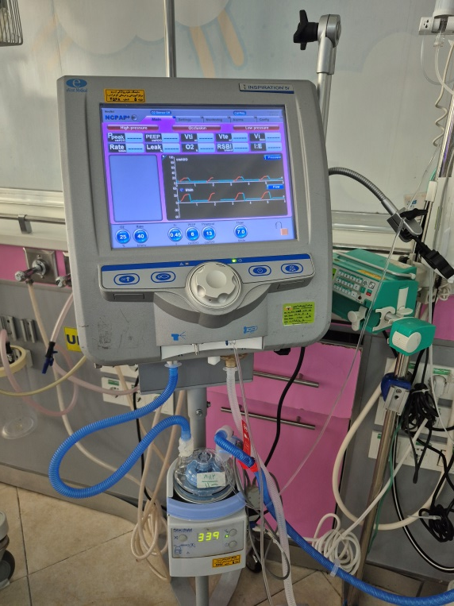
Common Types of Alarms in the NICU
Cardiorespiratory monitor alarms (heart rate, apnea, oxygen saturation)
Ventilator alarms
Infusion pump alarms
Crib or incubator
Humidifiers

Slide 17
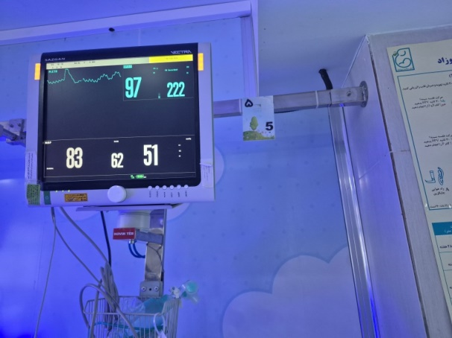
Strategies to Reduce Alarm Fatigue
Adjusting alarm thresholds and delays appropriate for neonatal population.
Education and training of staff
Device/Monitor optimization and maintenance
Multidisciplinary team & alarm management program (AMP)
Reduce background noise

Slide 18
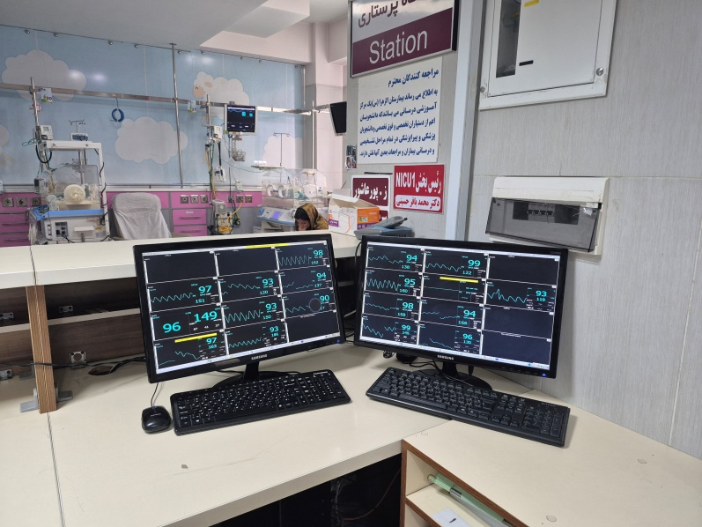
Technology Solutions
Smart alarms and integrated systems
Visual or silent alerts
Central monitoring stations

Slide 19
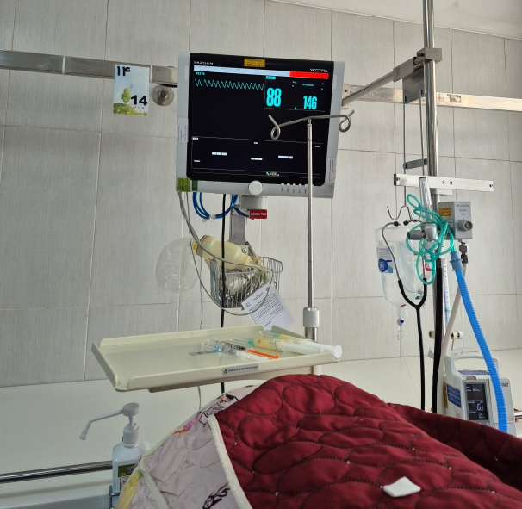
Single-family room (SFR) NICUs are better than open-bay NICUs
Advantages of Single-Family Rooms (SFRs):
Lower noise levels
Improved alarm clarity
Reduced sensory overload
Better customization

Slide 20
But caveats are:
Nurses may not hear alarms from other rooms as easily, so systems must ensure alarms are transmitted effectively (through pagers, smartphones, or centralized monitoring).
Alarm escalation design is critical — without a good secondary notification system, single rooms might increase response time to alarms.

Slide 21
Cautions
SFRs require strong alarm communication systems (mobile devices, central monitoring)
Inadequate design could cause delayed responses if alarms aren’t effectively transmitted.

Slide 22
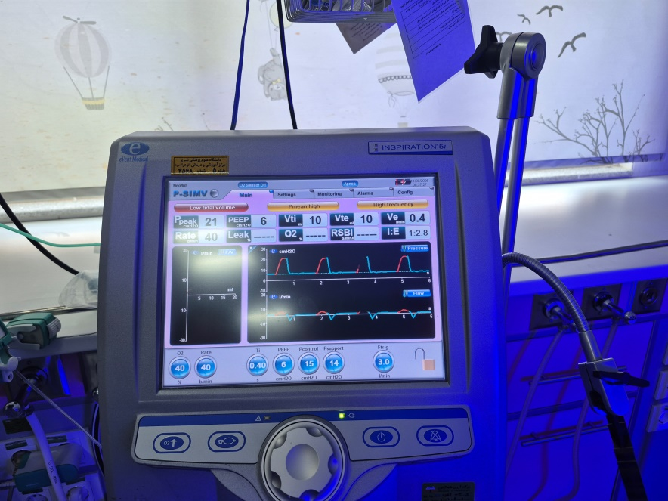
Single-family room designs can
significantly mitigate alarm fatigue and enhance patient safety.

Slide 23
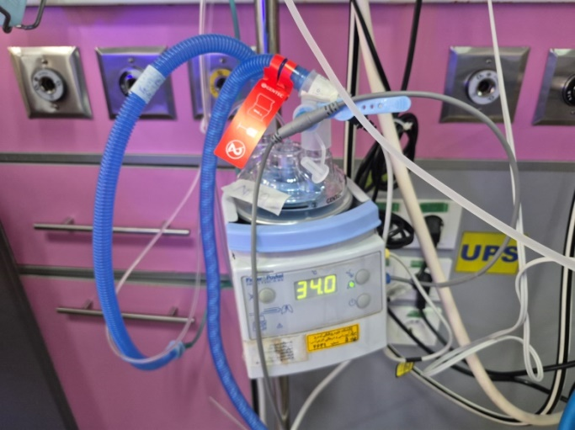
Role of Nurses
Report malfunctioning equipment
Assess alarm appropriateness per patient
Advocate for policy changes
Participate in education and audits

Slide 24
Summary
Alarm fatigue threatens safety and well-being
Most alarms are non-actionable
Customization, education, and teamwork reduce fatigue
Nurses are key to improvement

Slide 25

Thanks for your attention

