Slide 1
Transcatheter intervention in extremely low birth weight (ELBW) infants
Mohamad-Taghi Majnoon, MD
Pediatric Cardiologist
Assistant Professor
Children’s Medical Center of Excellence
Tehran University of Medical Sciences

Slide 2
Background & Scope
PDA is common in preterm neonates and can destabilize cardiorespiratory status.
Traditional options: medical therapy or surgical ligation.
Transcatheter device closure offers a minimally invasive alternative.
Piccolo enables percutaneous closure in ELBW infants ≥700 g.
1/19

Slide 3
Hemodynamically Significant PDA (hsPDA):
Why It Matters
Can worsen RDS, prolong ventilation, and drive cardiovascular instability.
Associated with higher risks of BPD, IVH, renal dysfunction, and mortality.
Clinical impact greatest in infants <28 weeks’ gestation.
Yet ~85% of untreated PDAs close spontaneously after discharge.
2/19

Slide 4
Defining hsPDA: Ongoing Controversy
No single consensus on echocardiographic or clinical thresholds.
Marked variability across institutions and countries.
Pulmonary vascular resistance evolves over days–weeks postnatally.
Requires serial reassessment of hemodynamic significance.
3/19

Slide 5
Assessing Significance
Combine echo assessment of shunt size/volume with clinical consequences.
Evaluate ductal dimensions and morphology within overall hemodynamics.
Integrate ventilatory needs, perfusion markers, and end‑organ effects.
Standard approach remains multi‑parameter and iterative.
4/19

Slide 6
Evolution of Transcatheter PDA Closure
1967 Porstmann: first transcatheter PDA closure.
Long limited by access/device constraints in tiny infants.
ADO II expanded feasibility in larger infants; later devices pushed limits.
Closure now possible in ~1–2 kg infants at experienced centers.
5/19

Slide 7
Amplatzer Piccolo Occluder—What Changed?
FDA‑approved (2019) for patients ≥700 g; engineered for ELBW anatomy.
Piccolo used in 54.8% of procedures;
Prospective multicenter (≥700 g) shows excellent 3‑yr safety/efficacy.
6/19

Slide 8
Patient Selection—Typical Inclusion
Weight: ≥700 g (Piccolo); often ≥1500 g for other devices.
Postnatal age: typically ≥3 days for stabilization.
Echo‑confirmed L→R shunt with hemodynamic consequences.
Failed medical therapy (indomethacin/ibuprofen/acetaminophen).
Anatomic suitability (e.g., duct 2–5.4 mm) and clinical stability.
7/19

Slide 9
Cath Lab vs NICU Bedside Closure
Standard: femoral venous access; fluoroscopic + echocardiographic guidance.
Bedside occlusion avoids transport risks in fragile ELBW infants.
Reports of faster recovery and reduced transfusion needs at bedside.
Team expertise and infrastructure determine feasibility.
9/19

Slide 10
Technical Steps (Typical Workflow)
Define ductal anatomy and select device size/type.
Advance device via venous route across ductus under echo/fluoro.
Deploy with attention to LPA and aortic origins to avoid obstruction.
Confirm stability and residual shunt; finalize release.
10/19

Slide 11
Complications—Major Device‑Related
Device embolization (~2.7%); often amenable to percutaneous retrieval.
Left pulmonary artery (LPA) stenosis; may require stent.
Aortic obstruction from device protrusion (uncommon with proper sizing).
Tricuspid regurgitation from device–valve interaction.
11/19

Slide 12
Other Complications & Risk Factors
Hemolysis (rare), infective endocarditis (rare), residual shunt.
Consensus guidance published for prevention and management.
Emphasize meticulous technique and vigilant post‑procedure monitoring.
12/19

Slide 13
Preventing & Managing Complications
Match device to ductal size/morphology; avoid protrusion.
Continuous echo guidance to surveil LPA/aortic patency.
Plan for retrieval strategies if embolization occurs.
Structured post‑closure surveillance protocols in NICU/clinic.
13/19

Slide 14
Transcatheter vs Surgical Ligation
Transcatheter: rapid recovery, fewer transfusions, no incision; bedside possible.
Surgical: decades of outcomes; useful with anatomic contraindications; accessible.
Utilization: >80% invasive closures are catheter‑based in some centers.
Further high‑volume comparative data still needed.
14/19

Slide 15
Clinical Outcomes
Large series: 758/762 (99.5%) successful implantation across devices.
Device mix: ADO II 38.8%, Piccolo 54.8%, AVP II 5.8%.
Complete ductal closure common on follow‑up
Durable safety/efficacy reported in multicenter Piccolo cohort.
15/19

Slide 16
Left Ventricular Function After Closure
~23% had LVEF <55% at 24 h; all normalized before discharge.
Pre‑procedure LV dilation predicts transient LVEF reduction.
Plan monitoring and support in early post‑closure period.
16/19

Slide 17
Pulmonary Outcomes & Timing
Study (Lai et al.): no significant BPD benefit vs medical management.
Possibilities: closure not early enough or population selection effects.
Optimal timing remains unsettled; early targeted therapy for select high‑risk infants may be considered.
17/19

Slide 18
Medical Therapy & Contemporary Practice
Agents: indomethacin, ibuprofen, acetaminophen remain first‑line.
Many persist despite prophylaxis; some need further therapy/ligation.
Many PDAs close spontaneously; trend toward conservative initial management.
Transcatheter/surgical closure as rescue for refractory hsPDA.
18/19

Slide 19
Anesthesia, Transport & Key Takeaways
Meticulous anesthesia/airway and ventilation strategies are essential.
For interhospital transport: stabilize, monitor, and coordinate teams.
Bedside transcatheter closure reduces transport‑related risk when available.
Piccolo enables closure ≥700 g with high success and low complications in experienced hands.
Outstanding questions: optimal timing, neurodevelopmental impact, cost‑effectiveness.
19/19

Slide 20
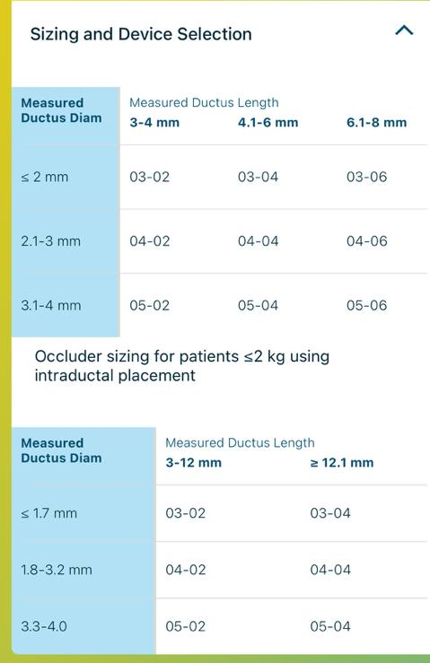

Slide 21
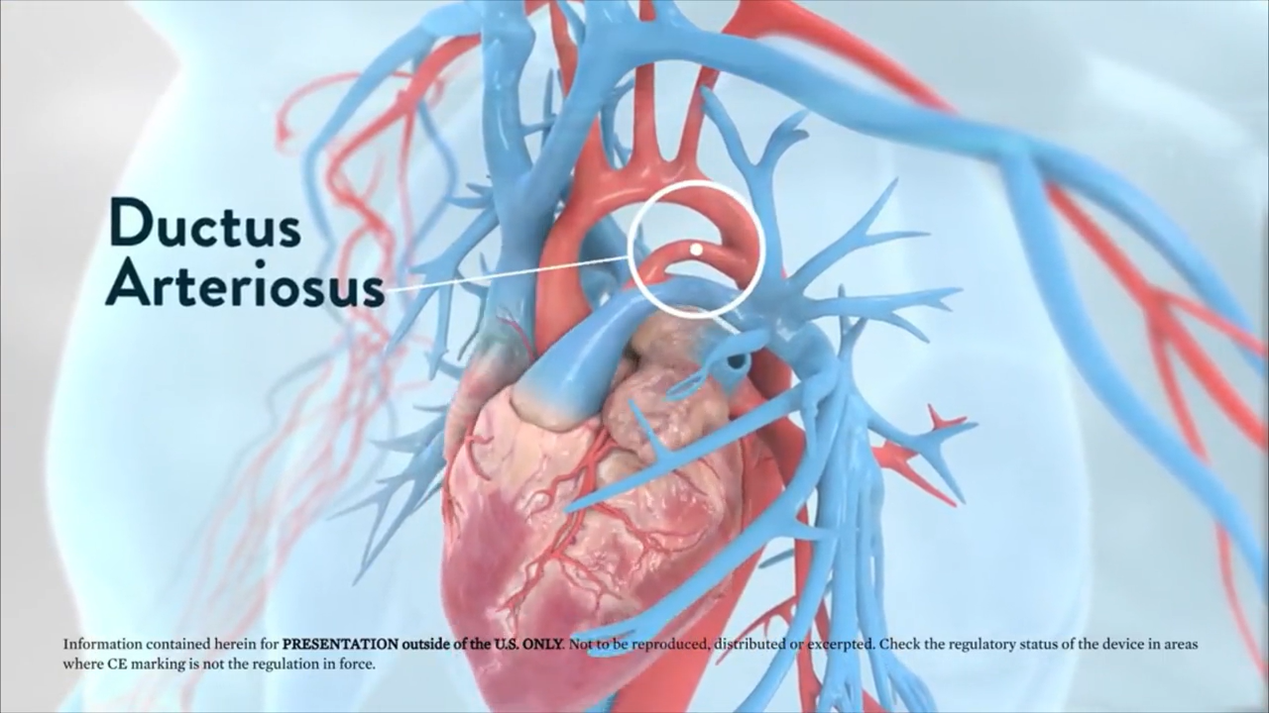

Slide 22

Thanks for Attention

