Slide 1
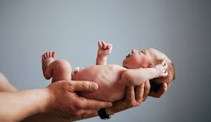
IN THE NAME OF Allah
Neonatal
Maternal and child mortality
World health statistics 2025
monitoring health for the SDGs, Sustainable Development Goals
Dr Reza Saeidi
profesore of neonatology
SBMU 1404.8.28

Slide 2
The neonatal period is the most vulnerable time for a child
Total neonatal deaths: ~2.3 million in 2023 (~6,300 per day), accounting for 47% of all under-5 deaths.
NMR is the number of deaths during the first 28 completed days of life per 1,000 live births in a given year or period.
It serves as a critical indicator of
newborn health,
maternal care quality,
and overall healthcare system effectiveness.

Slide 3
Global NMR (Latest Data: 2023)
According to the United Nations Inter-agency Group for Child Mortality Estimation (UN IGME):
the global NMR in 2023 was 17 deaths per 1,000 live births.
This marks a 53% decline from 37 deaths per 1,000 in 1990, though progress has slowed,
with an average annual reduction of about 2.3% over the full period.

Slide 4
Total neonatal deaths
~2.3 million in 2023 (~6,300 per day),
1- Regional highlights:
Highest in sub-Saharan Africa (27 per 1,000)
and central/southern Asia (21 per 1,000);
lowest in high-income countries (<5 per 1,000).
2- SDG Target:
Sustainable Development Goal, Reduce to ≤12 per 1,000 by 2030, requiring accelerated annual reductions of ~3-4% in high-burden areas.

Slide 5
NMR in Iran
(Latest Data: 2023)
Iran's NMR in 2023 was 8-10 deaths per 1,000 live births, a significant achievement reflecting strong public health investments, including expanded antenatal care and neonatal intensive care units. This is well below the global average and meets the SDG target of ≤12 per 1,000.
Trends:
NMR has declined steadily from ~28 per 1,000 in 1990,
with an average annual reduction of ~4-5% in recent decades.

Slide 6
Comparison: Global vs. Iran
Metric | Global (2023) | Iran (2023) | Notes
NMR (per 1,000 live births) | 17 | 8-10 | Iran outperforms global average by ~53%; ranks in top quartile regionally.
% of Under-5 Deaths | 47% | ~65% | Higher neonatal share in Iran highlights focus on newborn care.
Annual Reduction (2015-2023) | ~2.3% | ~4% | Iran's faster progress driven by policy interventions.
SDG Target Met? <12 | No | Yes | Iran achieved early; global needs acceleration.

Slide 7
Key Causes
(accounting for ~75% globally) and
Prevention
Globally and in Iran, top causes include
1- preterm birth (~35%),
2- birth asphyxia (~24%),
3- and infections (~15%).
Iran's success stems from strategies like universal antenatal steroids, skilled birth attendance (>95% coverage), and infection control.
Continued emphasis on equity in rural/low-SDI areas could further reduce disparities.
For interactive data, visit UNICEF's child mortality portal or WHO's Global Health Observatory.
4- Congenital anomalies (~10%).

Slide 9
درصد علل مرگ نوزادان به تفکیک علت
در سال 1402 بر اساس سامانه ثبت مرگ

Slide 10
Regional and Country Disparities
Region | Neonatal Mortality Rate (2023) | % of Global Neonatal Deaths
Sub-Saharan Africa | 27 | ~57% of under-5 deaths
Central & Southern Asia | 21 | N/A
Global Average | 17 | 100%
High-Income Countries | <5 (varies, e.g., ~2-3 in Europe/ North America) | <5%
Disparities remain stark, with higher rates in low- and middle-income countries,
particularly in sub-Saharan Africa and central/southern Asia.
Here's a summary of regional NMRs (per 1,000 live births) based on 2023 estimates:

Slide 11
Factors exacerbating disparities
In fragile and conflict-affected countries, which represent about 25% of global live births, nearly 50% of under-5 deaths occur.
Factors exacerbating disparities include
rural residence, poverty, low maternal education, and limited access to quality antenatal and postnatal care.

Slide 12
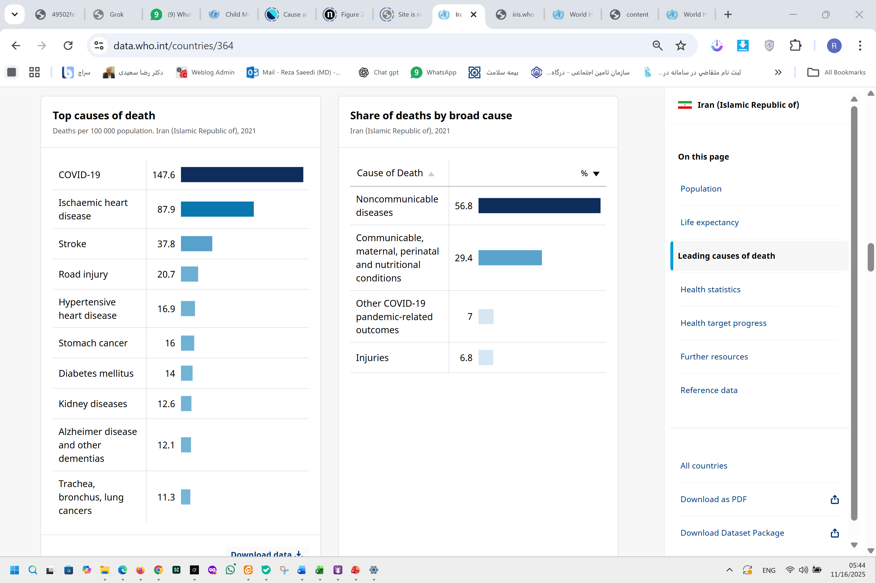

Slide 15
رتبه مرگ مادردانشگاههای علوم پزشکی
براساس MMR 5ساله (1403-1399)

Slide 16
مقایسه میزان مرگ و میر کودکان 1 تا 59 ماهه
به تفکیک دانشگاه ها 1402
منبع: نظام ثبت مرگ مرکز مدیریت شبکه
Notes:
اين شاخص تابعي از وضعيت سواد، شبكه راههاي روستايي، دسترسي به فوريتهاي پزشکی، هزينه خدمات درماني، وجود شبكه هاي ارتباطي مخابراتي، درآمد خانوار و سایر فاکتورها مي باشد

Slide 17
روند میزان مرگ نوزادان در هزار تولد زنده 1402 -1390
بر اساس سامانه ثبت مرگ

Slide 18
روند میزان مرگ نوزادان در هزار تولد زنده 1402 -1390
بر اساس سامانه ثبت مرگ

Slide 19
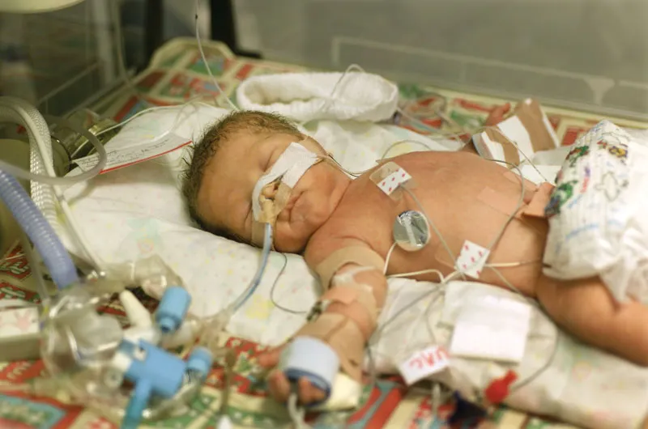
Prevention Strategies
Reducing NMR requires scaled-up interventions like:
Skilled birth attendance and emergency obstetric care.
Immunizations (e.g., against tetanus) and infection prevention.
Improved nutrition for mothers and EBF newborns.
KMC for preterm infants.
Strategies for Equity
Enhance rural health care,
maternal education,
reducing C-section rates (60%)
Telemedicine

Slide 20

Thank you for your attention

