Slide 1
NEONATAL HYPOTONIA
Vafaee-Shahi. M; MD
Associate Professor of Pediatric Neurology
Pediatric growth and development research center
Iran University of Medical Sciences

Slide 2
What is hypotonia?
Two kinds of tones: phasic and postural
Phasic tone: rapid contraction in response to a high-intensity stretch (DTRs)
Definition: Reduced resistance to passive movement
Distinguish from Weakness:
Hypotonia and weakness are symptoms, not a disease
Hypotonia: can exist with or without weakness
Clinical Impact: Can affect feeding, respiration and motor milestones

Slide 3
Pathophysiology
When postural tone depressed, trunk and limbs cannot maintain themselves against gravity and infant appears hypotonic
Maintenance of normal tone requires intact central and peripheral nervous system
Hypotonia is a common symptom of neurological dysfunction and occurs in diseases of brain, spinal cord, nerves, and muscles

Slide 4
Appearance oF Hypotonia
Spontaneous movement may be decreased
Full abduction of legs
Arms lie either extended at sides of body or flexed at elbow with hands beside head
Pectus excavatum
Flattening of occiput and loss of hair
In sitting posture, head falls forward, shoulders droop
Common feature of intrauterine hypotonia: Simian Crease, Hip dislocation and arthrogryposis Varies in severity from isolated clubfoot (most common manifestation) to symmetric flexion deformities of all limb joints

Slide 5
As a rule, newborns with arthrogryposis who require respiratory assistance do not survive extubation unless underlying disorder is myasthenia
Traction response, vertical suspension, and horizontal suspension further evaluate tone in infants who appear hypotonic

Slide 6
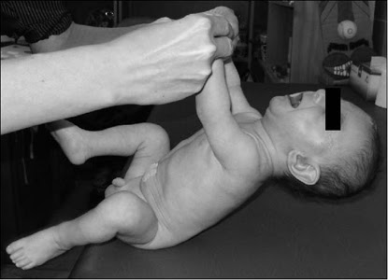
Normal Traction Response
Lift of head is almost parallel to body and there is flexion in all limb joints
Traction response is most sensitive measure of postural tone, and is not present in premature newborns of less than 33 weeks gestation
Presence of more than minimal head lag in term newborn is abnormal and indicates hypotonia

Slide 7
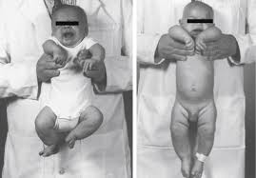
Normal Vertical Suspension
Arms help prop infant against examiners hands, and legs flex against gravity
Arms and shoulder fail to provide support, and legs do not resist gravity
When suspending a hypotonic infant vertically, head falls forward, legs dangle, and infant may slip through examiners hands because of weakness in shoulder muscles

Slide 8
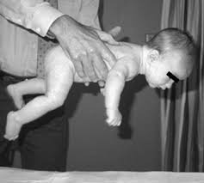
Horizontal Suspension
Normal Horizontal Suspension
Head rises intermittently and head and limbs resist gravity
Hypotonic and weak newborns and infants drape over the examiner hands, with head and legs hanging limply

Slide 9
APPROACH TO DIAGNOSIS
Hypotonia is nonspecific symptom in neonates with critical illnesses Sepsis, hypothyroidism, genetic disorders, and substance exposures can all cause low tone
Females who receive magnesium for preeclampsia often give birth infants with hypotonia that resolves over hours to days
First step in diagnosis is determine that location is in brain, spine, or motor unit. More than one site may be involved

Slide 10
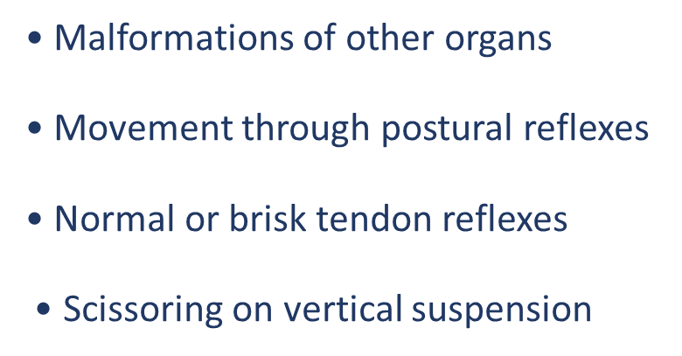
Central hypotonia (60%–80%) is more common than peripheral hypotonia (15%–30%)
Genetic testing reveals a diagnosis in approximately 30% of cases
Clues to Cerebral Hypotonia
• Abnormalities of other brain functions
• Dysmorphic features
• Fisting of the hands
Micro or Macrocephaly

Slide 11
Clues to Motor Unit Disorders
Absent or depressed tendon reflexes
Failure of movement on postural reflexes
Fasciculations
Muscle atrophy
No abnormalities of other organs

Slide 12
Combined Cerebral and Motor Unit Hypotonia
Acid maltase deficiency
Familial dysautonomia/Riley-Day syndrome
Giant axonal neuropathy
Hypoxic-ischemic encephalomyopathy
Infantile neuronal degeneration (Infantile Neuroaxonal Dystrophy)
Lipid storage diseases
Mitochondrial (respiratory chain) disorders
Neonatal myotonic dystrophy
Perinatal asphyxia secondary to motor unit disease

Slide 13
Assessment of hypotonic infant should include
Three-generation pedigree
History of drug or teratogen exposure (alcohol, solvents, drugs)
Breech presentation, reduced fetal movements, history of polyhydramnios
Family history of recurrent infantile deaths
Parental age, consanguinity, perinatal asphyxia, Apgar scores
History of neuromuscular disease, dysmorphism, arthrogryposis
DTRs, and fasciculations

Slide 14
Testing of hypotonic infant include
Brain imaging
Metabolic testing
Chromosomal microarray
Microarray and exome sequencing have highest yield

Slide 15
Differential Diagnosis of Infantile Hypotonia
Cerebral hypotonia
• Prader-Willi syndrome
• Trisomy
• Benign congenital hypotonia
• Chromosome disorders
Chronic nonprogressive encephalopathy
• Cerebral malformation
• Perinatal distress
• Postnatal disorders

Slide 16
Differential Diagnosis of Infantile Hypotonia
Peroxisomal disorders
• Cerebrohepatorenal syndrome (Zellweger syndrome)
• Neonatal adrenoleukodystrophy
Other genetic defects
• Familial dysautonomia
• Oculocerebrorenal syndrome (Lowe syndrome)
Other metabolic defects
Acid maltase deficiency

Slide 17
Differential Diagnosis of Infantile Hypotonia
Infantile GM1 gangliosidosis
Pyruvate carboxylase deficiency
Spinal cord disorders
Spinal muscular atrophies
• Acute infantile
• Chronic infantile
Autosomal dominant. Autosomal recessive. Congenital
cervical spinal muscular atrophy. Infantile neuronal
degeneration. Neurogenic arthrogryposis

Slide 18
Differential Diagnosis of Infantile Hypotonia
Polyneuropathies
• Congenital hypomyelinating neuropathy
• Giant axonal neuropathy
• Hereditary motor-sensory neuropathies
Disorders of neuromuscular transmission
• Familial infantile myasthenia
• Infantile botulism
• Transitory myasthenia gravis

Slide 19
Differential Diagnosis of Infantile Hypotonia
Myopathies
Congenital fiber-type disproportion myopathy
Centronuclear myopathy
Nemaline (rod) myopathy
Core myopathies
• Central core disease
• Multiminicore myopathy
Metabolic myopathies

Slide 20
• Acid maltase deficiency/Pompe disease
• Cytochrome-c oxidase deficiency
Congenital dystrophinopathy
Congenital myotonic dystrophy
Congenital Muscular dystrophies
Dystroglycanopathies/tubulinopathies (Fukuyama muscular dystrophy, Walker-Warburg syndrome, Muscle-eye-brain disease)
LAMA2-related muscular dystrophies
Collagen VI–related muscular dystrophies
Ullrich congenital muscular dystrophy

Slide 21

Thanks for your attention

