Slide 1
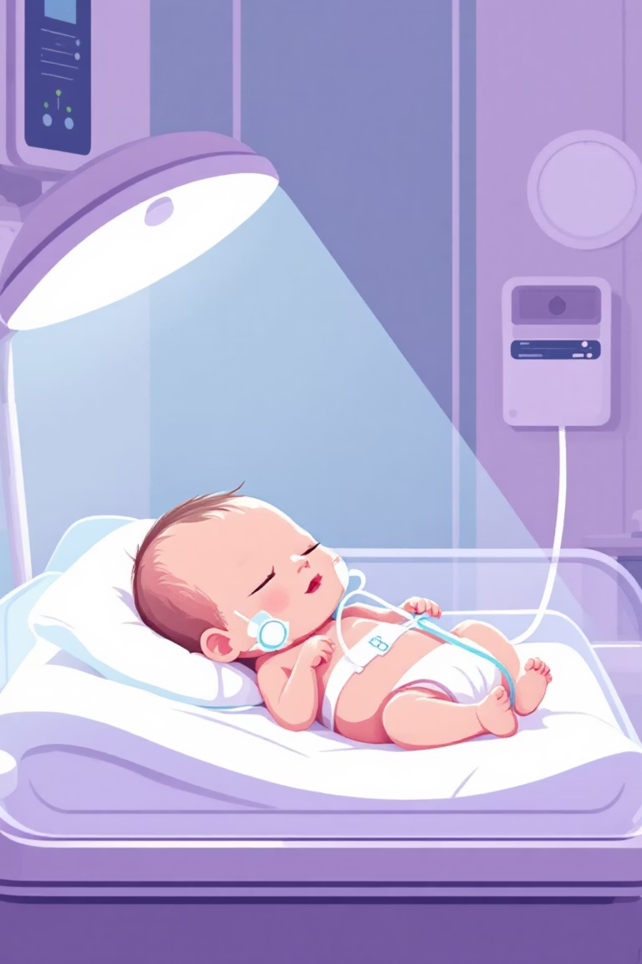
Neonatal Healthcare-Associated Infections (HAIs)
Healthcare-associated infections (HAIs), also known as nosocomial infections, occur within medical settings when infectious agents such as bacteria, viruses, fungi, or parasites affects susceptible hosts, leading to disease after 48hours of hospital stay.

Slide 2
Differentiating maternally acquired and hospital-acquired infections can be difficult.
Surveillance definitions typically describe nosocomial infections as infections that arise 2 or more days after initial admission to a nursery or NICU.
No precise time point, laboratory test, or clinical definition perfectly discriminates between infections that were likely attributable to vertical transmission from infections transmitted within the NICU.
Approximately 90% of hospitalized neonates with an infection presumed to be of maternal origin had onset of symptoms within 48 hours of birth.

Slide 3
HAIs in NICUs are major concern due to their widespread occurrence and serious effect on health of neonates (Mendonça et al., 2024).
The prevalence of HAIs in NICUs differs globally, with rates higher in developing countries when compared to developed nations.
HAI rates in developing countries can be up to three times higher than in developed countries (Maki and Zervos, 2021).
Nosocomial infection rates in NICUs range from 26 % to 81.7 %, with bloodstream infections and pneumonia being the common types (Kajiyazdi et al., 2021).
The rate of incidence of these infections are higher in neonates with low birth weight and in those neonates requiring total parenteral nutrition or mechanical ventilation.
In contrast to the NICU setting, the frequency of nosocomial infection in well-baby nurseries is estimated to be significantly lower, at 2.6 per 1000 patient days.

Slide 4

Neonatal Immune System Vulnerabilities
Immature Immunity
Compromised Barriers
Iatrogenic Breaches
Neonatal immune systems are functionally less mature than older children and adults.
Preterm infants have less developed innate immune systems, particularly physiological barriers like skin.
Medical devices and surgical wounds further increase HAI risk by breaching skin integrity.

Slide 5





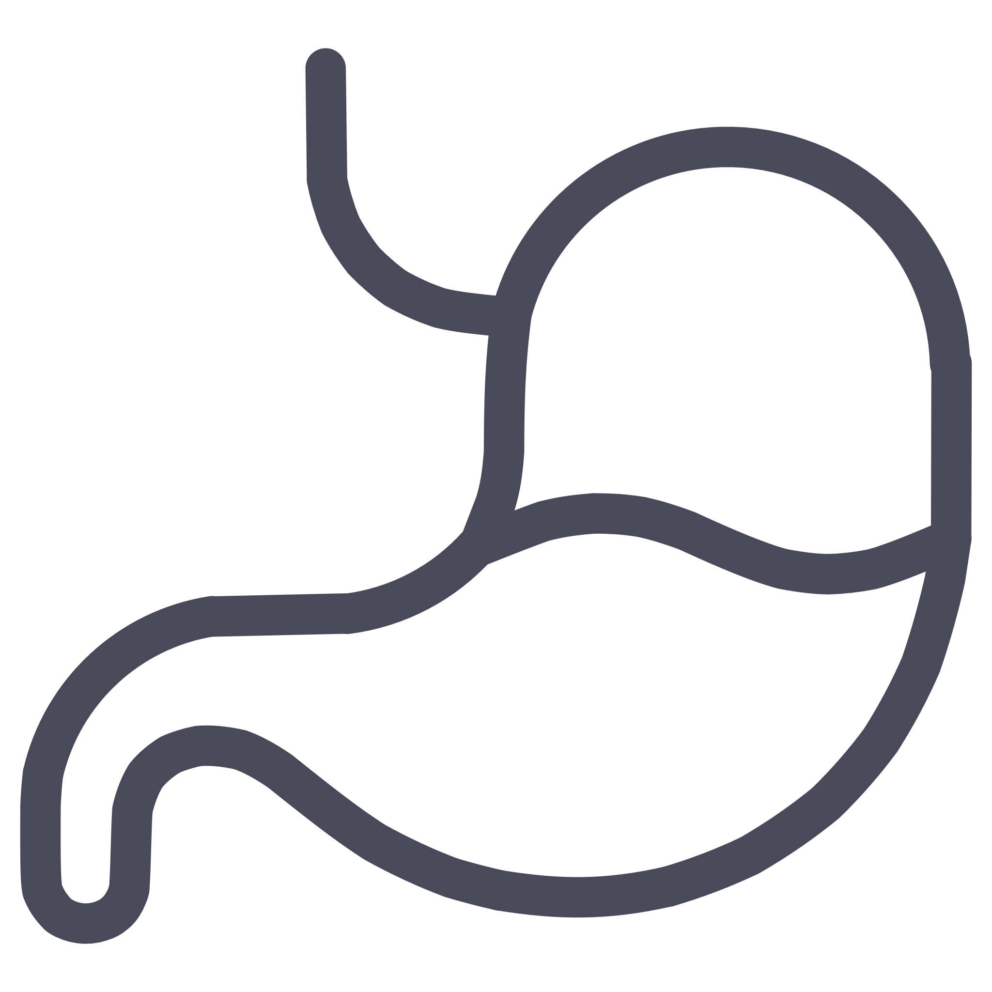
Immune System Impairments
Low IgG Levels
Preterm neonates have very low serum IgG due to incomplete transplacental transfer.
Cellular Impairment
T cells, neutrophils, monocytes, and complement pathways are functionally impaired in neonates.
Immature GI Tract
Reduced gastric acidification and fragile intestinal epithelium create pathogen entry points.

Slide 6
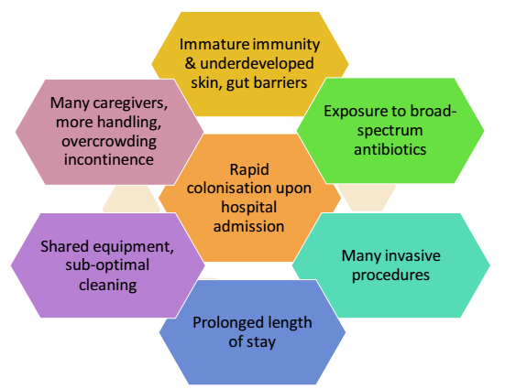
Why are hospitalized neonates vulnerable to infection?

Slide 7
.
Hands of healthcare workers’ are a most common vector for transmission of pathogen, highlighting the need for strict hand hygiene practices (Saiman et al., 2020).
The overcrowded and high-contact environment of NICUs further facilitates the spread of infections.
Additionally, vertical transmission from mother to neonate during pregnancy, delivery, or breastfeeding can also occur (Sivanandan et al., 2011).

Slide 8



Transmission of HAIs in NICUs
Contact
Droplet
Airborne
Direct or indirect contact from infected persons or contaminated sources.
from large respiratory droplets that fall out of the air at a maximum distance of 3-6 feet
from microscopic droplet nuclei, which can remain suspended in air for long periods and as a result travel longer distances

Slide 9
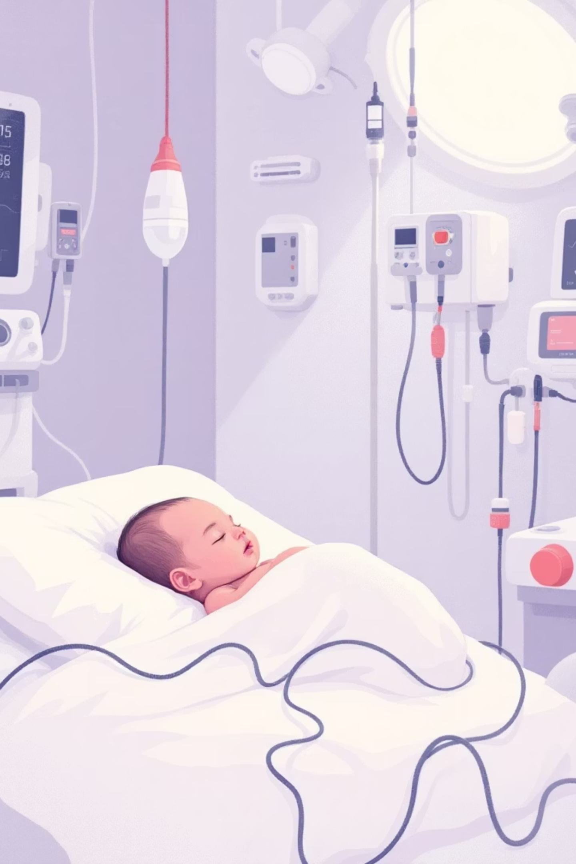
Key Risk Factors for HAIs
Medical Devices
1
Indwelling intravascular or transmucosal devices are major risk factors, even after adjusting for birth weight.
Therapeutic Agents
2
Broad-spectrum antimicrobials alter the microbiome, increasing resistant organisms. Corticosteroids and H2 blockers also raise risk.
Parenteral Nutrition
3
Increases bloodstream infection risk, potentially due to immune effects, contamination, or delayed GI development.

Slide 10
The sterile in-utero environment gives way to colonization after birth, forming "normal flora."
Most neonatal HAIs are caused by the infant’s own flora. The “abnormal flora” of the neonate residing in the NICU is determined at least in part by the NICU environment and the hands of health care workers.
It’s important to note that contact transmission of bacteria, viruses, and fungi through the hands of healthcare workers is arguably the most significant but also potentially the most preventable means by which potentially harmful microorganisms are disseminated.
Poor compliance with hand hygiene has repeatedly been shown as a cause of outbreaks and transmission of resistant microorganisms.

Slide 11
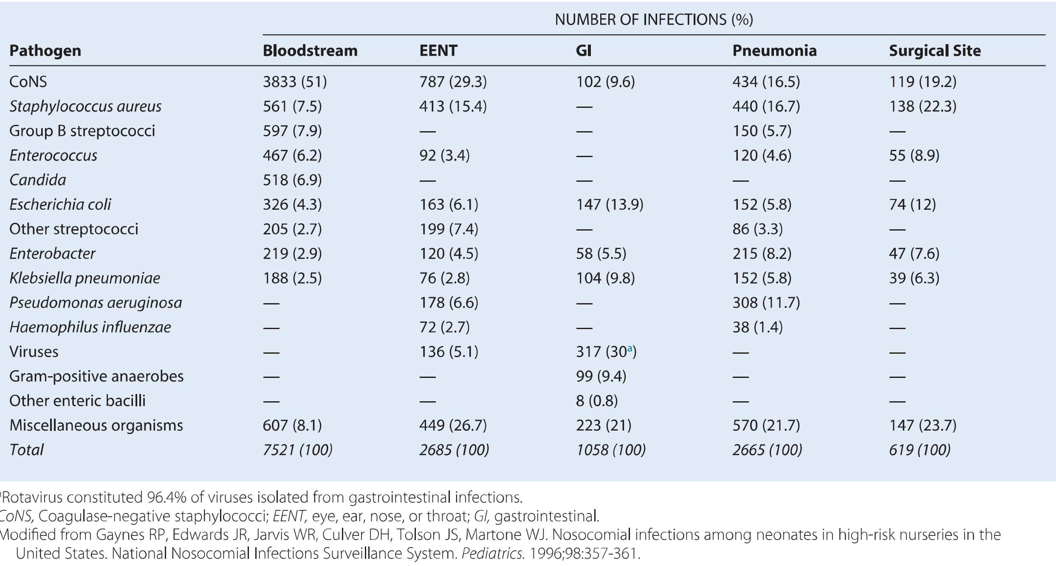
Most Common Nosocomial Pathogens in Neonatal Intensive Care Unit Patients

Slide 12
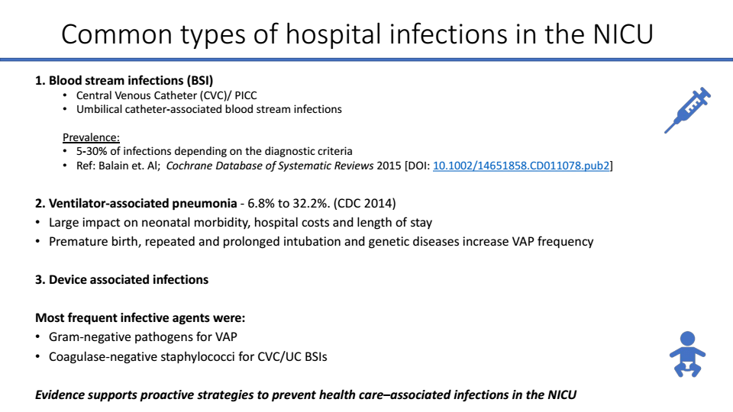

Slide 13
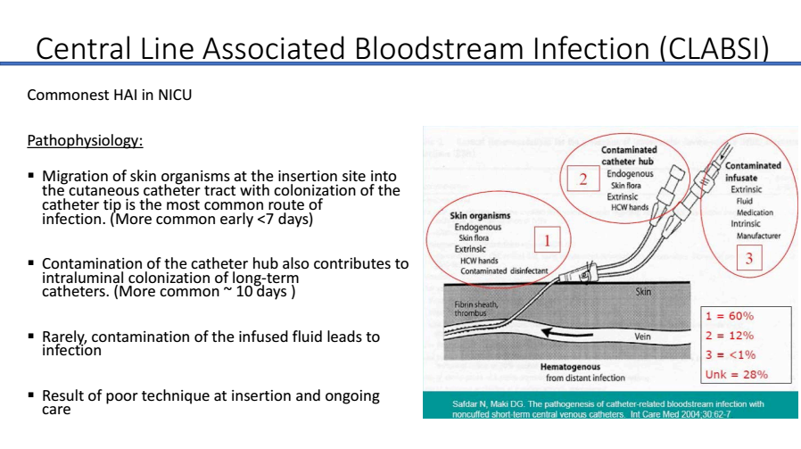

Slide 14
Akey strategy to minimize the risk of catheter-associated bloodstream infections is the prompt removal of indwelling catheters when no longer medically necessary.

Slide 15
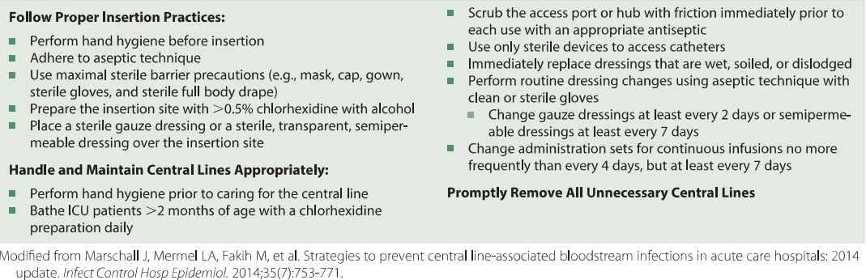
Checklist for Clinicians in the Prevention of Central Line—Associated Bloodstream Infections

Slide 16
Ventilator-associated pneumonia (VAP
An episode of pneumonia diagnosed in patients undergoing mechanical ventilation (MV) for ≥48 h
The second most common healthcare-associated infection among infants
Rates that range from 2.7 to 10.9 episodes per 1000 days of MV in the neonatal intensive care units (NICU) in high-income countries

Slide 17
Basic Strategies to Prevent Ventilator-Associated Pneumonia
Avoid intubation if possible: use noninvasive positive pressure ventilation in selected populations. Minimize the duration of mechanical ventilation. Manage patients without sedation whenever possible. Avoid unplanned extubation. Provide regular oral care with sterile water.
Minimize breaks in the ventilator circuit. Change the ventilator circuit only if visibly soiled or malfunctioning

Slide 18


Slide 19
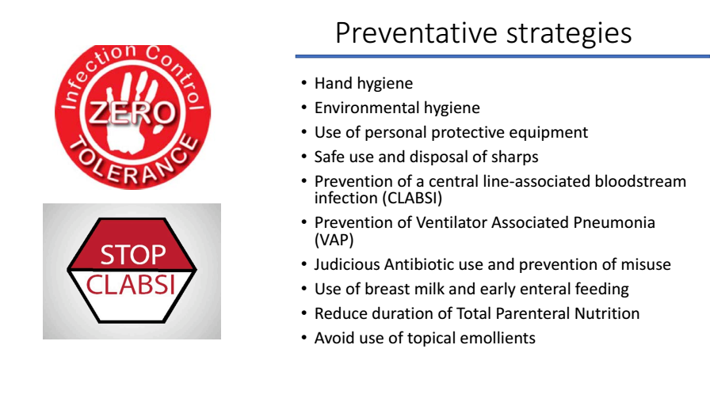

Slide 20
What is the most effective intervention for reducing health care associated infections?

Slide 21
Hand hygiene
• Most effective method for reducing health care associated infections (Larson et al Clin Infect Dis 1999 )
• Higher rates of hand hygiene compliance = lower rates of central line bloodstream infection (Edqards JD et al.a
• CDC published guidelines for hand hygiene in health care settings in 2002(updated 2009)

Slide 22


Hand Hygiene: Soap vs. Alcohol
When to Use Soap & Water
When to Use Alcohol-Based Products
Visibly soiled hands
Hands are not visibly soiled
Contaminated with proteinaceous materials, blood,
or body fluids
Recommended by CDC and WHO for all clinical settings
More effective, faster, and less damaging to skin
After using the restroom

Slide 23
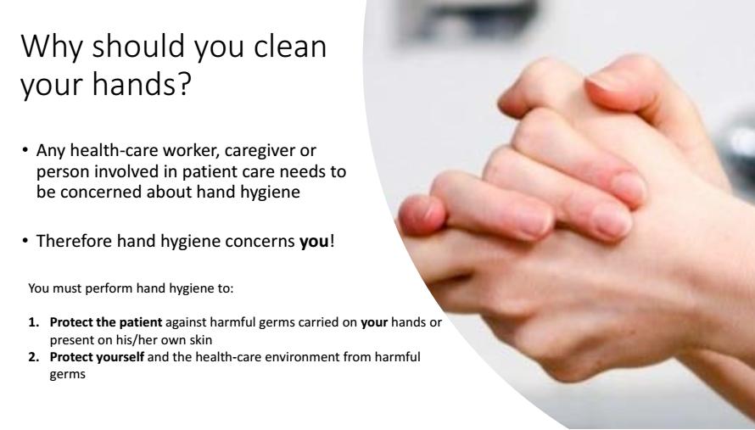

Slide 24
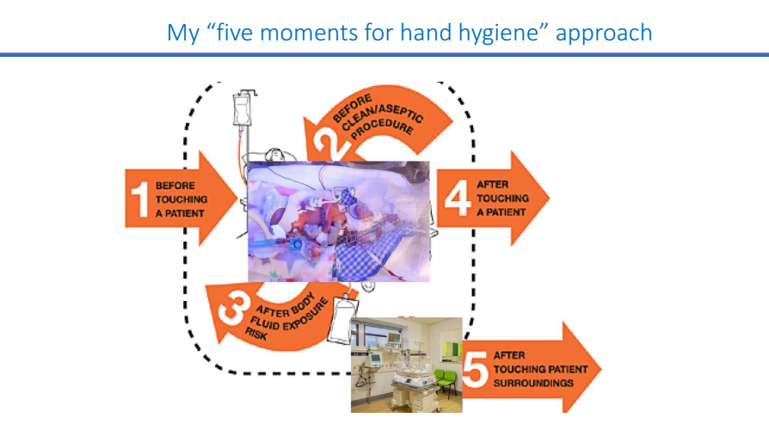

Slide 25






Additional Hand Hygiene Guidelines
Initial Wash Duration
Avoid Hand Jewelry
Natural Nails Only
Wash hands and forearms to elbows upon nursery arrival; ensure thorough washing and rinsing.
Associated with increased microbial load; avoid for direct patient care.
No artificial nails or extenders; natural nails kept less than ¼-inch long.

Slide 26

Gloves, Gowns, and Face Protection
Gloves
Gowns
Face Protection
Do not replace hand hygiene. Wear for contact with infectious materials. Change between dirty and clean tasks. Perform hand hygiene immediately after removal.
Not for routine care. Wear fluid-resistant gowns when soiling is anticipated or during procedures with splashing/spraying of body substances.
Masks, face shields, and goggles provide barrier protection. Use during procedures likely to generate splashes or sprays of body substances.

Slide 27
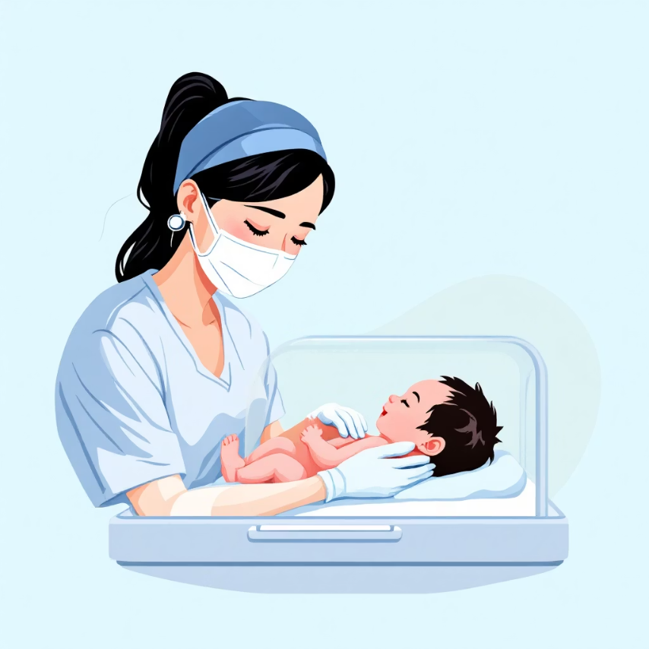
Healthcare Workers & Infection Control
Healthcare workers can transmit and acquire infections. Those with respiratory, cutaneous, or gastrointestinal infections should not provide direct patient care to neonates.
Non-immune staff should avoid highly communicable diseases. Pregnant workers can care for CMV-shedding neonates with standard precautions.

Slide 28



Breastfeeding & Infection Prevention
Human milk offers optimal nutrition and reduces infection episodes in infants, especially preterms.
Contraindications
Safe Handling
Pump Hygiene
Active untreated tuberculosis, HSV lesions around nipples, or HIV infection (in some regions).
Proper collection, storage, and administration techniques are crucial to prevent contamination.
Cleaning and disinfection of breast pumps are essential for mothers expressing milk.

Slide 29
با رعایت اصولی چون:
✅ شست‌وشوی دقیق دست‌ها
✅ ضدعفونی صحیح وسایل و محیط
✅ استفاده آگاهانه از آنتی‌بیوتیک‌ها
✅ آموزش مداوم کارکنان
✅ و پایش مستمر شاخص‌های عفونت
می‌توان بار عفونت‌های بیمارستانی را به میزان قابل‌توجهی کاهش داد و محیطی ایمن‌تر برای نوزادان فراهم ساخت.

Slide 30
