Slide 1
THERAPEUTIC HYPOTHERMIA B. Basiri- Neonatologist Hamadan University of Medical Science

Slide 2
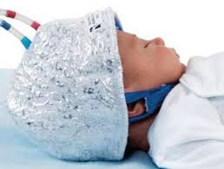
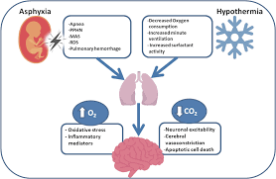
History
The earliest recommendations for induced hypothermia can be traced back to the Ancient World.
The Greek physician Hippocrates observed that infants exposed in the open survived much longer in winter than summer
Many centuries later, physiologists such as Claude Bernard and William Edwards first described the effects of hypothermia on the human body
The first uncontrolled trials of cooling for resuscitation were reported more than 50 years ago
-Alistair J. Gunn,Abbot R. Laptook-TH translates from ancient history into practice-Pediatr Res. Author manuscript; available in PMC 2017 March 27

Slide 3
Early studies of hypothermia in newborn infants
Small, uncontrolled studies in the 1950s and 1960s in which infants who were not breathing spontaneously at 5 minutes after birth were immersed in cold water until respiration began and then allowed to spontaneously rewarm over many hours . Neonatal outcomes were reported to be better than historical controls in over 200 asphyxiated neonates.
This empiric approach was overtaken by the development of active resuscitation techniques, case reports of subcutaneous fat necrosis with calcification after cooling ,and the higher neonatal oxygen requirements and greater mortality rates among premature newborns kept hypothermic after birth. Because of this evidence, there was a pause in investigations of therapeutic hypothermia for HIE

Slide 4
Recent Studies
Since 2005 :RCTs in term neonates with perinatal asphyxia,
)TOBY Trial2009)- (NICHD Trial2005)- (COOL CAP Trial)…
hypothermia has become standard of care
Martin R,- Fanaroff A. Neonatal- Perinatal Medicin – Disease of the fetus and Newborn-12 th ed-2024

Slide 5
What is therapeutic hypothermia?
Therapeutic hypothermia(TH), also known as cooling therapy or hypothermia treatment, is an intervention for moderate to severe HIE. Therapeutic hypothermia which aimed to minimize or avoid permanent brain damage, can be defined as cooling of the neonate within the first 6 h of hypoxic event to 33–34 C body temperature for 72 h that is followed by a gradual re-warming of 0.5 C per hour until the core temperature becomes 36.5–37.0 C

Slide 6
Principal Determinants of Neuroprotective Benefit
1- Timing : 6 hour
2- Degree : 3-4 C
3-Duration ; 72 hours
Volpe J-Volpe s neurology of the newborn- 6th ed-

Slide 7
Mechanism of Benefit
1- A decrease in energy consumption
2- A decrease in the accumulation of extracellular glutamate
3- A decrease in the generation of reactive oxygen and nitrogen spices
4- Inhibition of inflammatory mechanisms
5- Interruption of downstream molecular cascades of apoptosis
Volpe J-Volpe s neurology of the newborn- 6th ed-

Slide 8
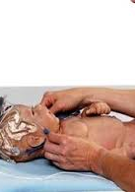
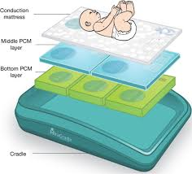
Principle Approaches
1- Selective head cooling (by water- circulating cap ; cool cap)
2- Whole body cooling (by water- circulating blankets
Volpe J-Volpe s neurology of the newborn- 6th ed-

Slide 9
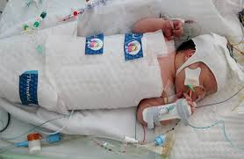
Difference?
In the Cochran analysis that has been updated frequently since then, no differences has been demonstrated between head cooling or whole body hypothermia.
Martin R,- Fanaroff A. Neonatal- Perinatal Medicin – Disease of the fetus and Newborn-12 th ed-2024

Slide 10
Selection of Infants(AAP)
1- More than 35 week gestational age
2- Less than 6 hours of age
3- Evidence of asphyxia (at list one to two of following:)
a)Apgar score less than 6 at 10 min or need to PPV or CC at 10 min
b)Any acute perinatal sentinel event that may result in HIE
c)Cord Ph<7.0 or BE -16mmol/L or less
d) Arterial pH<7.0 or BE -16 mmol/L within 60 min of birth
4- Presence of moderate to severe neonatal encephalopathy on clinical exam
Volpe J-Volpe s neurology of the newborn- 6th ed-

Slide 11
It is now clear that:
Early implementation of TH:
Reduces the extent of cerebral injuries in MRI
Reduces mortality
Improves neurodevelopmental outcomes
Volpe J-Volpe s neurology of the newborn- 6th ed-

Slide 12
Contraindications
Gestational age earlier than 36 weeks
Birth weight <1800 g
Older than 6 hours of age at the time of initiating therapeutic hypothermia (though some physicians will consider therapeutic hypothermia for up to 24 hours after birth)
Major congenital abnormality
Death appears inevitable
Life-threatening coagulopathy with significant active bleeding may be an exclusion criterion.
Neurologically significant head trauma or skull fracture, causing major intracranial hemorrhage. Subgaleal bleeding is a relative contraindication for selective head cooling. Consider whole-body cooling for these infants after initial stabilization.
An imperforate anus is an exclusion criterion for selective head cooling because rectal temperature recordings can not be obtained. An imperforate anus is not a contraindication for whole-body cooling with an esophageal probe.

Slide 13
Complications
Cardiovascular complications – (bradycardia, Prolonged QT interval, ventricular arrhythmias, reduced cardiac output, hypotension)
Reduction in surfactant production, increased pulmonary vascular resistance, increased oxygen consumption and oxygen requirement
Electrolyte imbalance: hypokalaemia, hypo magnesia, hypophosphatemia
Coagulopathy, particularly platelet function
Infection risk increases due to inhibition of pro-inflammatory response (Increased incidence of sepsis, line & wound infections)
Pharmacokinetics alter due to changes in liver & renal function
Delayed gastric emptying and elevated serum amylase

Slide 14
Therapeutic hypothermia for neonatal encephalopathy in developing countries: Current evidence
Therapeutic hypothermia for neonatal encephalopathy in developing countries: Current evidence
The following factors were found to be associated with the loss of efficacy of therapeutic hypothermia –
the absence of objective evidence of acute birth asphyxia
suboptimal care during transport of extramural neonates
uncontrolled hypothermia before admission to a neonatal unit, and the severity of HIE.
Chawla D-Therapeutic hypothermia for neonatal encephalopathy in developing countries: Current evidence-Clinical Epidemiology and Global Health
Volume 26, March–April 2024, 101507

Slide 15
Umbrella review
This umbrella review showed that therapeutic hypothermia is effective to reduce mortality at neonatal period and disability at the age of 18 months. The sub group analysis reviled that therapeutic hypothermia is effective in low and middle income settings. Therefore, the practice gap shall be breached to save neonatal life and enhance later on quality of life
Birhanu D, Lingaia B,..- Effectiveness of therapeutic hypothermia for neonatal HIE outcome: umbrella review. Intensive Care Medicine – Pediatric and Neonatal.. (2025) 3:27

Slide 16
Low- and Middle-Income Countries
Results from a recent meta-analysis of 10 studies showed that therapeutic hypothermia in these settings showed little to no benefit in reducing death or severe disability. In addition, therapeutic hypothermia was associated with increased bleeding and thrombocytopenia. However, this is controversial, and many experts advocate for continuing therapeutic hypothermia in these settings
Shah M-Neonatal Therapeutic Hypothermia-National library of medicine-Last Update: September 14, 2025.

Slide 17
Premature Babies at or Before 35 Weeks of Gestation
Results from retrospective analysis of preterm infants undergoing therapeutic hypothermia have resulted in concerning findings and an increased rate of adverse events. Results from a major randomized trial that was recently published showed no benefit and potentially worse outcomes for infants undergoing therapeutic hypothermia between 33 and 35 weeks of gestation
Shah M-Neonatal Therapeutic Hypothermia-National library of medicine-Last Update: September 14, 2025.

Slide 18
Therapeutic Hypothermia for Mild Hypoxic-Ischemic Encephalopathy
it is unclear if therapeutic hypothermia benefits this population, and additional studies are needed to determine the long-term risks and benefits of therapeutic hypothermia in this group of babies.
Shah M-Neonatal Therapeutic Hypothermia-National library of medicine-Last Update: September 14, 2025.

Slide 19
Late Initiation of Therapeutic Hypothermia (6-24 Hours After Birth)
Beginning therapeutic hypothermia within the accepted 6-hour time window studied in large randomized controlled trials is often impossible. Results from a recent randomized clinical trial, analyzed using Bayesian methods, indicated a 64% probability of benefit in reducing death or disability. However, changing current practices based on this analysis is controversial, and most centers have not implemented late cooling as a standard of care
Shah M-Neonatal Therapeutic Hypothermia-National library of medicine-Last Update: September 14, 2025.

Slide 20
Longer (120 Hours versus 72 Hours) or Deeper (32 °C versus 33.5 °C)
In a randomized trial, results showed that longer or deeper therapeutic hypothermia did not show any benefit in outcomes at 18 months of age.
Shah M-Neonatal Therapeutic Hypothermia-National library of medicine-Last Update: September 14, 2025.

Slide 21
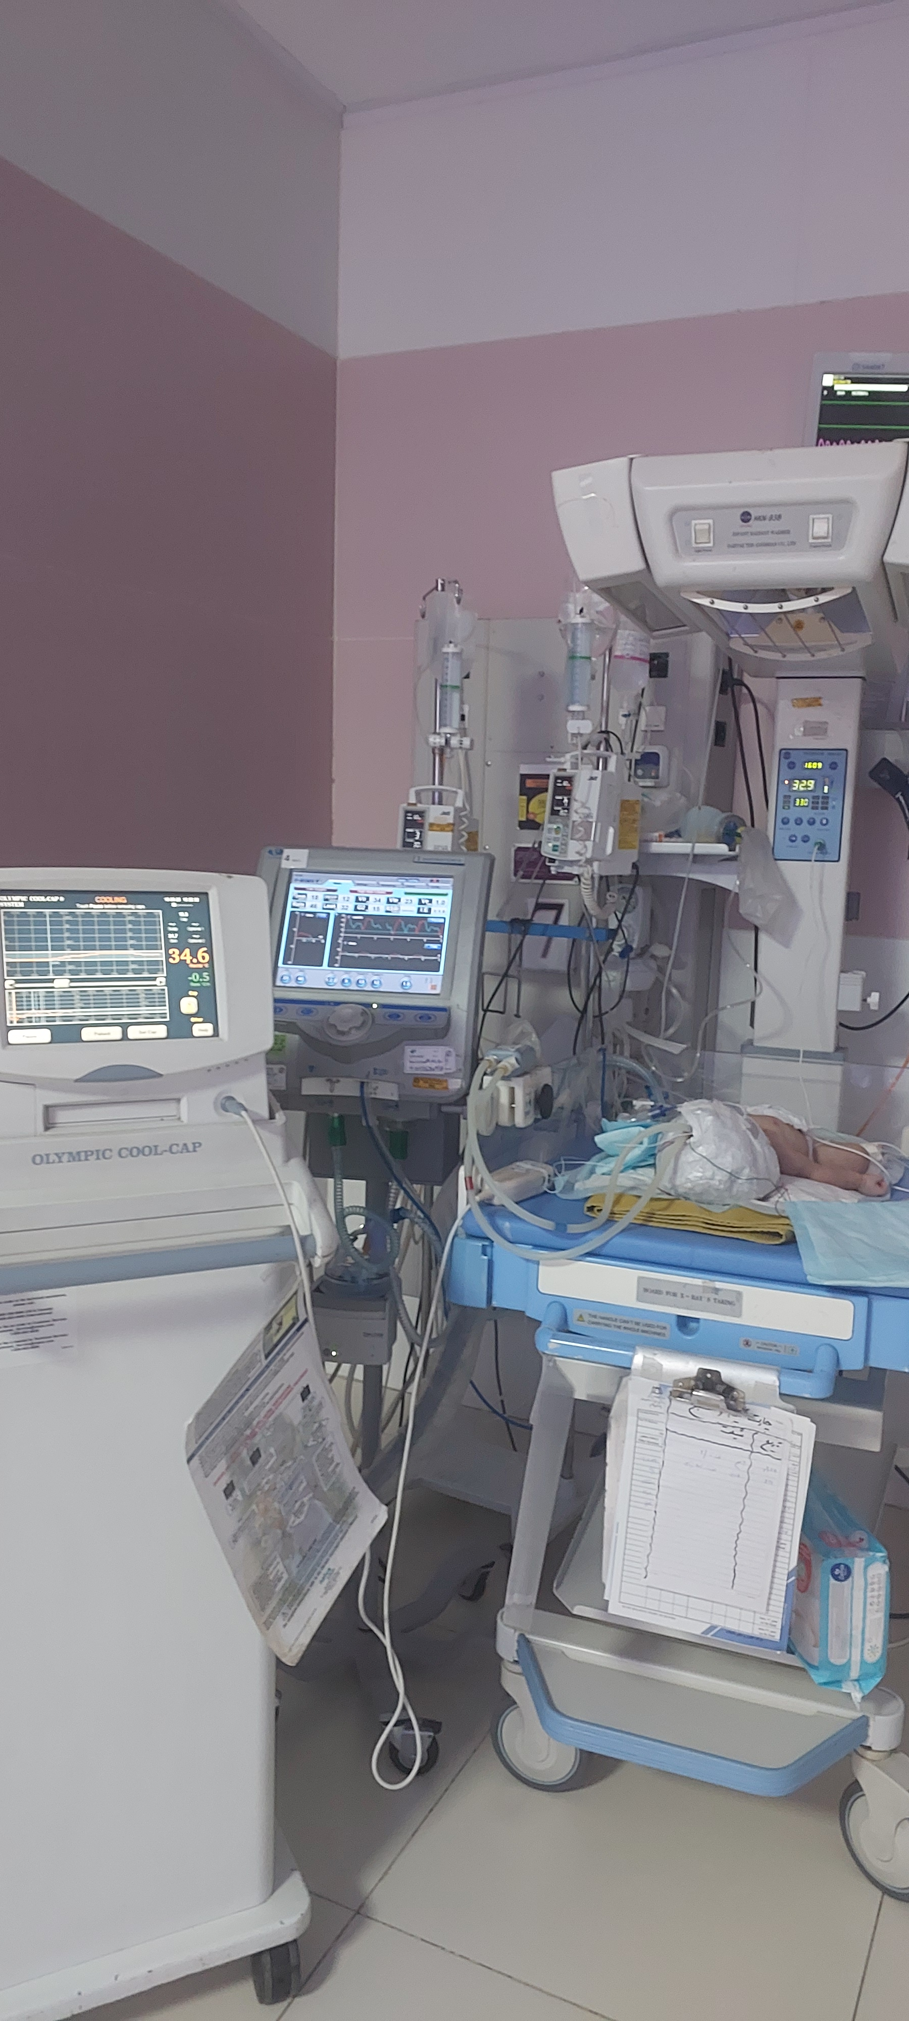
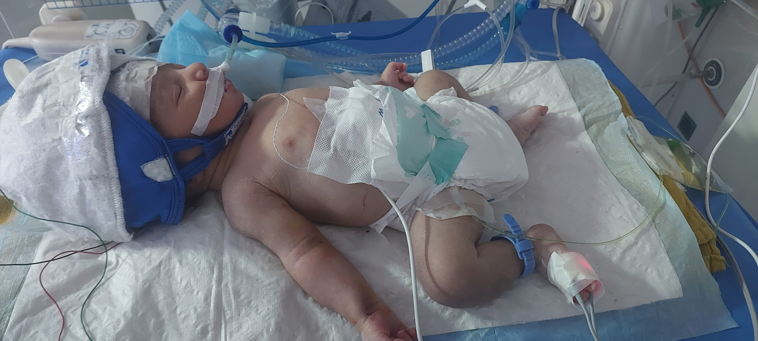
thank you

