Slide 1
Challenges in Preterm Neonatal Resuscitation
Arash Bordbar, Neonatologist & Perinatologist
Associate Professor of IUMS
An overview of NRP-based strategies and global NICU practices (2025).
NRP 9th Ed, AAP 2025; Uppsala & Iowa NICU Guidelines 2024

Slide 2
Definition and Scope
Preterm birth: <37 weeks gestation.
High-risk subgroup: <32 weeks.
Main goals: Thermoregulation, respiratory stabilization, and timely intervention.
NRP 9th Ed, AAP 2024; Uppsala & Iowa NICU Guidelines 2024

Slide 3
Viability Threshold
Current consensus: Viability ≥22–23 weeks (region-dependent).
Requires multidisciplinary discussion with parents.
Legal and ethical frameworks vary globally.
Shared decision-making critical below 24 weeks.
Discuss prognosis, morbidity, and long-term disability risks.
Cultural and legal expectations differ internationally.
NRP 9th Ed, AAP 2024; Uppsala & Iowa NICU Guidelines 2024

Slide 4
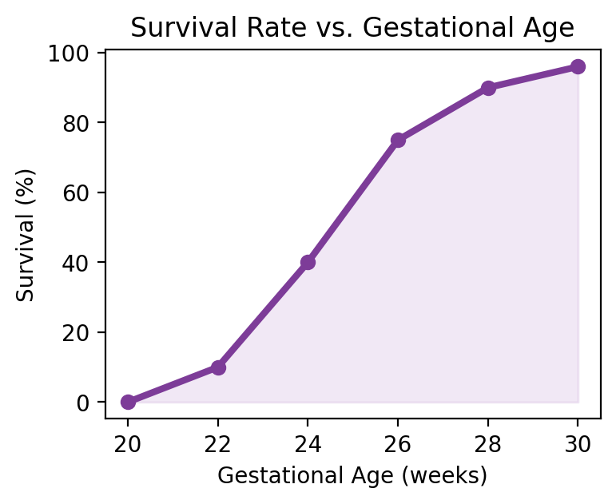
Viability Threshold
Current viability threshold is 22–23 weeks.
Survival increases sharply after 24 weeks.
Parental counseling and legal context remain critical.
NRP 9th Ed, AAP 2024; Uppsala & Iowa NICU Guidelines 2024

Slide 5
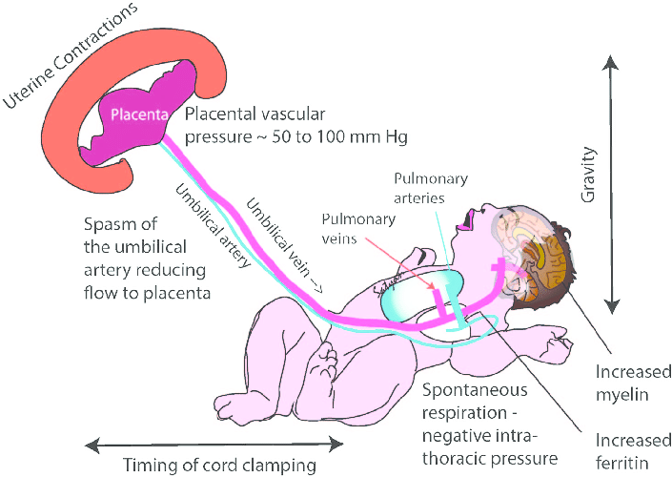

Slide 6
Delayed Cord Clamping (DCC)
NRP 9th Ed recommends DCC for ≥60 seconds if feasible
Improves circulatory transition and decreases IVH risk.
Challenge: Maintaining temperature and respiratory support simultaneously.
NRP 9th Ed, AAP 2024; Uppsala & Iowa NICU Guidelines 2024

Slide 7
Early cord clamping (< 60 seconds after birth) may interfere with healthy transition from fetal to neonatal circulation, as it leaves fetal blood in the placenta rather than filling the newborn infant's circulating blood volume.
Preterm infants who have deferred umbilical cord clamping are more likely to survive their hospital stay, less likely to receive medications for
hypotension, and less likely to receive a blood transfusion.
For most vigorous preterm infants , clamping the umbilical cord should be deferred for at least 60 seconds by carefully.
Coordinating care with the obstetric providers, the rapid evaluation and initial steps of newborn care, including thermal management, can be performed with the umbilical cord intact

Slide 8
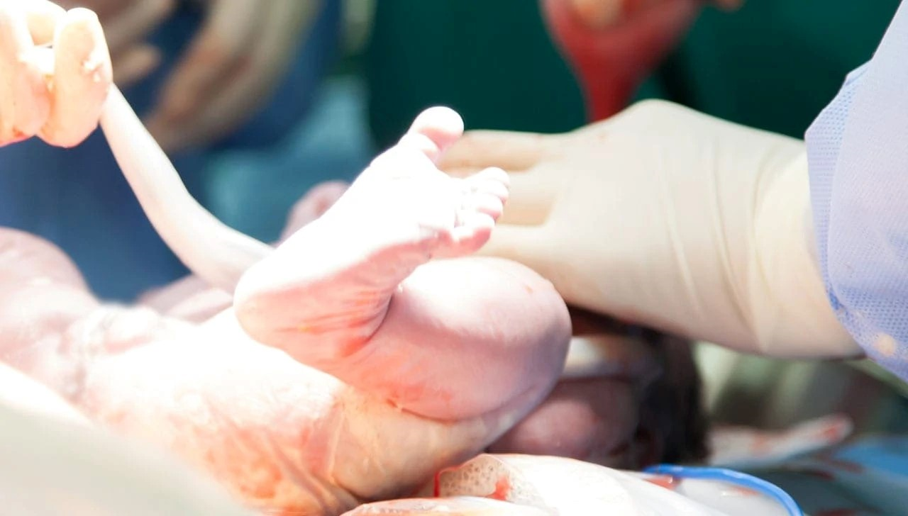
For preterm infants born at less than 28 weeks' gestation, umbilical cord milking is not recommended because it has been associated with an increased risk of intraventricular hemorrhage.
In infants born at between 28 and 34 weeks' gestation who do not require resuscitation and in whom delayed cord clamping cannot be performed, it may be reasonable to milk the intact umbilical cord toward the infant prior to clamping the umbilical cord.

Slide 9
If the birth parent's condition is hemodynamically unstable or the placental circulation is not intact, such as after a placental abruption, bleeding placenta previa, bleeding vasa previa, or cord avulsion, the cord should be clamped and cut immediately after birth.

Slide 10
Not enough evidence exists to make a definitive recommendation regarding whether umbilical cord clamping should be deferred in preterm newborns who are not vigorous after birth.
If the placental circulation is intact, it may be reasonable to briefly defer umbilical cord clamping while the obstetric provider gently stimulates the infant to breathe. If the infant does not begin to breathe during this time, additional treatment is required. The umbilical cord should be clamped and the infant should be brought to the radiant warmer.

Slide 11
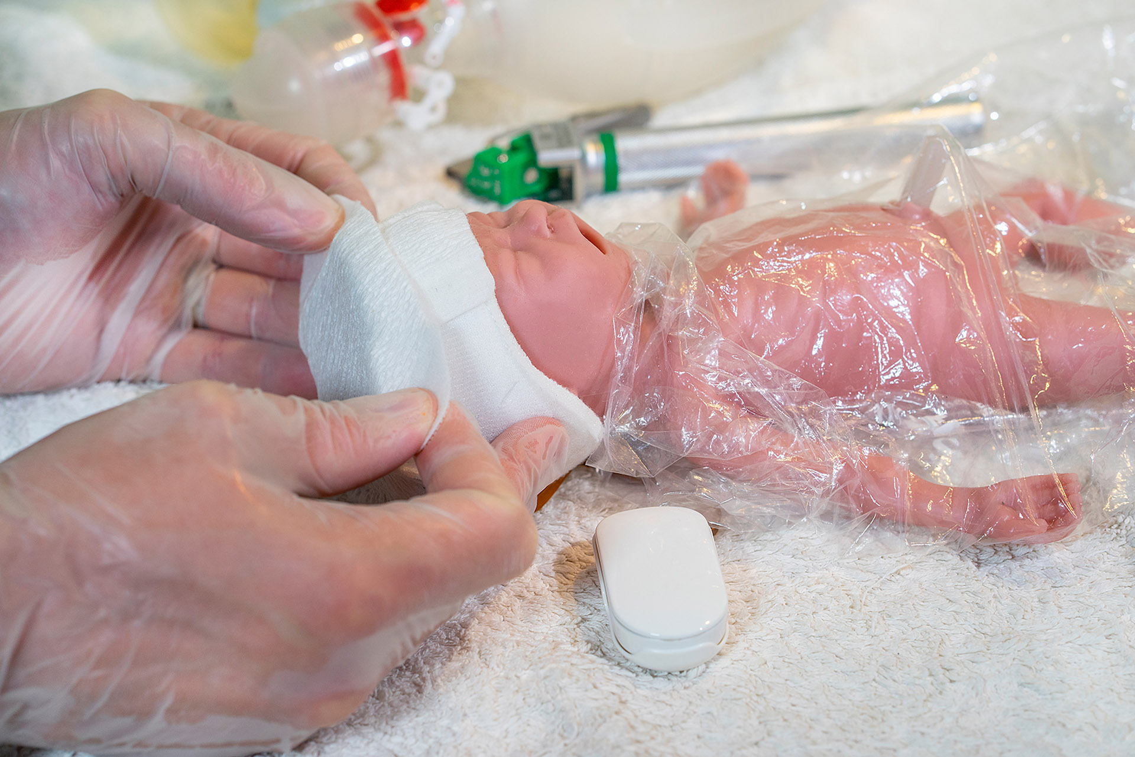
Initial Thermal Management
Use of polyethylene wrap, servo-controlled warmers, and humidity >70%.
Early temperature maintenance = survival advantage.
NRP 9th Ed, AAP 2024; Uppsala & Iowa NICU Guidelines 2024

Slide 12
Set the temperature in the room where the infant will be resuscitated and receive initial care to approximately 23C to 25°C.
• Preheat the radiant warmer well before the time of birth.
• After delivery, quickly place a hat on the infant's head
Use a prewarmed transport incubator if the infant will be moved after initial care is completed.
Maintain the infant's axillary temperature between 36.5°C and 37.5°C
Additional steps for thermoregulation of infants born at less than 32 weeks'
gestation; Use a thermal mattress as an additional
heat source.

Slide 13
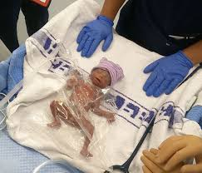
Drying the body is not necessary. Instead of being dried with towels, very preterm infants should be wrapped up to their neck in polyethylene plastic immediately after birth. This can be done by the obstetric provider, with assistance as needed, before the umbilical cord is clamped as part of the rapid evaluation and initial steps of care.

Slide 14
Respiratory Support
Initiate CPAP 5–6 cmH₂O for spontaneously breathing preterms.
Avoid excessive PPV pressure.
Use T-piece resuscitator for consistency.
NRP 9th Ed, AAP 2024; Uppsala & Iowa NICU Guidelines 2024

Slide 15
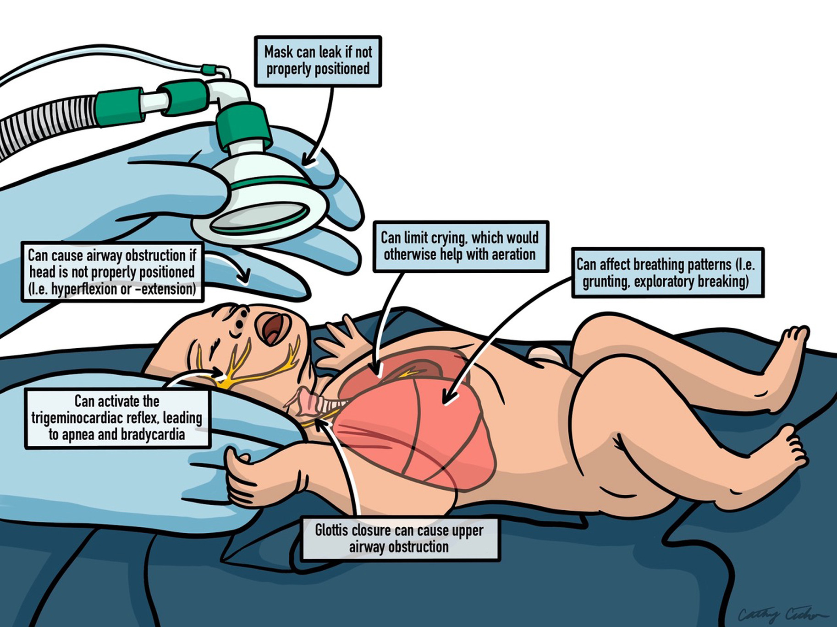
Application of a face mask for CPAP may induce the trigemino-cardiac reflex, a reflex triggered by nerves on the infant's face, resulting in apnea and bradycardia •

Slide 16
• If ventilation is required, use the lowest inflation pressure necessary to achieve and maintain a heart rate greater than 100 bpm.
The infant's heart rate response, is the best indicator of effective ventilation.
An initial inflation pressure of 20 to 25 cm H20 is adequate for most preterm newborn infants.
The volume of air required to ventilate a preterm infant's lungs is very small and may not result in perceptible chest movement.
Use the lowest inflation pressure necessary to maintain a heart rate of at least 100 bpm and gradually improve SPO2.
It is reasonable to limit face mask ventilation to a maximum inflation pressure of 30 cm H2O.

Slide 17
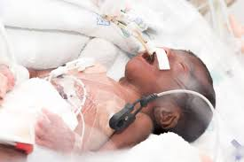
Consider administering surfactant if the infant requires intubation for respiratory distress or is extremely preterm.
After initial stabilization, preterm infants who need intubation and mechanical ventilation because of respiratory distress syndrome should be given surfactant.

Slide 18
Oxygen Targeting
Preterm infants who reach an SPo2 of 80% to 85% within the first 5 minutes experience improved survival and neurologic outcomes.
To achieve this target, they may require a higher initial Fio2 or more rapid titration.
For newborn infants whose gestational age is 32 to 34 weeks, the current recommendation is to initiate resuscitation with 21% to 30% oxygen and use a pulse oximeter and an oxygen blender to guide the administration of oxygen in order to maintain SPo2 within the same target range described for healthy term newborn infants.
NRP 9th Ed, AAP 2024; Uppsala & Iowa NICU Guidelines 2024

Slide 19
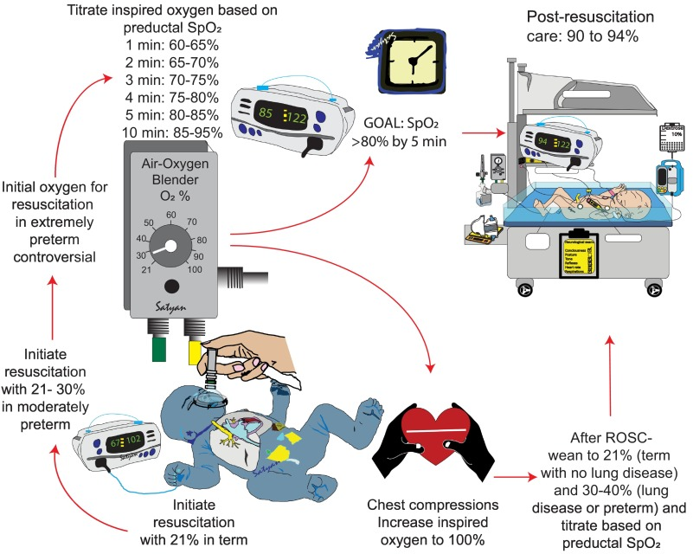
For newborn infants whose gestational age is <32 weeks, an initial Fio2 of 30% or greater may be considered based on institutional guidelines. As long as pulse oximetry is used to guide therapy to avoid the extremes of oxygenation.
NRP 9th Ed, AAP 2024; Uppsala & Iowa NICU Guidelines 2024

Slide 20
Handle the newborn infant gently.
While this may seem obvious, this aspect of care may be forgotten when members of the resuscitation team are trying to perform many steps quickly.
If possible, avoid multiple intubation attempts, frequent suctioning, and other painful, noisy, or irritating stimuli.
Do not position the newborn infant's legs higher than the head (Trendelenburg position).
Placing the legs higher than the head may increase cerebral venous pressure and the risk of bleeding. It may be helpful to place the infant in a midline, supine (on the back) position with the head slightly elevated to avoid obstruction of venous drainage.
Avoid using high pressure during ventilation or CPAP.
Excessive pressure can create a pneumothorax or interfere with venous return from the head. Both of these complications have been associated with an increased risk of brain hemorrhage.
NRP 9th Ed, AAP 2024; Uppsala & Iowa NICU Guidelines 2024

Slide 21
Post-Resuscitation Stabilization
Transfer to pre-warmed incubator with full cardiorespiratory monitoring.
Consider early caffeine and surfactant therapy as indicated.
NRP 9th Ed, AAP 2024; Uppsala & Iowa NICU Guidelines 2024

Slide 22
Precautions that should be taken after the initial stabilization period
Monitor the newborn infant's temperature.
Very preterm infants should remain wrapped in polyethylene plastic until they have been moved to a warmed and humidified incubator.
Even moderately and late preterm infants remain at risk for hypothermia and should be carefully monitored.
Monitor blood glucose levels.
Monitor the newborn infant for apnea and bradycardia.
Preterm newborn infants often have unstable respiratory control. Significant
apnea and bradycardia during the stabilization period may be the first clinical
signs of an abnormality in body temperature, oxygenation, CO2,
electrolytes, blood glucose, or blood acid levels.

Slide 23
Common Pitfalls
Delayed ventilation onset, poor teamwork, lack of feedback devices.
Inadequate preparation and role allocation before delivery.
NRP 9th Ed, AAP 2024; Uppsala & Iowa NICU Guidelines 2024

Slide 24
Team Dynamics and Simulation
Frequent NRP simulation improves performance.
Team briefings before high-risk deliveries reduce errors.
NRP 9th Ed, AAP 2024; Uppsala & Iowa NICU Guidelines 2024

Slide 25
Conclusion
Modern preterm resuscitation integrates evidence, ethics, and empathy.
Continuous training and parental partnership remain central pillars.
NRP 9th Ed, AAP 2024; Uppsala & Iowa NICU Guidelines 2024

Slide 26
