Slide 1
New Procedures in PostResuscitation Ventilation for Newborns in the Delivery Room, Especially Premature Infants
Dr heidarzadeh

Slide 2
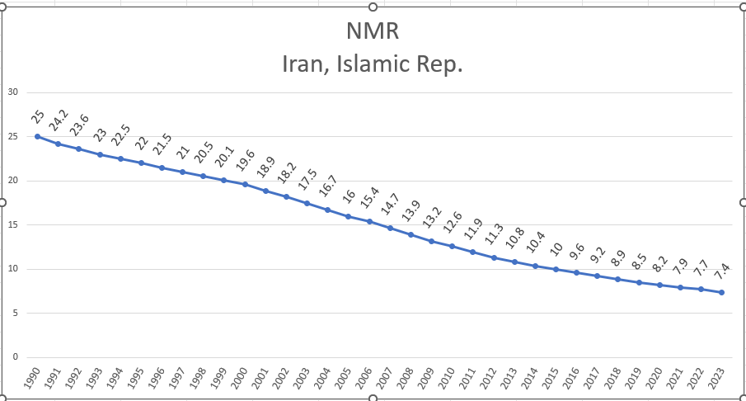

Slide 3
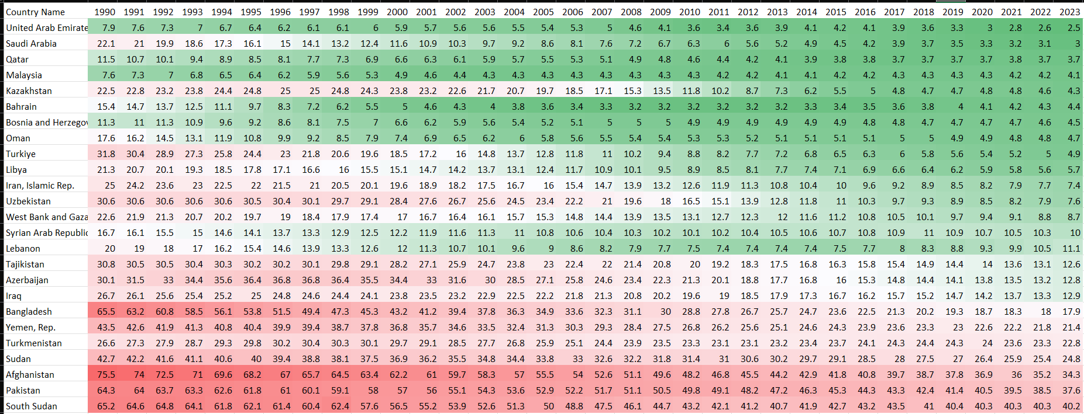
NMR Iran and Muslem country

Slide 4
Traditional post-resuscitation ventilation
Positive pressure ventilation (PPV) delivered via face mask or endotracheal tube,
Guided by the ABCs (airway, breathing, circulation) of resuscitation.
The NRP 8th edition (2021) recommends initial PPV at 20-25 cm H2O peak inspiratory pressure (PIP) for term infants, but lower for premies (15-20 cm H2O) to avoid injury.

Slide 5
Continuous Positive Airway Pressure (CPAP):
Now a first-line post-resuscitation tool for spontaneously breathing premies.
Recent protocols suggest initiating nasal CPAP at 5-8 cm H2O immediately after stabilization.
This maintains FRC and reduces work of breathing.
A 2023 meta-analysis in Pediatrics indicated CPAP reduces intubation rates by 30-50% in preterm infants compared to PPV alone.

Slide 6
Sustained Inflation (SI):
Involves an initial inflation of 20-30 seconds at 20-25 cm H2O, followed by CPAP.
Trials like the SAIL study (2019, with follow-ups in 2022-2024) showed mixed results: beneficial for lung recruitment in some premies but increased pneumothorax risk in others.
Updated ILCOR guidelines (2023) cautiously recommend SI for non-vigorous preterm infants, with ongoing debates.

Slide 7
Volume-Targeted Ventilation (VTV):
Using devices like T-piece resuscitators or next-generation ventilators, VTV delivers consistent tidal volumes (4-6 mL/kg) rather than pressure-based.
A 2024 review in Archives of Disease in Childhood suggests VTV halves the duration of mechanical ventilation in the delivery room for extremely low birth weight (ELBW) infants.

Slide 8
Less Invasive Surfactant Administration (LISA):
Combined with CPAP, LISA involves administering surfactant via thin catheter without intubation.
European guidelines (ERC 2021, updated 2024) endorse this for premies <32 weeks with RDS signs post-resuscitation, potentially decreasing bronchopulmonary dysplasia (BPD) incidence by 20%.

Slide 9
High-Flow Nasal Cannula (HFNC):
Emerging as an alternative to CPAP for milder cases, providing 2-8 L/min flow.
A 2025 pilot study in Neonatology (pre-print) indicates HFNC may be equally effective for post-resuscitation support in late preterm infants, with better tolerance.

Slide 10
Strategy | Key Features | Benefits | Risks | Evidence Level (GRADE) | Typical Use in Premies
Standard PPV | Short bursts at fixed pressure | Quick stabilization | Barotrauma, volutrauma | High | Initial resuscitation if apneic
CPAP | Continuous pressure via nasal prongs | Non-invasive, maintains FRC | Nasal trauma, failure in severe RDS | High | Spontaneously breathing >28 weeks
Sustained Inflation (SI) | Prolonged initial breath | Better lung recruitment | Pneumothorax (5-10% increase) | Moderate | Non-vigorous <32 weeks
Volume-Targeted Ventilation (VTV) | Tidal volume control | Reduces over-ventilation | Requires specialized devices | Moderate | During PPV escalation
LISA/MIST | Surfactant via catheter + CPAP | Avoids intubation | Bradycardia during procedure | High | RDS signs in <32 weeks

Slide 11
Several landmark studies underpin these procedures:
Sustain Study (2022): Randomized 200 preterm infants to SI vs. standard PPV; found improved FRC but no difference in BPD rates. Published in The Lancet Child & Adolescent Health.
NINSAPP Trial (2023): Compared nasal intermittent positive pressure ventilation (NIPPV) to CPAP post-resuscitation; NIPPV reduced failure rates by 15% in <28-week gestations. From JAMA Pediatrics.
OPTIMIST-A Trial (2024): Evaluated minimally invasive surfactant therapy (MIST, similar to LISA) in delivery room settings; showed 25% reduction in mechanical ventilation needs. In New England Journal of Medicine.
AeroFact Study (ongoing, interim 2025): Aerosolized surfactant delivery during CPAP—promising for avoiding any instrumentation, with early data suggesting feasibility in ELBW infants.
Meta-analyses, such as one in Cochrane Database of Systematic Reviews (2024 update), support non-invasive strategies but note heterogeneity in outcomes, urging gestational age-specific protocols.

Slide 12
Delivery room teams must integrate these procedures into workflows:
Equipment: T-piece devices (e.g., Neopuff) for precise pressure/volume control; capnography for end-tidal CO2 monitoring to avoid hypercapnia.
Monitoring: Target SpO2 60-65% at 3 minutes, rising to 85-95% by 10 minutes; heart rate >100 bpm as success indicator.
Team Training: Simulation-based NRP training now includes modules on SI and LISA, emphasizing multidisciplinary coordination.
Challenges include variability in resource availability—high-income settings adopt faster than low-resource ones—and the need for rapid decision-making. For extremely preterm babies (<25 weeks), ethical considerations like parental involvement in resuscitation limits arise.

Slide 13
Supraglottic Airways:
Now recommended as effective alternatives to face masks and tracheal tubes in selected settings.
Face-mask ventilation is ineffective
When endotracheal intubation is not feasible or unsuccessful.
For infants ≥34 weeks gestation, supraglottic airways can provide a stable airway during the initial stabilization period

Slide 14
Video Laryngoscopy:
newly suggested for training purposes and in select intubation scenarios.
This technology enhances visualization of the glottis and may improve first-attempt success rates, particularly for clinicians with less experience in neonatal intubation

Slide 15
Outcomes and Complications
Data synthesized from 2023-2025 reviews; outcomes like BPD reduction vary by 10-30% across strategies.
Long-term, these procedures aim to lower neurodevelopmental impairments, with follow-up studies showing improved Bayley scores in CPAP-treated cohorts.

Slide 16
Future Directions and Controversies
Ongoing research explores adjuncts like caffeine administration in the delivery room (CAFE Trial, 2025) and AI-assisted monitoring for predictive ventilation adjustments. Controversies include the role of delayed cord clamping alongside ventilation—balancing oxygenation with placental transfusion—and equity in access to advanced tools.
While evidence leans toward non-invasive dominance, some experts argue for earlier intubation in profoundly immature lungs to ensure stability. Balanced views from sources like Pediatric Research (2024) stress the need for more randomized trials in diverse populations.
This synthesis underscores that while no single "new" procedure revolutionizes care, iterative refinements based on evidence are transforming outcomes for premature newborns.

Slide 17
Thanks

