Slide 1
Neuroprotection in HIE
Dr H.sheykholeslami
Neonatologist

Slide 2
INTRODUCTION
NE is an altered level of consciousness, seizures, hypotonia, and altered reflexes in a neonate.
Although determining the cause of NE is not always straightforward, HIE is one of the most frequent causes
many hospitals around the world lack the resources to provide TH safely and reliably; and up to 29% of treated neonates still develop disabilities despite TH
Graham, E. M., & Burd, I. (2025). Updates in Treatment of Hypoxic-Ischemic Encephalopathy. Clinics in Perinatology, 52(2), 321–343.

Slide 3
Primary Neuronal Damage
inhibition of energy-producing molecular processes
increasing extracellular acidosis,
failure of Na+/K+ (ATPase) membrane pumps
(cytotoxic edema).
Free radical production(neuronal death)

Slide 4
Secondary Neuronal Damage
secondary energy failure starts within 6 to 8 hours after insult.
high energy phosphates are reduced
Depletion of ATP and an increase in Pi, a decrease in the PCr/Pi ratio
Glutamate activates N-methyl-d-aspartate (NMDA) receptors, which excess entry of intracellular Ca2+
Free Radical Formation oxygen and nitrogen
Apoptosis, the most important cause of neuronal death, with caspase-3 identified as the execution protein
proinflammatory cytokines TNFα, [IL]-1β, and IL-18

Slide 5
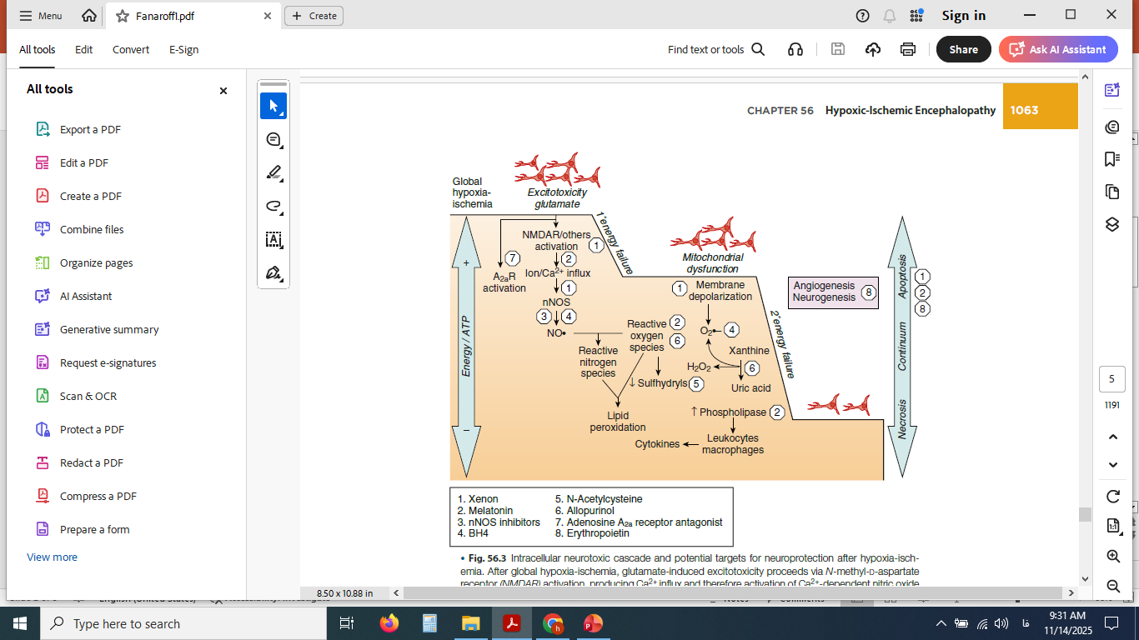

Slide 6
Management

Slide 7
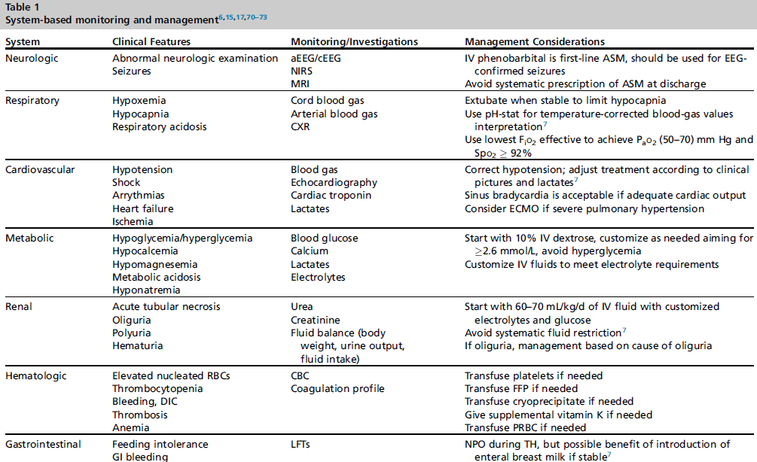

Slide 8
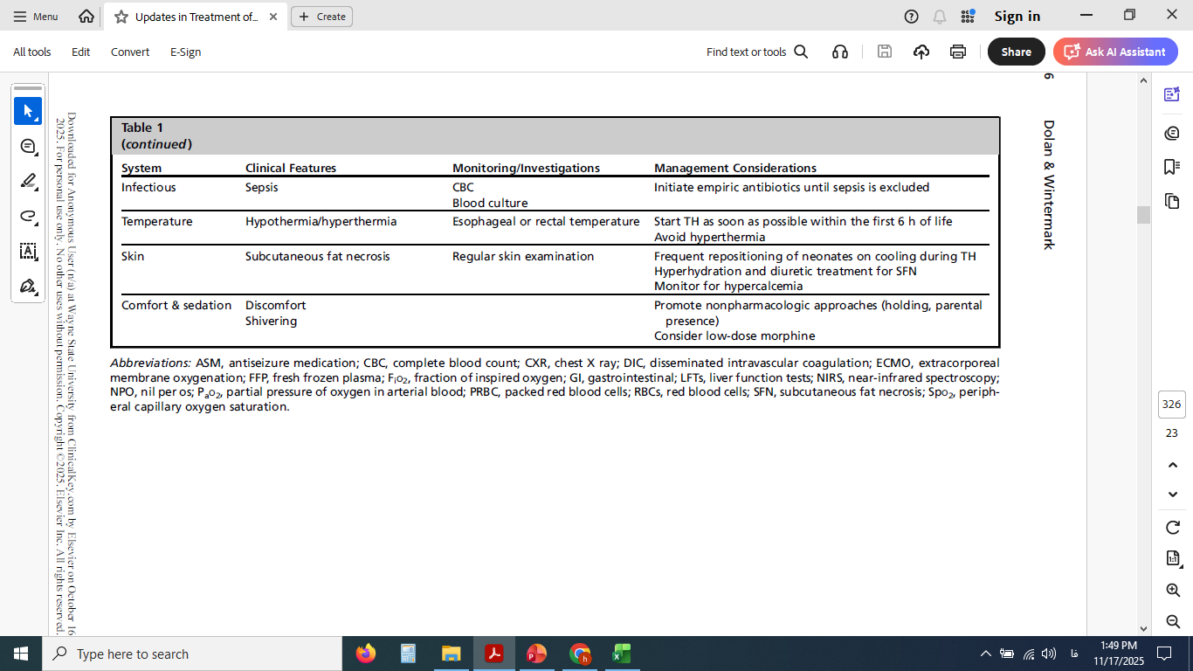

Slide 9
Other Strategies

Slide 10
Corticosteroids
There is concern about the long-term effects of large doses of dexamethasone given shortly after birth, particularly in preterm infants, in whom it is estimated that there is a significant increase in the risk of cerebral palsy.

Slide 11
Hypothermia

Slide 12
Magnesium sulfate
Magnesium sulfate (MgSO4) is an NMDA receptor antagonist and has been proposed to be an effective agent for brain protection and is used extensively in preterm labor for fetal neuroprotection. no sustained benefits have been reported
Koning G, Leverin AL, Nair S, et al. Magnesium induces preconditioning of the neonatal brain via profound mitochondrial protection. J Cereb Blood Flow Metab 2019;39(6):1038–55.

Slide 13
Melatonin
potent antioxidant → ↓ ROS/RNS
Anti-inflammatory (↓ TNF-α, IL-1β, NF-κB)
Mitochondrial stabilization → ↑ ATP
Anti-apoptotic (↓ caspase-3/9, ↑ Bcl-2)
Improved cerebral perfusion
Preservation of BBB integrity
Although melatonin may have beneficial effects, more pharmacokinetic studies need to be performed
Pang R, Han HJ, Meehan C, et al. Efficacy of melatonin in term neonatal models of perinatal hypoxia-ischaemia. Ann Clin Transl Neurol 2022;9(6):795–809

Slide 14
N-Acetylcysteine
NAC is a precursor of glutathione and can therefore act as an antioxidant and is also a scavenger of oxygen free radicals. In animal experiments, it has been used in combination with hypothermia, but clinical studies in humans have not yet been performed.

Slide 15
Allopurinol
Allopurinol is an inhibitor of xanthine oxidase and has free-radical scavenging action. The long-term effects of allopurinol after perinatal asphyxia in 23 neonates were published in 2011. At the mean age of follow-up of 5 years, no differences in long-term outcome between the allopurinol treated infants and controls were demonstrated.
Maiwald CA, Annink KV, Ru¨diger M, et al. Effect of allopurinol in addition to hypothermia treatment in neonates for hypoxic-ischemic brain injury on neurocognitive outcome (ALBINO): study protocol of a blinded randomized placebocontrolled parallel group multicenter trial for superiority (phase III). BMC Pediatr 2019;19(1):210.

Slide 16
Xenon
Xenon is a noncompetitive antagonist of the NMDA subtype of the glutamate receptor, although other mechanisms of action have been reported. Xenon appears to be neuroprotective in animal models of perinatal asphyxia. No beneficial effects of xenon in combination with therapeutic hypothermia could be demonstrated.
Sun M, An Z, Wei H, et al. Xenon attenuates hypoxic-ischemic brain damage by inhibiting autophagy in neonatal rats. Neuroreport 2023;34(5):273–9.

Slide 17
Stem Cells
Stem cells or progenitor cells may have multiple beneficial effects on outcome after hypoxic-ischemic injury, as has been shown in preclinical studies.
Interestingly, a recent RCT evaluating cord milking in 1730 neonates demonstrated that it reduced the rate of moderate to severe HIE and the need for TH
Katheria AC, Clark E, Yoder B, et al. Umbilical cord milking in nonvigorous infants: a cluster-randomized crossover trial. Am J Obstet Gynecol 2023;228(2): 217.e1–14.

Slide 18
Topiramate
Reduces glutamate excitotoxicity
Limits sodium and calcium overload
Stabilizes cellular metabolism
Inhibits apoptotic pathways
showed a trend toward less mortality and seizures, but the difference was not significant; no improvement was seen on MRI brain injuries.
Noh MR, Kim SK, Sun W, et al. Neuroprotective effect of topiramate on hypoxic ischemic brain injury in neonatal rats. Exp Neurol 2006;201(2):470–8.

Slide 19
Caffeine
Adenosine receptor antagonism → ↓ inflammation, ↑ CBF
Mitochondrial stabilization
Respiratory stimulation → fewer secondary hypoxic events
Potential reduction of cerebral edema
↓ Oxidative stress & cytokine production
Preclinical studies have suggested improved functional outcomes when combined with TH.
Sabir H, Maes E, Zweyer M, et al. Comparing the efficacy in reducing brain injury of different neuroprotective agents following neonatal hypoxia–ischemia in newborn rats: a multi-drug randomized controlled screening trial. Sci Rep 2023;13(1):9467.

Slide 20
Azithromycin
Azithromycin is an antibiotic with anti-inflammatory properties.
No RCTs have yet investigated the safety or efficacy of azithromycin in the context of neonatal HIE
Barks JDE, Liu Y, Wang L, et al. Repurposing azithromycin for neonatal neuroprotection. Pediatr Res 2019;86(4):444–51.

Slide 21
EPO
Erythropoietin (EPO) was proposed as another potential therapy for neonatal HIE after it displayed neuroprotective and neurorestorative effects in preclinical models
Neuroprotective effects of EPO have been associated with stimulation of production of growth factors, including vascular endothelial growth factor secretion and brain-derived neurotrophic factor
Rangarajan V, Juul SE. Erythropoietin: emerging role of erythropoietin in neonatal neuroprotection. Pediatr Neurol 2014;51(4):481–8

Slide 22
Sildenafil
Sildenafil is a phosphodiesterase type 5 inhibitor, already used in neonates for the treatment of pulmonary hypertension. It has been found to prevent neuronal death, enhance neurogenesis and synaptic plasticity, and improve motor outcomes in preclinical models of HIE
Wintermark P, Lapointe A, Steinhorn R, et al. Feasibility and safety of sildenafil to repair brain injury secondary to birth asphyxia (SANE-01): a randomized, double-blind, placebo-controlled phase ib clinical trial. J Pediatr 2024;266: 113879.

Slide 23
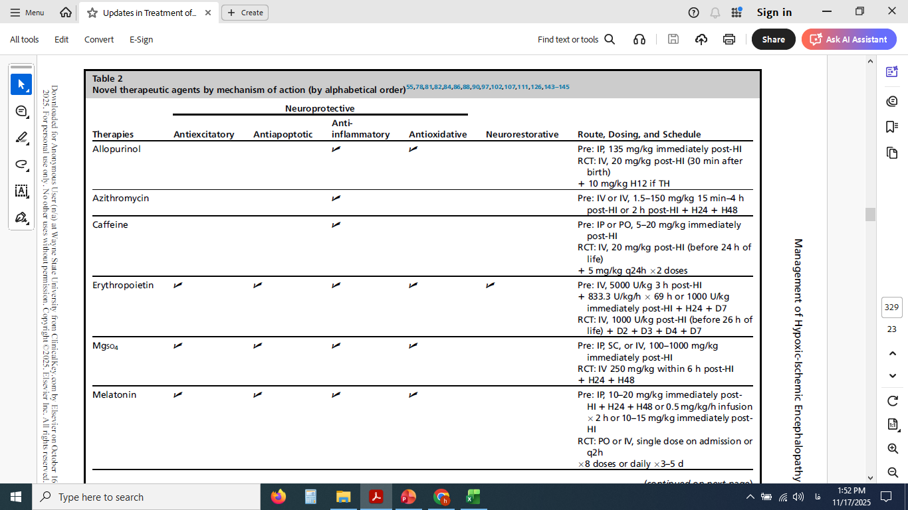

Slide 24
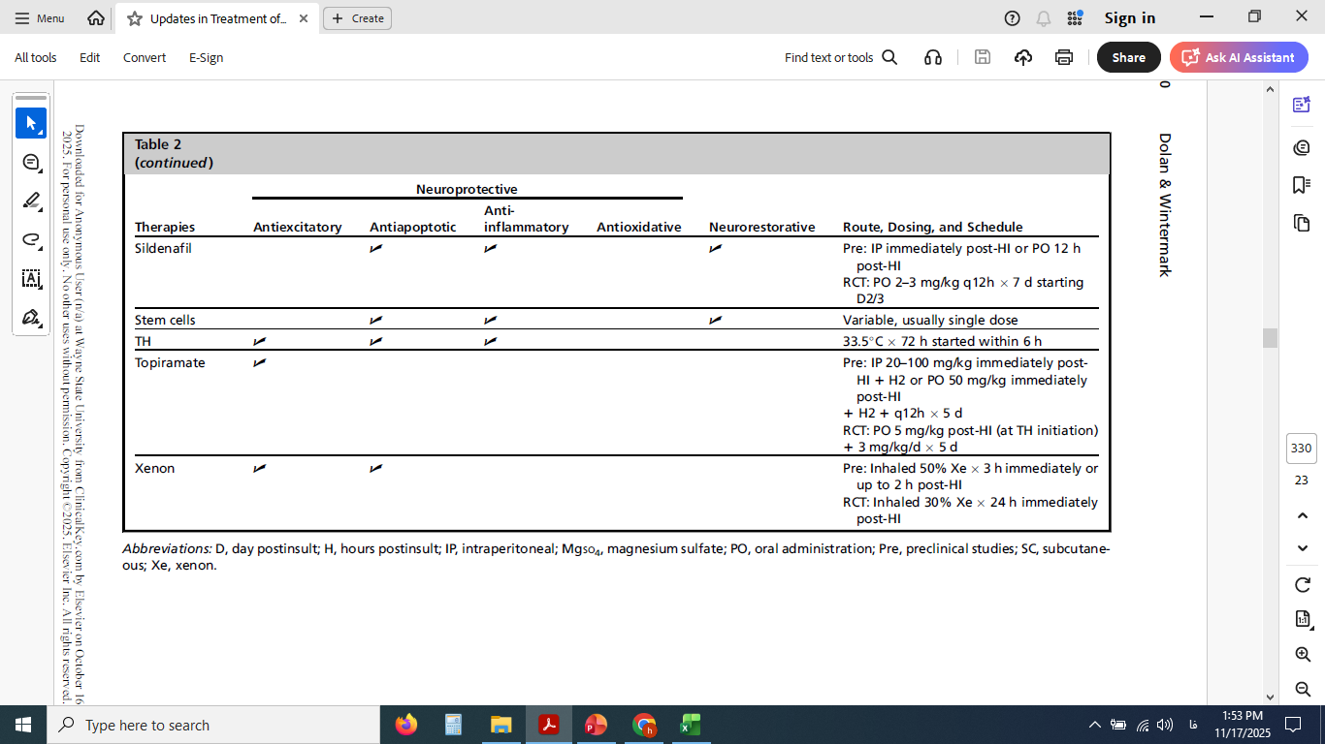

Slide 25
Major Recommendations
Daily management of neonates with NE/HIE should be first supportive with the target goal to re-establish homeostasis of the different body organs/systems. Ongoing cardiac dysfunction, acute kidney injury, electrolytes imbalance, impaired gas exchange, and similar may all contribute to worsening brain injury and thus subsequent adverse neurodevelopmental outcomes

Slide 26

از حضور ارزشمند شما سپاسگزارم

