Slide 1

Evidence – based Pharmacologic
Therapies in Neonatal Hyperbilirubinemia
Maral Ghassemzadeh
TUMS, Hakim Children Hospital

Slide 2
01
Adjuvant Pharmacologic Therapies

Slide 3
Focus and Evidence Criteria
Emphasis on adjuvant pharmacologic therapies for unconjugated neonatal hyperbilirubinemia.
Utilization in addition to standard phototherapy and exchange transfusion.
Focus on :
phenobarbital, fibrates, zinc sulfate, ursodeoxycholic acid (UDCA), probiotics, and selected complementary approaches.
Emphasis on level of evidence (LOE) and GRADE strength of recommendations.
Introduction and Focus

Slide 4
Pathophysiology Relevant to Drug Therapy
Key Targets for Therapy
Unconjugated hyperbilirubinemia in term and late- preterm infants results from increased bilirubin production, reduced hepatic uptake and conjugation, and increased enterohepatic circulation.
Key therapeutic targets :
induction of UGT1A1- mediated conjugation, interruption of intestinal deconjugation and reabsorption, optimization of bile flow and stooling.

Slide 5
02
Standard of Care

Slide 6
Reference Framework
First-line Management
Intensive phototherapy and timely exchange transfusion as the cornerstone of management.
Pharmacologic adjuvants must be judged against outcomes , need for ET, phototherapy duration, hospitalization, avoidance of HBE

Slide 7
03
Phenobarbital

Slide 8

Mechanism and Rationale
Induction of Bilirubin Conjugation
Induces hepatic microsomal enzymes, UDPGT1A1, ↑ conjugation and clearance. may ↑ bile flow
Onset delayed, ≥3–5 days, ↓ usefulness in acute jaundice. prolonged hyperbilirubinemia (Crigler–Najjar type II).
Potential adverse effects :respiratory depression, sedation, poor feeding, ↓W.G , ND concerns.
Not routinely recommended due to limited clinical benefit relative to sedation risk.

Slide 9

Evidence from RCTs and Meta-analysis
Systematic Review Findings
Meta Analysis on RCTs 2018-2024
Cochrane Database
Limited high quality data
01
02
03
reduction in peak TSB (2-3 mg/dl) phototherapy duration
( 12-24 hrs) ??
No consistent reduction in ET need
Limited high- quality data , long- term ND data.

Slide 10

Clinical Role and Cautions
Recommendations :
LOE 2a, 1b
(meta‑analysis of small RCTs)
GRADE C (weak , low–moderate certainty) ,
D (recommendation against)
Heterogeneity
small sample size
single‑center
risk of bias
Not recommended as routine adjunctive Nor Std Tx of typical neonatal jaundice.
May have a role in selected conditions such as prolonged hyperbilirubinemia under specialist supervision. not in typical neonatal jaundice

Slide 11
04
Fibrates

Slide 12
Fenofibrate and Clofibrate Mechanisms
PPAR- α agonists enhancing hepatic bilirubin conjugation and excretion.
Enhancement of Bilirubin Conjugation
Single- dose regimens tested in neonates as adjuvant therapy to phototherapy.

Slide 13

Clofibrate: SR/ MA 2023
Safety Concerns ??
GRADE B ( conditional recom. ) , LOE 1b
Reductions in TSB( significant ) and phototherapy duration ( 12-18 Hours) , May be useful as adjuvant TX in Sever cases
01
Limited Safety prolonged data in Neonates, especially Preterm and Hemolysis
02

Slide 14

Fenofibrate: Systematic Review and Meta-analysis
2 B, GRADE C , Weak Recommendation
Efficacy Findings
Less Studies , Small Sample Size, M.A : Might
↓TSB, ↓phototherapy & cost and admission duration, Less Effective than clofibrate
Adverse effects rare & mild
long- term safety ? More limited data

Slide 15
Clinical Implications
Use in Selected Contexts ..?
Clofibrate may be considered in high- TSB, phototherapy resistant, close monitoring as adjuvant
Routine use not yet strongly recommended. Not Yet in Guidelines
01.
02.

Slide 16
05
Zinc Sulfate

Slide 17

Mechanism and Rationale
Oral zinc salts bind unconjugated
bilirubin, ↓ enterohepatic circulation,
bound to porphyrines , ↓ of bili formation from heme,
inhibition of intestinal beta glucoronidase
Evaluated for prevention and treatment of neonatal hyperbilirubinemia.

Slide 18
Mechanism
Binds unconjugated bilirubin in the intestine
Effects
Inhibits beta- glucuronidase.
Reduces enterohepatic circulation of bilirubin.
Evaluated for prevention and treatment.
LOE 2a, GRADE B/C.

Slide 19
Updated Systematic Review and Meta-analysis
Efficacy Findings , 2 a and grade b / c
Some M.A show significant ↓ TSB and phototherapy duration as an adjunct TX.
10 RCTs, Iran , India, china , Egypt, 2018-2021, 2023, Heterogeneity, variable trial quality , No difference in ET need or admission duration
No serious adverse events; mild GI intolerance.
( abdominal pain , GI discomfort, mild nausea) evidence remains limited and routine clinical use is not yet recommended
2 a and grade b

Slide 20
Practical Considerations
Usage and Safety
Typical regimens oral zinc sulfate 5–10 mg/kg/day during phototherapy.
Promising adjunct in settings with high burden of jaundice and limited access to exchange transfusion.

Slide 21
06
Ursodeoxycholic Acid (UDCA)

Slide 22
Mechanism and Evidence
Role in Bilirubin Excretion
Improves bile flow, protects cholangiocytes, displace endogenous, toxic bilirubin conjugates from hepatocyte membrane, facilitate bilirubin excretion into bile canaliculi
Not recommended for routine use in unconjugated
neonatal hyperbilirubinemia due to insufficient benefit,
LOE 2 a ,
GRADE B , C,
↓phototherapy duration & TSB, adjunct only ,C evidence limited, Greater RCT
Small studies suggest potential benefits, but robust RCT data lacking.
S.R disappointing results.
No sig reduction in TSB / Photo duration

Slide 23
07
Complementary and Traditional Therapies

Slide 24
Probiotics
1
5
IVIG
Tin Compounds
2
Contents
6
Treatment of Conjugated Hyperbilirubinemia
Bilinaster (Iranian Herbal Agent)
3
7
Definitive Care
Shir-Khesht (Traditional Iranian Plant Gum)
4

Slide 25





Probiotics Use , Level of Evidence2a, heterogeneity.
Countries Involved
China
Iran
Turkey
Mechanism of Action
Restore healthy gut flora that inhibits beta glucuronidase or binds to unconjugated bilirubin in the gut.
Promoting fecal excretion.
Clinical Implication
Insufficient evidence in jaundice; may be considered if risks need for gut flora support.
Lactobacillus rhamnosus, Bifidobacterium.
Along with photo , inhibition of b glucuronidase producing bacteria in intestine ↓ EH cycle.
Not significant ↓in time.

Slide 26


Tin Compounds (Metalloporphyrins) Efficacy and Evidence
Human data highly limited.
HO inhibitor
Data Source :
animal models and small- scale phase I/II trials.
Concerns : Early studies noted transient elevation of hepatic enzymes, hepatotoxicity.

Slide 27
Clinical Implication
High potential, but currently not recommended for clinical use outside of strictly controlled, ethically reviewed research protocols.
Level of Evidence (LoE)III–IV.
Strength of Recommendation (SOR)C− (Not recommended outside trials).

Slide 28
IVIG Use in Neonatal Jaundice
01
when immune- mediated hemolysis is the cause of unconjugated hyperbilirubinemia.
02
↓ RBC hemolysis by coating Fc receptors on RBCs.
03
AAP in immune- mediated hemolysis, TSB within 2 to 3 mg/dL of exchange threshold despite intensive phototherapy.
04
Evidence that IVIG reduces the need for ET is unclear
Rh L : LOE 1 , Grade A/B ( Strong) , ABO : Grade B, LOE 2 ( conditional).

Slide 29
Direct Hyperbilirubinemia Treatment
Treatment is tailored to the specific etiology of the jaundice.
Best outcomes for patients diagnosed with biliary atresia require a Kasai operation within the first 2 months of life.
Infectious causes of cholestasis are treated with specific antimicrobial agents.
Treatment with cholic acid and chenodeoxycholic acid is often curative for many BASDs.
Patients with GALD appear to respond well to IVIG and double- volume exchange transfusion.
Severe hepatic damage may require liver transplantation.
Parenteral nutrition- induced cholestasis is managed with cyclic PN, reducing the duration of exposure and initiating enteral feeds as early as possible.

Slide 30




Approaches
Potential for toxicity.
Herbal preparations, traditional remedies, infant massage.
Studies
High risk of bias.
LOE 3a–4, GRADE D.
No high- quality evidence.

Slide 31
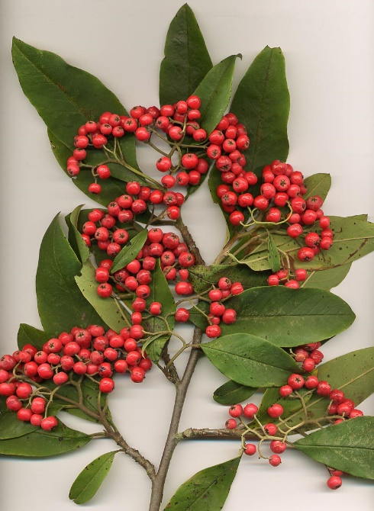
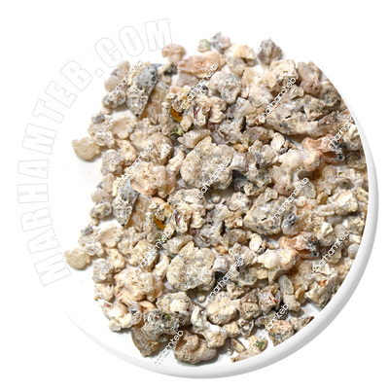
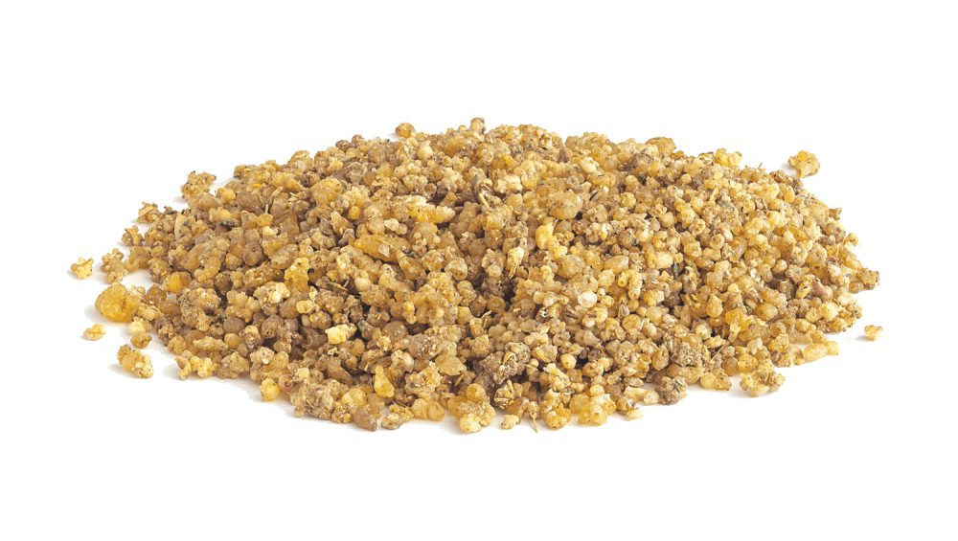
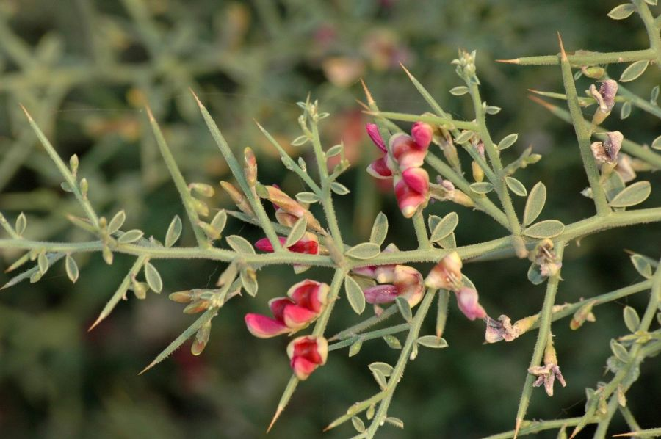
Herbal Products
Cotonesster Frigidus
Comeithornalhagia Psuedalhagi
Tragacanth Gum

Slide 32


Evidence and Safety
Various herbal and traditional remedies proposed.
Lack of High-Quality Evidence
High risk of bias, lack of standardized definitions, and rigorous safety monitoring.

Slide 33

Efficacy and Evidence of Bilinaster, Iranian Herbal
Evidence : regional studies; small Iranian RCT published in 2023 (n=55) compared Bilinastr vs phenobarbital.
01.
02.
Similar reduction in TSB levels.
03.
Bilinastr group significantly less sedation.

Slide 34
Clinical Implication
01
02
Potentially safer than phenobarbital based on limited data.
Cannot be recommended internationally pending robust, blinded, multi- center validation.
03
04
05
Level of Evidence (LOE)III.
Strength of Recommendation (SOR) C (Experimental, needs global RCT).
A systematic review showed that herbal remedies (especially Bilineaster drop) are probably effective as adjuvant therapies along with standard therapies in the treatment of neonatal jaundice.

Slide 35
Shir-Khesht (Traditional Iranian Plant Gum)
Efficacy and Evidence
01
Shir- Khesht is a plant- derived polysaccharide or gum used traditionally as a mild laxative and jaundice treatment.
02
A single small RCT Arak 2022 (n=60) modest TSB decline (approximately 1 mg/dL difference) when administered alongside standard care, without notable severe adverse events.

Slide 36
Clinical Implication
Represents traditional practice; lacks sufficient evidence for inclusion in modern clinical guidelines.
Level of Evidence (LOE)IV.
Strength of Recommendation (SoR)C− (Not evidence- based).

Slide 37
07
Safety Considerations Across Drug Classes

Slide 38
Safety
Cardiorespiratory instability (phenobarbital).
Unanticipated effects on neurodevelopment.
Concerns
Hepatic and muscular toxicity (fibrates).
Underpowered trials to detect rare or long- term adverse events.
Disturbances of micronutrient balance (zinc).
LOE 1b–3a, GRADE B–C.

Slide 39
08
Comparative Summary of Efficacy

Slide 40
Efficacy
Reduction in TSB levels and duration of phototherapy.
No reduced need for exchange transfusion.
Robust evidence for zinc sulfate and fenofibrate.
LOE 1a–2a, GRADE B–C.
Findings
Older evidence for phenobarbital and clofibrate.

Slide 41
Standard Therapies, Definitive Care
Phototherapy and, in severe cases, exchange transfusion, remain the sole definitive and guideline- supported therapies for managing significant unconjugated hyperbilirubinemia.

Slide 42
09
Pragmatic Clinical Recommendations

Slide 43

Recommendations
Intensive phototherapy and exchange transfusion as cornerstone.
Avoid routine use of phenobarbital or clofibrate.
May consider oral zinc sulfate or fenofibrate in selected high- risk cases ???
Do not recommend herbal or traditional remedies.
LOE 1a–3a, GRADE B–D.

Slide 44
Treatment Guidelines
01
02
03??
04
Treat intensive phototherapy and timely exchange transfusion as cornerstone of management.
Avoid routine use of phenobarbital or clofibrate.
May consider oral zinc sulfate or fenofibrate in selected high- risk cases.
Do not recommend herbal or traditional remedies.
Recommendations

Slide 45
10
Research Gaps and Future Directions

Slide 46
Research Needs
Priorities
Large, high- quality RCTs for meaningful outcomes.
01
Long- term safety data for fenofibrate, zinc, and UDCA.
02
Implementation research in low- and middle- income countries.
03
LOE 2a–3a, GRADE B , C.
04

Slide 47
11
Take-Home Messages

Slide 48
Summary Points
Future research should prioritize clinically meaningful outcomes and long- term follow- up.
Drug therapy remains adjunctive to phototherapy and exchange transfusion.
Phenobarbital and clofibrate have niche roles due to safety concerns.
Fenofibrate and zinc sulfate show promising efficacy but need further data.
Herbal and traditional remedies lack robust evidence.
Key Conclusions

Slide 49

Thanks

Slide 50
References
1. Cochrane Neonatal Group. Phenobarbital for neonatal jaundice. Cochrane Database Syst Rev. 2018;CD004305.
2. Al‑Harbi KT et al. Phenobarbital in prevention of neonatal hyperbilirubinemia: Randomized control trial. J Neonatal Perinatal Med. 2021;14(3):321‑327.
3. Esmaeili M et al. Clofibrate as adjunct therapy to phototherapy: A systematic review and meta‑analysis. Pediatr Neonatol. 2024;65(2):89‑97.
4. Farhat R et al. Effect of clofibrate on serum bilirubin and hospitalization
duration: Meta‑analysis of RCTs. BMC Pediatr. 2023;23:811.
Hassan A et al. Ursodeoxycholic acid for neonatal hyperbilirubinemia:
Systematic review. J Perinatol. 2023;43:764‑772.

Slide 51
Summary
Points
01
Drug therapy is adjunctive to phototherapy and exchange transfusion.
04
Avoid herbal and traditional remedies.
02
Historical or niche roles for phenobarbital and clofibrate.
05
Prioritize clinically meaningful outcomes and long- term follow- up.
03
Promising efficacy for fenofibrate and zinc sulfate with further data needed.
06
LOE 1a–3a, GRADE B–C.

Slide 52
CONTENTS
01
02
03
04
PART
PART
PART
PART
Adjuvant Pharmacologic Therapies
Standard of Care
Phenobarbital
Fibrates
05
06
07
08
PART
PART
PART
PART
Zinc Sulfate
Ursodeoxycholic Acid (UDCA)
Complementary and Traditional Therapies
Safety Considerations Across Drug Classes
09
10
11
12
PART
PART
PART
PART
Comparative Summary of Efficacy
Pragmatic Clinical Recommendations
Research Gaps and Future Directions
Take-Home Messages

