Slide 1
Local Infections in newbrns: An Update
Sabzehei md
Hamadan University Of Medical Sciences

Slide 2
Overview of Local Infections
Local infections are common during the neonatal period.
Incidence 0.5–8%, higher in low-resource settings.
They may precede systemic sepsis.
Prompt recognition and management are crucial.
Zupancic J, et al. Pediatrics. 2022.

Slide 3
Local vs. Systemic Infections in Newborns
Feature | Local Infection | Systemic Infection
Scope | Confined to one tissue or body part. | Disseminated via the bloodstream or CNS.
Severity | Generally less severe; potentially manageable. | High risk of mortality; considered a medical emergency.
Signs | Site-specific inflammation (redness, localized pain). | Generalized signs (lethargy, temperature instability, poor feeding).
Example | Omphalitis, impetigo | Sepsis, meningitis
Intervention | Targeted therapy (topical or localized antibiotics). | Immediate, broad-spectrum IV antibiotics and supportive care.

Slide 4
Neonatal Omphalitis
Definition:
- Omphalitis is infection of the umbilical stump and surrounding tissues in newborns
Incidence:
  - High-income countries – <0.5 cases per 1000 live births.
  - Low-resource areas – up to 8–20 per 1000 live births.
Mortality remains high in low-resource settings (up to 15%), mainly due to delayed recognition and systemic spread.
Thaver D, et al. Seminars in Perinatology. 2024.

Slide 5
Etiology
Pathogen Notes
Staphylococcus aureus (including MRSA) Most common causative organism globally
Streptococcus pyogenes (Group A Strep) May cause necrotizing fasciitis
Gram-negatives (E. coli, Klebsiella, Pseudomonas) Frequent in hospital-acquired or mixed infections
Anaerobes Often progressing to necrosis or abscess formation
Mixed bacterial infections are common
O'Hara CM, Brenner FW. Clinical Microbiology Reviews. 2024.

Slide 6
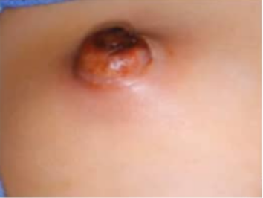
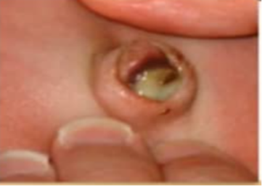
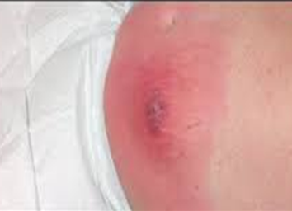
Clinical Presentation
Severity Grade | Clinical Findings
Mild (Localized) | Minimal erythema < 2 cm No purulence No systemic signs Cord separation process may be slightly delayed
Moderate (Infectious) | Clear or opaque purulent discharge Moderate induration Erythema extending > 2 cm May have mild systemic signs
Severe(Complicated) | Rapidly spreading cellulitis/induration Deep extension (abscess formation) Evidence of systemic toxicity Signs of omphaloarteritis

Slide 7
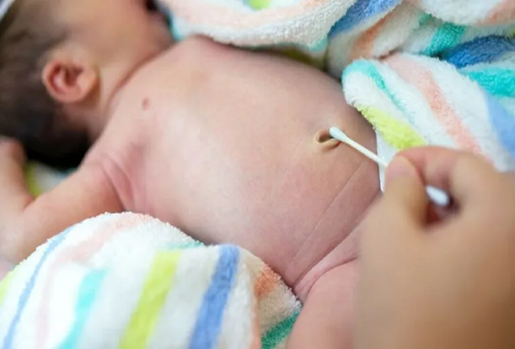
Diagnosis
Primary diagnosis is clinical.
Supportive investigations:
  CBC (leukocytosis, neutrophilia)
  Blood cultures
  Swab or aspirate culture from umbilical site
  *Urinalysis, urine culture, and cerebrospinal fluid culture if the patient has systemic symptoms
  *Umbilical Doppler Ultrasound: In severe cases for abscess or portal vein thrombosis

Slide 8
Management
Severity First-line Regimen Notes
Mild localized IV flucloxacillin+ gentamicin Staph and gram-negatives
Severe/systemic IV vancomycin + ceftazidime or meropenem MRSA and resistant gram-negatives
*Anaerobic suspicion Add metronidazole or clindamycin
Duration: Total course length is typically 10 days for uncomplicated omphalitis; longer courses (14 up to 21 days) are warranted if deep tissue involvement (cellulitis/abscess) or systemic bacteremia developed.
AAP. Red Book: 33rd ed. 2024.

Slide 9
Recent Research Highlights
Antimicrobial resistance patterns
  Increase in MRSA (up to 30–40% of isolates in NICUs).
  Klebsiella shows rising ESBL and carbapenemase production, prompting broader empiric coverage.
  Hiermandi N,et al. Antimicrob Steward Healthc Epidemiol. 2025
2. Chlorhexidine application programs
  WHO’s multicountry trial confirms single postnatal chlorhexidine dose is as effective as repeated applications.
  World Health Organization, 2024
3. Novel diagnostics
  Point-of-care molecular tests for Staph aureus and Klebsiella developed for district hospitals.
  Nguyen M, et al. Frontiers in Pediatrics. 2024
4. Microbiome studies
  Healthy cord colonization by nonpathogenic Staphylococci may help prevent pathogen dominance.
  Rahman T, et al. Nature Microbiology. 2025.

Slide 10
Neonatal Mastitis
Neonatal mastitis is an infection of breast tissue in infants
It affects both sexes but is slightly more common in females
Incidence: approximately 1 in 2000–5000 live births.
Risk factors:
  Physiologic breast hypertrophy in neonates
  Local trauma from manual expression of “witch’s milk”
Walsh A et al. J Pediatric Infect Dis Soc, 2021.

Slide 11
Etiology
Staphylococcus aureus remains the leading cause (often MRSA in community settings).
Less frequent: Group B Streptococcus, E. coli, and Pseudomonas aeruginosa.
Mixed infections possible in nosocomial or preterm neonates.
Jain A et al. Int J Contemp Pediatrics, 2023

Slide 12
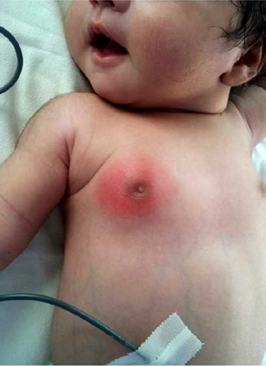
Clinical Presentation
Localized signs: unilateral breast erythema, warmth, induration, tenderness, purulent discharge possible.
Systemic signs: fever, irritability—may suggest bacteremia or sepsis (about 10–20% cases).
Kaplan L et al. Pediatrics.2021

Slide 13
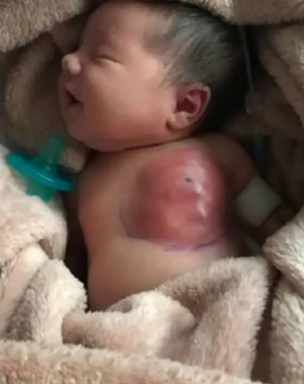
Diagnosis
Clinical diagnosis is most important
Breast Ultrasound (Best Method): In all cases suspected of mastitis, ultrasound is essential to differentiate between cellulitis and abscess .
Obtain blood culture if systemic symptoms present.
Aspiration or drainage culture may guide antibiotic choice.
Kapngni A et al. Afr J Pediatr Surg.2022

Slide 14
Management
Oral antibiotics (cephalexin, clindamycin) may suffice for mild cases.
Empirical IV antibiotics:
  Coverage for S. aureus including MRSA until cultures known.
  Typical regimen: Vancomycin + third-generation cephalosporin.
Abscess → Needle aspiration or incision & drainage.
Kaplan rl. Pediatr Emerg Care.2024

Slide 15
Recent Research Highlights
1. MRSA prevalence in neonatal units rising globally.
2. Ultrasound‑guided aspiration preferred over surgical drainage to minimize scarring and minimize risk to developing breast tissue.
Al-Harbi M, Front Pediatr. 2024.
3. Open Incision and Drainage: This procedure is recommended only in cases where needle drainage is not possible (thick-walled or fibrotic abscess) or when repeated aspiration fails
Shah SS, et al. Pediatr Infect Dis J. 2022.
4. No evidence supports routine hormonal or anti‑inflammatory therapy.
Lee JH, Clin Pediatr, 2023.

Slide 16
Neonatal Impetigo
Neonatal impetigo is a superficial, highly contagious bacterial skin infection common in the neonatal period, particularly in nurseries or crowded environments.
Incidence: vary widely based on hygiene protocols
Risk Factors:
  Prematurity and low birth weight.
  Breaks in the skin barrier (e.g., abrasions from monitoring equipment).
  Poor hospital/nursery hygiene practices
AAP. Red Book: 33rd ed. 2024.

Slide 17
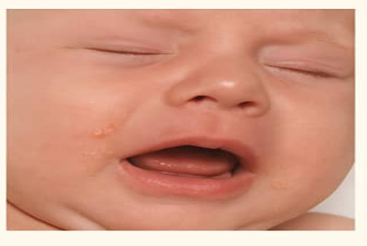
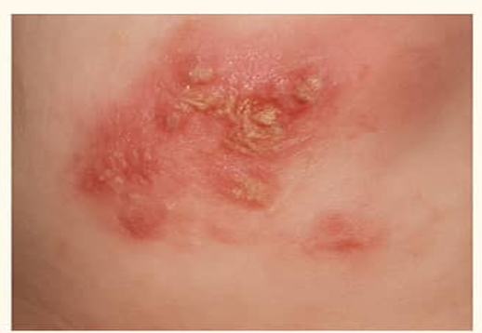
Etiology& Clinical Presentation
The primary causative agent is almost universally Staphylococcus aureus.
The presentation varies based on the type:
  Non-bullous: Starts as small vesicles or pustules on any body surface.These rupture quickly, forming characteristic honey-colored crusts.
  Bullous: Large bullae (up to 1–3 cm). The roof of the bulla sloughs off easily , leaving a moist, red base that dries into a thin, clear-to-brown crust.
Talarico, R., et al. Matern Fetal Neonatal Med, 2020.

Slide 18
Diagnosis & Management
Diagnosis is primarily clinical.
  Gram Stain/Culture: Culture Should be sent to identify resistance patterns (e.g., MRSA).
Management:
  Localized/Non-bullous: Topical Therapy
    Mupirocin 2% ointment applied 2–3 times daily to affected areas for 7–10 days.
  Bullous or Widespread Disease: Systemic Antibiotics
    If MRSA is suspected or confirmed, IV Vancomycin (for severe cases)
Infection Control: Affected infants should be isolated.
Remington.9th ed 2022.

Slide 19
Recent Research Highlights
1. Recent studies indicate a rising prevalence of neonatal impetigo, especially in high-density healthcare settings
Johnson, A. et al. Pediatr Infect Dis J, 2024.
2. Increasing cases of antibiotic-resistant strains highlight the need for continuous surveillance and stewardship in antibiotic use.
Williams, J., et al. Clinical Infectious Diseases. 2023.
3. Research is actively progressing towards vaccine development against neonatal infections, as well as exploring the potential role of probiotics in improving skin health and preventing conditions like impetigo.
Garcia, M., et al. Infection and Immunity. 2024.

Slide 20
Neonatal Conjunctivitis
Definition: Inflammation of the conjunctiva in newborns
Prevalence: Affects 1-2% of newborns
Etiology:
  First 24 hrs: Chemical causes
  2 to 5 days : Bacterial causes (Neisseria gonorrhoeae, Staphylococcus aureus).
  5 to 14 days: Chlamydia trachomatis
  6 to 14 days: Herpes keratoconjunctivitis
Risk factors: Maternal infection, PROM, lack of prophylaxis, lacrimal duct obstruction.
Koller, T., et al. Pediatric Infectious Disease Journal, 2019.

Slide 21
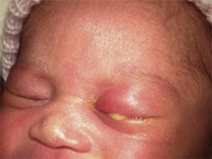
Clinical & Management
Symptoms: A purulent discharge, edema, and erythema of the lids and hyperemia of the conjunctiva
Diagnosis: Cultures or PCR for specific pathogens.
Management: Empirical treatment should be started soon after sending the culture
  Gonococcal: Ceftriaxone IM/IV (25–50 mg/kg). The alternative is cefotaxime single dose of 100 mg/kg
  Chlamydia: Oral erythromycin 14 days or azithromycin 20 mg/kg/day x 3 days.
  HSV: Topical vidarabine or trifluridine five times a day for ten days and evaluate and treat for systemic herpes; an ophthalmology consult is indicated.
Le, G.H., et al. Pediatrics and Neonatology, 2020

Slide 22
Recent Research Highlights
1. Azithromycin is under evaluation as a potential single-dose therapy for chlamydial infections in neonates, with studies indicating efficacy and convenience compared to traditional regimens
Cates W, et al. Pediatric Infectious Disease Journal. 2024
2. Universal ocular prophylaxis with erythromycin ointment at birth to prevent gonococcal and chlamydial conjunctivitis despite emerging alternatives.
3. Povidone-iodine (2.5%) is more effective than erythromycin ointment in areas with high prevalence of HSV infections or chlamydial infections with penicillin resistatance
American Academy of Pediatrics. Pediatrics. 2024.
4. Molecular diagnostics (PCR/NAAT Panel) improving pathogen detection, allowing for faster and more accurate identification of causative agents .
Johnson M, et al. Ophthalmology. 2024.

Slide 23

Thanks for your attention

