Slide 1

Amplitude Integrated EEG (aEEG)
Mohsen Javadzadeh
Child Neurologist
Fellow of Pediatric Clinical Neurophysiology

Slide 2
Basics: aEEG vs. cEEG
Amplitude integrated electroencephalography is a
  limited channel electroencephalography that provides a
  noninvasive method for
  continuous observation of
  cerebral background activity at the bedside.

Slide 3
The cEEG is like a snapshot of the brain function and does not provide much information about changes and activities over the course of care.
Benefits of this new type of EEG include:
  limited number of electrodes; (readily applicable & easy to operate)
  relatively short training required for interpretation
  immediate interpretation
  continuous and long term recording

Slide 4
How aEEG is constructed
To produce aEEG, the cerebral electrical signal received from the electrodes after amplification, is:
  Filtered,
  Rectified (Aligned), and
  Compressed

Slide 5
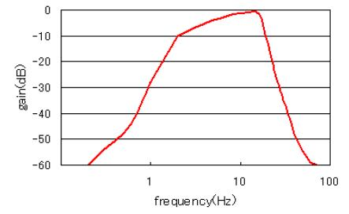
Filtering the signal to frequencies between 2-15 Hz

Slide 6
aEEG
Signal filtered
Notes:
6

Slide 7
aEEG
Signal rectified, smoothed
Notes:
7

Slide 8
aEEG
Signal compressed in time
Notes:
8

Slide 9
aEEG
Signal compressed in time
Notes:
9

Slide 10
aEEG
Signal compressed in time
Notes:
10

Slide 11
aEEG
Signal compressed in time
Notes:
11

Slide 12
aEEG
Signal compressed in time
Notes:
12

Slide 13
aEEG
Signal compressed in time
Notes:
13

Slide 14
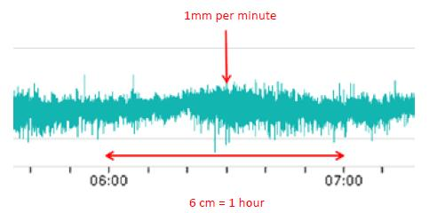
Time compression is standardized to one millimeter per minute and thus 6 cm per hour

Slide 15
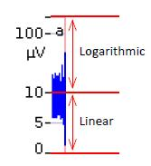
Semi-logarithmic display of amplitude
The amplitude of the signal is displayed semi-logarithmically, which means that the scale of amplitudes (measured in μV) initially runs from 1-10μV in a linear manner and from 10-100μV in a logarithmic manner.

Slide 16
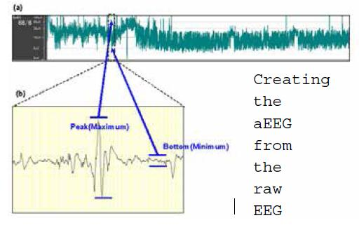

Slide 17
Visual interpretation of pattern recognition
Generally, aEEG tracing is visually interpreted by pattern recognition based on three basic variables:
  1. Continuity: density of traces; (the difference between the lower and upper margins of the trace). Wide trace indicates discontinuous trend with increased variability.
  2. Amplitude (in microvolts) of the lower (minimum) and upper (maximum) border of the band.
  3. Cycling (rhythmic periodic widening and narrowing of the trace),

Slide 18
aEEG classification
The background pattern was originally classified (only according to voltage amplitude) as:
  Normal (upper band more than 10 mV and lower band >5 mV),
  Moderately abnormal (upper band >10 mV and lower band <5 mV), or
  Suppressed (Severely abnormal) (upper band <10 mV and lower band <5 mV).
    Interobserver agreement was excellent for voltage amplitude and the use of this scheme accurately predicted neurodevelopmental outcome at 18 to 24 months.

Slide 19
aEEG classification
Pattern recognition as well as voltage criteria are used to describe aEEG results
  This method uses cEEG terminology (for example, burst suppression, isoelectric tracing, trace alternant).
  The background pattern is continuous, discontinuous, burst suppression, continuous low voltage or flat/ isoelectric.

Slide 20
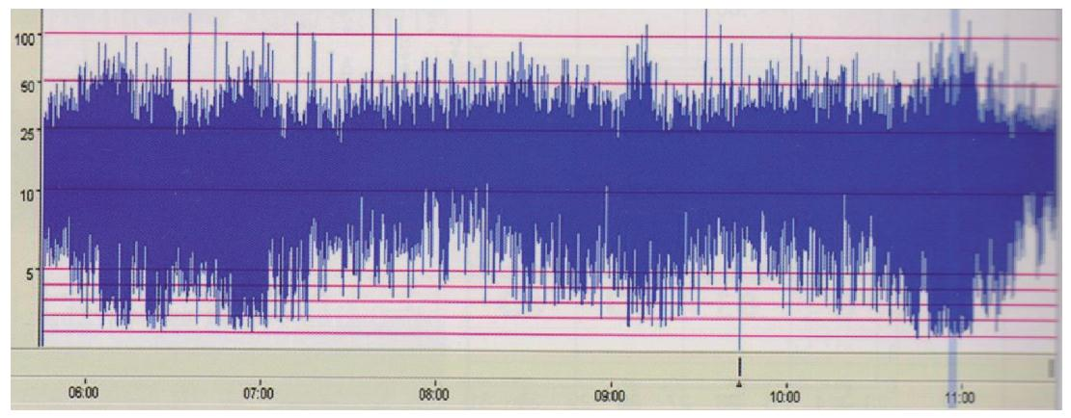
Continuous Normal Voltage (CNV) pattern
(seen in full-term infants)
Continuous activity with lower amplitude around 7 (5-10) μV, and maximum amplitudes 25(-50) μV

Slide 21
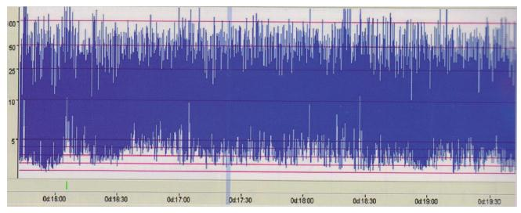
Discontinuous Pattern (DC)
Minimum amplitude variable, but mainly below 5 μV, and maximum amplitudes over 10 μV

Slide 22
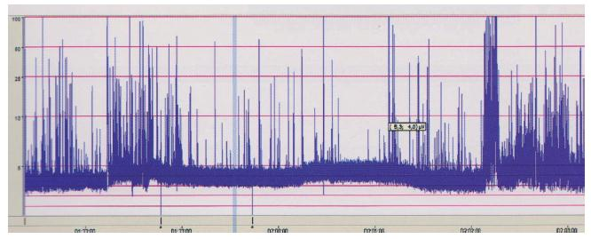
Flat Trace Pattern
(Continuous low voltage) (CLV) continuous activity of very low amplitude
(around or below 5 μV))

Slide 23
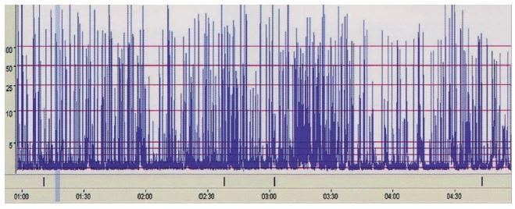
Burst suppression (BS)
Minimum amplitude without variability at 0-1 (2) μV, and bursts with amplitude 25 μV.
– BS+ denotes a BS background with dense burst ≥100 bursts/h
– BS- defines a BS background with sparse bursts, less than 100 bursts/h

Slide 24
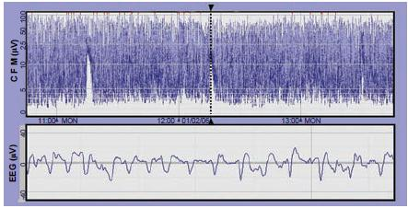
Two single seizures on a discontinuous background.
The seizures appear with a 1-h interAval; each one can be seen as a transient rise of the lower margin. The original EEG shows slightly irregular 2–3 Hz spike-wave complexes.

Slide 25
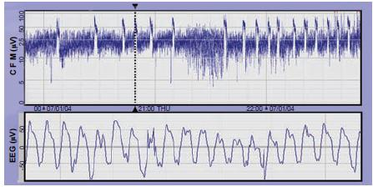
Repetitive seizures on a CNV background pattern.
All seizures are seen as transient rises of both the lower and upper margins of the aEEG. The corresponding EEG below shows rhythmic spike-wave complexes of 3 Hz.

Slide 26
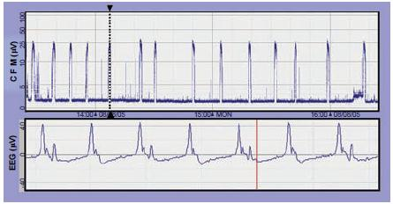
Repetitive seizures arising on an inactive (isoelectric) background
The EEG during the seizures shows slow (0.7 Hz) polyspike-wave complexes.

Slide 27
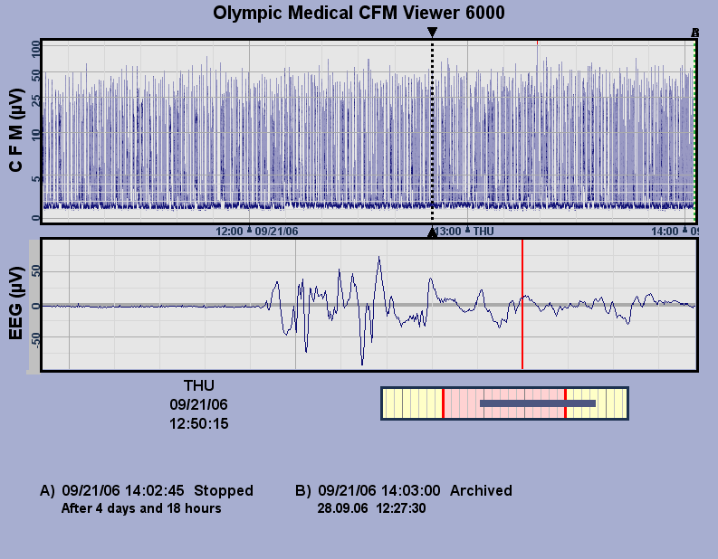
Severe suppression of CFM with high voltage bursts on EEG

Slide 28
aEEG & induced hypothermia
For neonates with suspected hypoxic ischaemic encephalopathy, aEEG can be a useful adjunct for assessing the degree of severity in selecting patients for therapeutic hypothermia, BUT it should not be used as the sole criteria.

Slide 29
aEEG & induced hypothermia-2
There are many neonates with abnormal aEEG background at 3–6 h that go onto have normal outcomes following hypothermia. Later aEEG (36–48 h) may be more predictive of neurodevelopmental outcome.
A normalised background by 48 h is predictive of good outcome in neonates receiving therapeutic hypothermia, whereas aEEG background never normalising is highly specific for a poor outcome.

Slide 30
