Slide 1
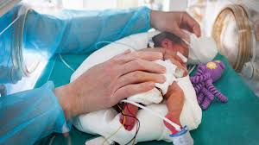
Evaluating effectiveness and risks of Probiotics in Preterm Infants Setareh Sagheb(MD) TUMS

Slide 2
The Challenge: NEC in Preterm Infants
NEC is the most prevalent gastrointestinal emergency in preterm infants, associated with significant mortality, intestinal failure, and neurodevelopmental disability.
Incidence Rate:5-7% of very preterm infants affected by necrotizing enterocolitis
23-51% death rate among infants who develop NEC
24to 61% neurodevelopmental disability.
Jones IH, Hall NJ. Contemporary outcomes for infants with necrotizing enterocolitis-a systematic review. J Pediatr. 2020;220:86–92.e3. PubMed doi: 10.1016/j.jpeds.2019.11.011

Slide 3
The FDA cautions that microorganisms contained in probiotics have been reported in the medical literature as causing bacteremia or fungemia, sometimes with a severe clinical course, in very preterm or very low birthweight (VLBW) infants. September 29, 2023
Moreover, the American Academy of Pediatrics states “Given the lack of FDA-regulated pharmaceutical-grade products in the United States, conflicting data on safety and efficacy, and potential for harm in a highly vulnerable population, current evidence does not support the routine, universal administration of probiotics to preterm infants, particularly those with a birth weight of <1000 g.”

Slide 4
WHAT’S KNOWN ON THIS SUBJECT
A meta-analysis summarizing 60 randomized trials suggested 46% reduction in NEC, 23% reduction in mortality, and 11% reduction in late-onset sepsis with probiotics in very preterm infants with low to moderate certainty.
These benefits were not observed in infants with a birth weight less than 1000 g. The associated risk, particularly probiotic sepsis, is not well established.
Sharif S, Meader N, Oddie SJ, Rojas-Reyes MX, McGuire W. Probiotics to prevent necrotising enterocolitis in very preterm or very low birth weight infants. Cochrane Database Syst Rev. 2023;7(7):CD005496. PubMed doi: 10.1002/14651858. CD005496.pub6

Slide 5
Because of the immaturity of the immune system in preterm infants, translocation of probiotic bacteria from the intestine into the bloodstream can lead to probiotic sepsis.
Whereas none of the trials included in systematic reviews, described probiotic sepsis, real-world data have reported cases of probiotic sepsis and mortality.
Kulkarni T, Majarikar S, Deshmukh M, et al. Probiotic sepsis in preterm neonates-a systematic review. Eur J Pediatr. 2022; 181(6):2249–2262. PubMed doi: 10.1007/s00431-022-04452-5

Slide 6
Study Overview (multicenter cohort study)
Research Scope
Key Focus
Population-based cohort study examining 32,667 infants born before 34 weeks' gestation across 33 Canadian Neonatal Network units from 2016-2022.
Al shaikh BN, Ting J, Lee S, et al. Effectiveness and Risks of Probiotics in Preterm Infants. Pediatrics. 2025;155 (3):e2024069102
Objective: Evaluate effectiveness and risks of probiotics in infants <34 weeks gestation and <1000g in preventing necrotizing enterocolitis (NEC), mortality, and late-onset sepsis—plus the rare but serious risk of probiotic sepsis.

Slide 7
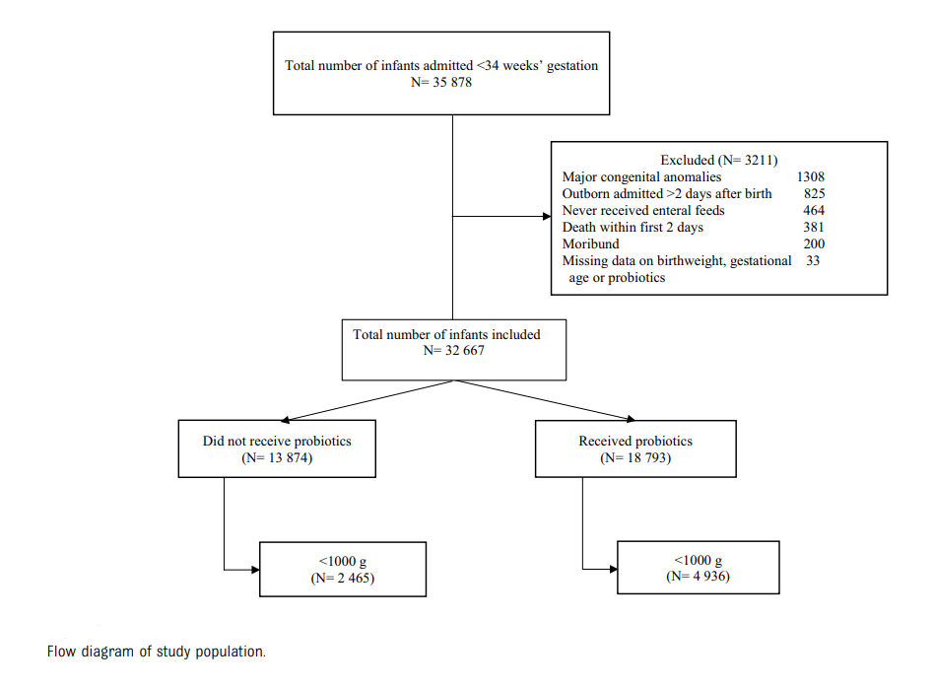

Slide 8
Probiotic Products Used
Multistrain probiotics (30 sites) (FloraBABY, RenewLife) containing
4 Bifidobacterium strains (Bifidobacterium breve,
Bifidobacterium bifidum, Bifidobacterium longum subsp,
and Bifidobacterium infantis) and Lactobacillus rhamnosus
Typical dose: 0.5g daily(1 sachet daily),
Continued until discharge or 34-35 weeks or transfer to level II units;
Al shaikh BN, Ting J, Lee S, et al. Effectiveness and Risks of Probiotics in Preterm Infants. Pediatrics. 2025;155 (3):e2024069102
Single-strain Probiotic (2 sites)
BioGaia (Sweden)
Lactobacillus reuteri
Typical dose: 5 drops daily
15 Unit protocols indicated that probiotics were administered mostly within 24 hours of enteral feed initiation, which in most cases occurred within the first 2 days after birth

Slide 9
NEC was classified as modified Bell stage 2 or higher.
Probiotic sepsis–related mortality referred to death within 7 days of probiotic sepsis with no other organisms isolated from blood culture and with an absence of other reasons identified as the primary cause for death.
Al shaikh BN, Ting J, Lee S, et al. Effectiveness and Risks of Probiotics in Preterm Infants. Pediatrics. 2025;155 (3):e2024069102

Slide 10
Outcomes
The primary outcomes were NEC, mortality, and late-onset sepsis.
Secondary outcomes included probiotic sepsis, NEC occurring after 7 days of age, and late mortality (>7 days of age).
They also evaluated the distribution of organisms attributed to late-onset sepsis to discern any change in the pattern of organisms. Additionally, they assessed these outcomes according to probiotic supplement type: multistrain and single-strain probiotics.

Slide 11
Study Population
Probiotic Group
Control Group
18,793 infants (57.5%)
Median gestational age: 29 weeks
Received probiotic supplements added to feeds
13,874 infants (42.5%)
Median gestational age: 31 weeks
Did not receive probiotics

Slide 12
Special focus on 7,401 extremely low birth weight (ELBW) infants weighing less than 1000g—the highest-risk group for complications.
Infants with a birth weight less than 1000 g represented 26.3% (7401) of the group with a GA less than 34 weeks who received probiotics, compared with 17.7% (4936 )of those who did not.

Slide 13
In this formula-recipient group, infants in the probiotic group were less mature than those who did not receive probiotics (30.6 ± 2.0 vs 31.8 ± 1.7 weeks’ GA).
Among the infants with a birth weight less than 1000 g, 567 (7.7%) received formula in the first 28 days of age, with comparable GA between the formula-recipient infants in the probiotics and nonprobiotics groups (26.6 ±2.2 vs 26.5 ± 2.2 weeks’ GA).

Slide 14
In the group with a birth weight less than 1000 g, all-cause death was lower among infants who received probiotics than those in the nonprobiotics group.
In the multivariable analysis, probiotics were associated with lower odds of mortality, mortality after 7 days, and the composite outcome of NEC or mortality in infants with a GA of less than 34 weeks and ELBW.
There were no associations between probiotics and NEC, surgical NEC, or NEC that occurred after 7 days of age.

Slide 15
Because probiotic uptake stabilized at approximately 60% in 2018, they conducted post hoc analyses of the primary outcomes, restricting the study period to 2018–2022 .
The results of the primary analyses were confirmed.
No statistically significant differences were observed for NEC or late-onset sepsis in infants weighing less than 1000 g or when other regression models were used.
Al shaikh BN, Ting J, Lee S, et al. Effectiveness and Risks of Probiotics in Preterm Infants. Pediatrics. 2025;155 (3):e2024069102

Slide 16
33 infants with isolation of probiotic organisms born before 34 weeks’ GA. Of them,Lactobacillus, Bifidobacterium, or both were isolated without any other organisms in 27 (1.4/1000) infants.
Among the 27 infants with probiotic sepsis only,3 had both Lactobacillus and Bifidobacterium isolated simultaneously.
Of note, 11 (41%) of these infants had NEC or spontaneous intestinal perforation 7 days before or after probiotic sepsis.
There were 24 infants with probiotic sepsis in the ELBW cohort. Of them, 20 (4.0/1000) had probiotic sepsis without other isolated microorganisms. Three of them had Lactobacillus and Bifidobacterium isolated.
Nine (45%) of them had NEC or intestinal perforation 7 days before and after probiotic sepsis. Among infants diagnosed with probiotic sepsis, 2 died within 7 days of probiotic sepsis

Slide 17
Discussion
Probiotics in their cohort were not associated with NEC but were associated with a decreased rate of death or NEC, and death within 7 days of NEC development, suggesting that a lower rate of NEC may have partially contributed to the reduction of all-cause mortality.
Infants who received probiotics in the cohort born before 34 weeks’ GA were of significantly lower GA than those who did not; thus, they were at higher risk of NEC, suggesting potential for residual confounding. Nonetheless, although the point estimates in adjusted models were statistically nonsignificant, they favored associations with probiotics.
The restriction of analysis to the years 2018–2022, during which practice uptake stabilized, indicated a potential association with reduced NEC and late-onset sepsis.
Al shaikh BN, Ting J, Lee S, et al. Effectiveness and Risks of Probiotics in Preterm Infants. Pediatrics. 2025;155 (3):e2024069102

Slide 18
Their study indicated that both the multistrain and singlestrain probiotic products used in Canadian NICUs exhibited similar associations.
Multistrain probiotics are shown in the literature to be more effective in preventing NEC and late-onset sepsis. Their findings on the single-strain probiotics were driven from 2 sites only, which limits our certainty.
Chi C, Li C, Buys N, Wang W, Yin C, Sun J. Effects of probiotics in preterm infants: a network meta-analysis. Pediatrics. 2021;147(1): e20200706. PubMed doi: 10.1542/peds.2020-0706

Slide 19
In their cohort, probiotic sepsis occurred in 1.4 and 4.0 per 1000 preterm infants born before 34 weeks’ GA and with ELBW, respectively. These rates, particularly for Bifidobacterium probiotic sepsis, were probably underestimated because of inconsistent collection of anaerobic blood cultures to retrieve Bifidobacterium species in Canadian NICUs.
Al shaikh BN, Ting J, Lee S, et al. Effectiveness and Risks of Probiotics in Preterm Infants. Pediatrics. 2025;155 (3):e2024069102

Slide 20
Probiotic supplementation was associated with a significant reduction in mortality (adjusted OR 0.62; 98.3% CI 0.53–0.73).
No significant decrease in NEC or late-onset sepsis rates was observed, although trends favored probiotics in certain subgroups.
Probiotic sepsis was rare—1.4 per 1000 in preterm and 4 per 1000 in ELBW infants—with 2 possible probiotic-related deaths reported.
Al shaikh BN, Ting J, Lee S, et al. Effectiveness and Risks of Probiotics in Preterm Infants. Pediatrics. 2025;155 (3):e2024069102

Slide 21

What are the key clinical takeaways from this study?
Probiotic supplementation in preterm infants was associated with reduced mortality but not lower NEC or sepsis rates. Probiotic sepsis was rare but warrants caution. Clinicians should select high-quality products, ensure strict infection monitoring, and continue research through randomized trials to confirm long-term safety and efficacy.

