Slide 1
Management of Hyperbilirubinemia in the Newborn Infant 35 or More Weeks of Gestation
Parvaneh Sadeghimoghadam
Tehran University of Medical Sciences

Slide 2
Prevention
The ACOG recommends that pregnant women be tested to determine their ABO blood group and Rh(D) type and an antibody screen test
If maternal AS positive or unknown: infant should have a direct antiglobulin test (DAT) and blood type
infant’s blood type should be determined as soon as possible using either cord or peripheral

Slide 3
Suboptimal intake hyperbilirubinemia
Breastfeeding fewer than 8 times per day has been associated with higher TSB concentrations
Low milk and low caloric intake contribute to decreased stool frequency and increased enterohepatic circulation of bilirubin

Slide 4
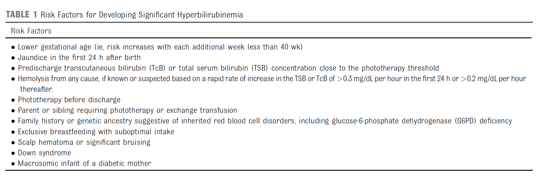
Identifying Risk Factors for
Hyperbilirubinemia

Slide 5
Assessment of jaundice in post natal nursery
All infants should be visually assessed for jaundice at least every 12 hours following delivery until discharge
TSB or TCB should be measured as soon as possible for infants noted to be jaundiced <24 hours after birth.

Slide 6
TSB should be measured if the TCB exceeds or is within 3 mg/dl of the phototherapy treatment threshold or if the TCB ≥ than 15 mg/dl.
A rapid rate of increase (0.3 mg/dl per hour in the first 24 hours or 0.2 mg/dl per hour thereafter) suggests hemolysis . In this case, perform a DAT if not previously done

Slide 7
There are clinical events that should raise suspicion about the presence of G6PD deficiency
Newborns who receive phototherapy before hospital discharge( probably because of both increased bilirubin production and decreased conjugation )
readmission and retreatment after initial hospital discharge
Severe hyperbilirubinemia or atypical development of hyperbilirubinemia such as elevated TSB in a formula-fed infant or late-onset jaundice
An infant with G6PD deficiency can develop a sudden and extreme increase in TSB that may be hard to anticipate or prevent
Even after what appears an acute hemolytic event, there may be there little or no laboratory evidence of hemolysis

Slide 8
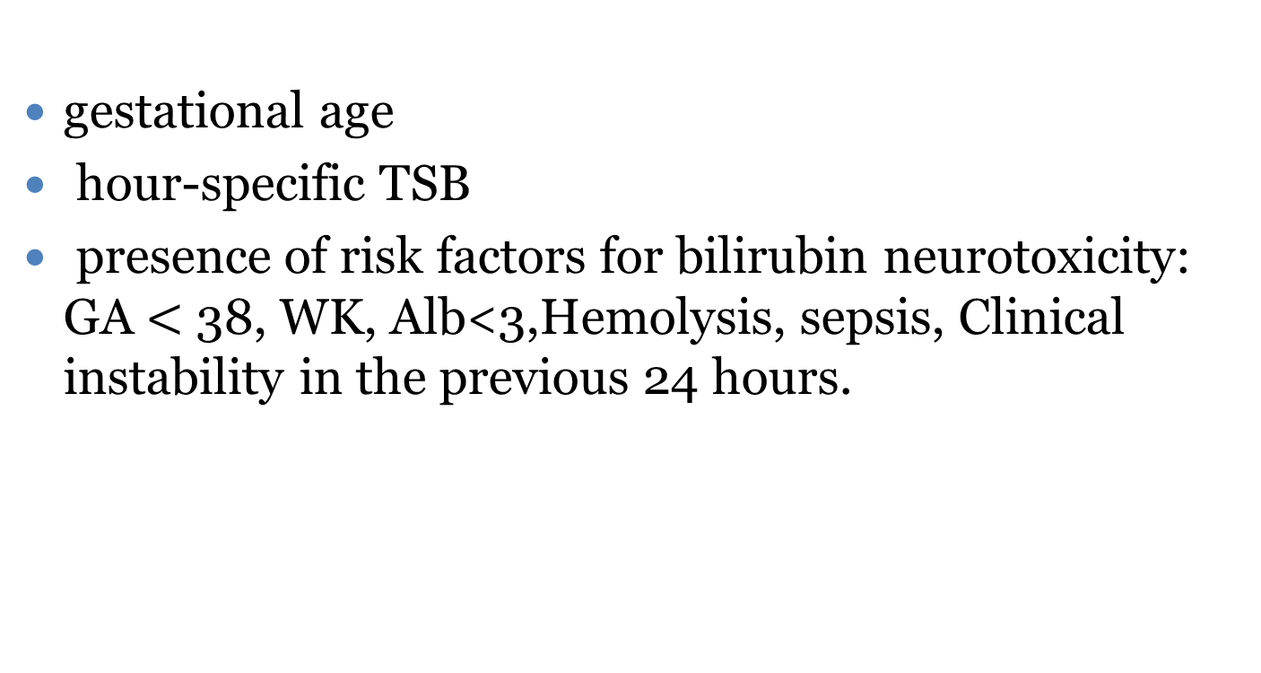
Decisions to initiate phototherapy or escalate care are guided by the
gestational age
hour-specific TSB
presence of risk factors for bilirubin neurotoxicity: GA $<$ 38, WK, Alb<3,Hemolysis, sepsis, Clinical instability in the previous 24 hours.

Slide 9
Infants with TSB concentrations below the phototherapy threshold
Among infants with TSB concentrations below the phototherapy threshold, the potential need for future phototherapy or escalation of care increases the closer the TSB is to the phototherapy threshold.

Slide 10
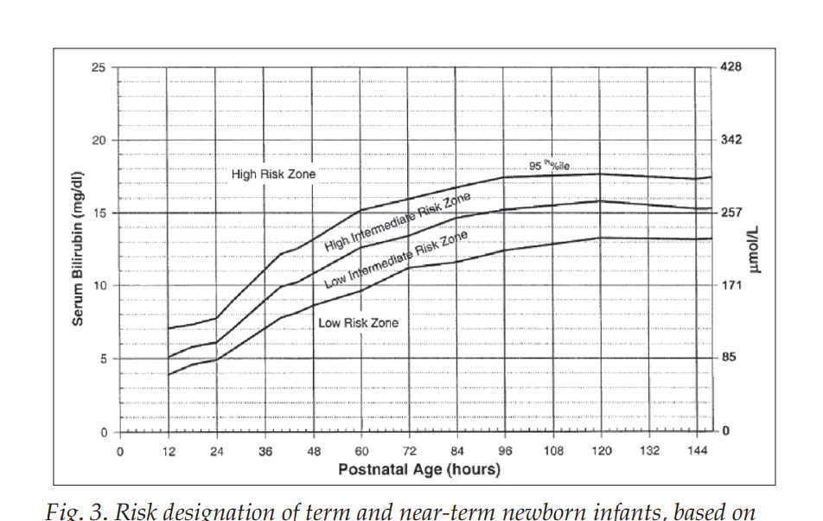

Slide 11
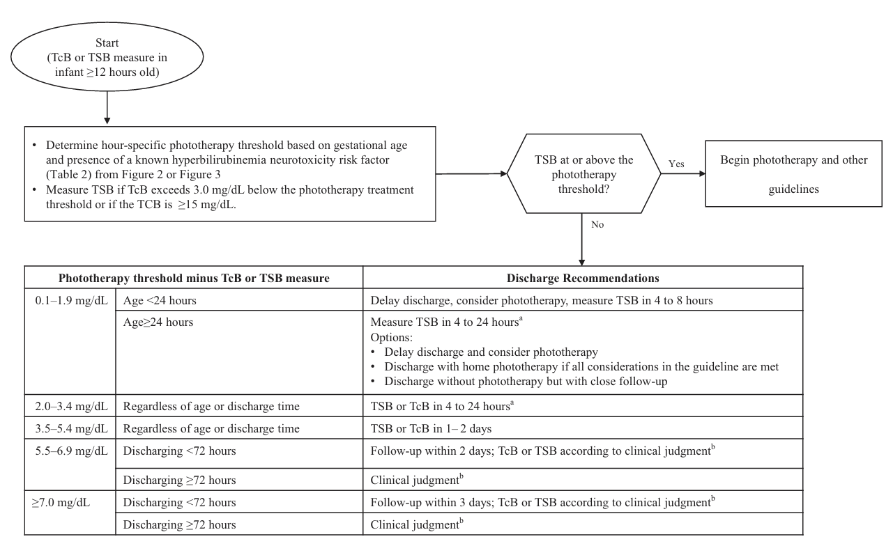

Slide 12
Evaluating elevated Direct-Reacting or Conjugated Bilirubin
For breastfed infants who are still jaundiced at 3 to 4 weeks of age, and for formula-fed infants who are still jaundiced at 2 weeks of age,
the total and direct reacting (or conjugated) bilirubin concentration should be measured to identify possible pathologic cholestasis.
When prolonged jaundice occurs :clinicians should also review the newborn screening results, because some conditions detected through newborn screening ( galactosemia , hypothyroidism, tyrosinemia ) can lead to persistent jaundice

Slide 13
Evaluating elevated Direct-Reacting or Conjugated Bilirubin
A direct serum bilirubin concentration >1.0 mg/dl has been used for conjugated bilirubin
Because the prevalence of biliary atresia is low, nearly all (> 99%) infants who have a single elevation of the direct bilirubin concentration do not have biliary atresia
A repeat measurement within a few days to 2 weeks

Slide 14
TREATMENT OF
HYPERBILIRUBINEMIA
Recommended phototherapy thresholds are far below those at which overt acute bilirubin neurotoxicity or kernicterus occurs and there is some evidence that phototherapy may lead to a small increase in the risk of subsequent childhood epilepsy The committee determined that new evidence that bilirubin neurotoxicity does not occur until concentrations well above the 2004 exchange transfusion thresholds justified raising the phototherapy treatment thresholds by a narrow range

Slide 15
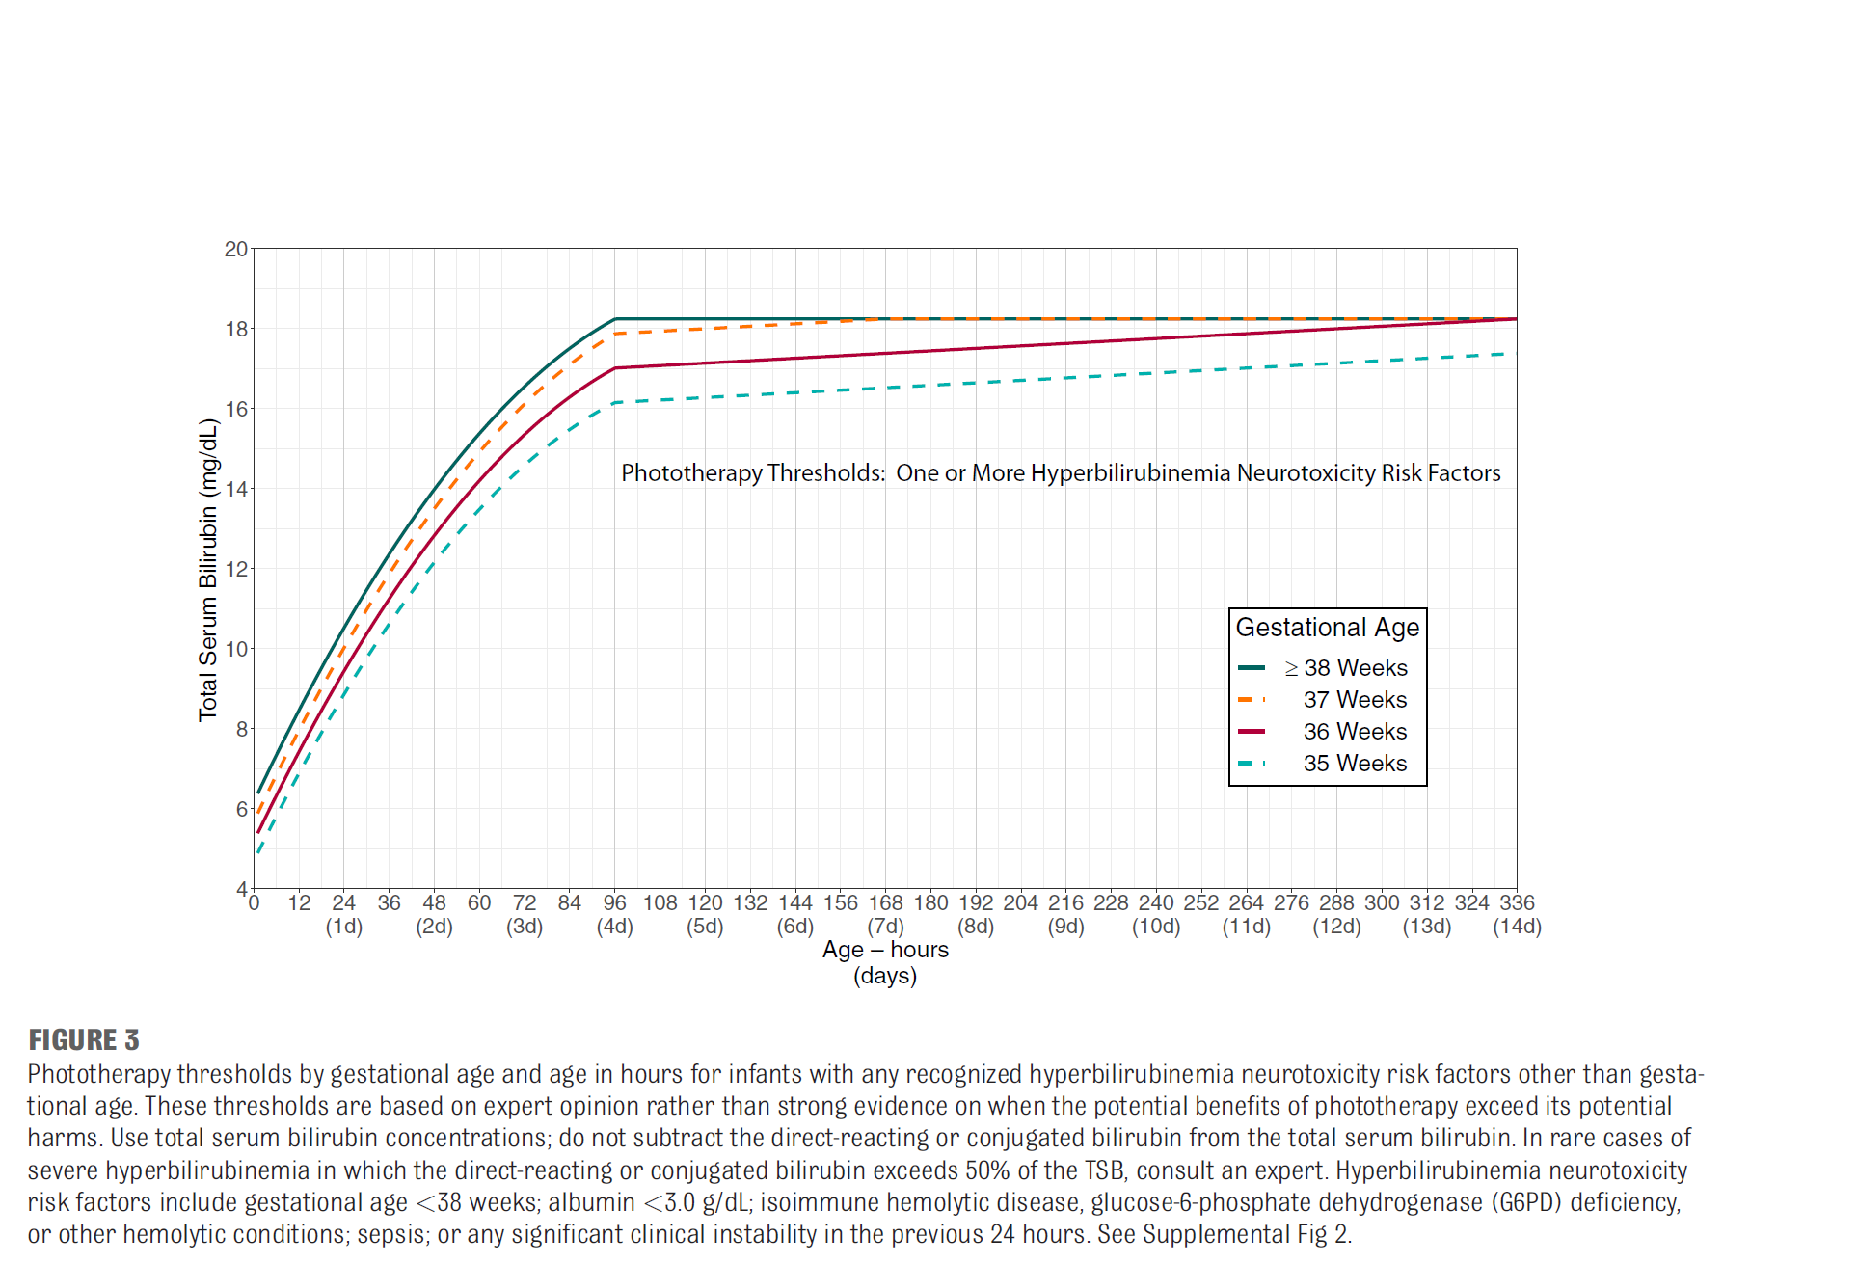
PHOTOTHREPY CURVE

Slide 16
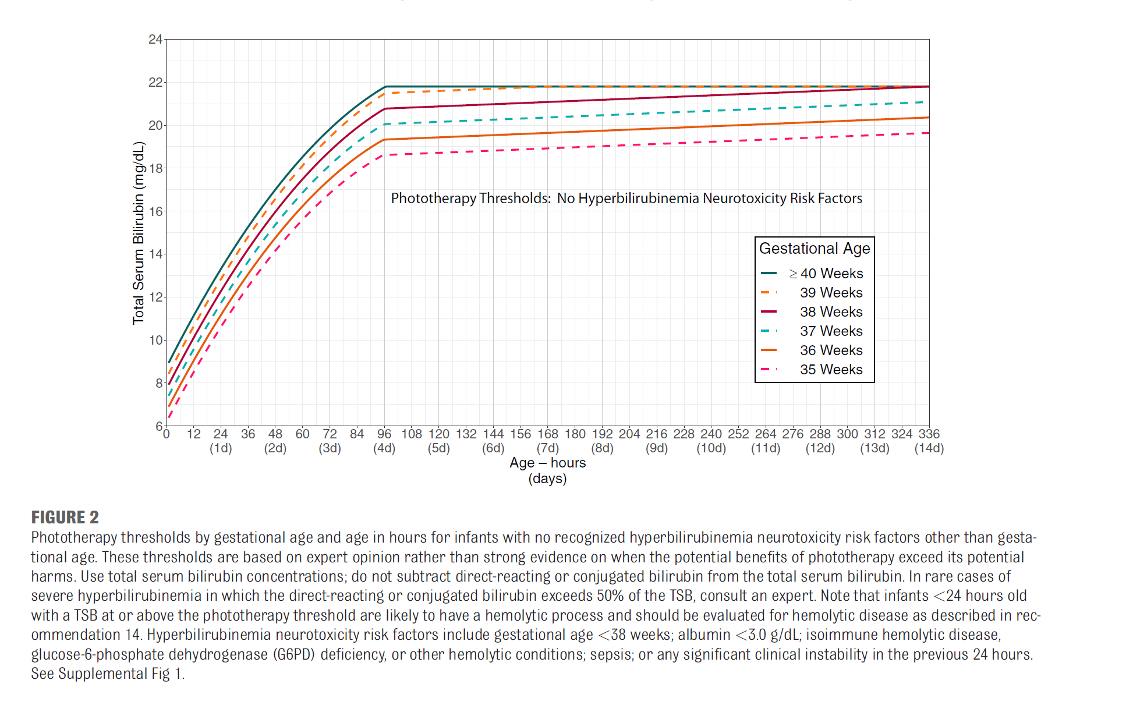

Slide 17
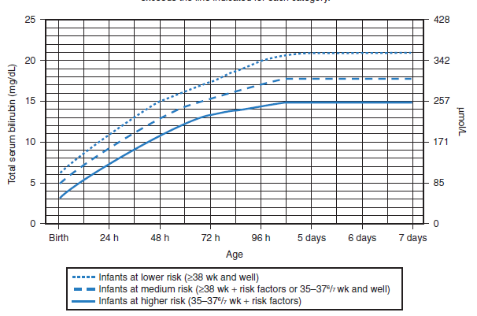
درمان
فوتوتراپی
شروع فوتوتراپی در نوزادان 35 هفته و بالاترGA بر اساس منحنی زیر:
Notes:
تا وقتی ندانیم عازضه چقدر تاثیز می ذاره نمی تونیم بفهمیم که چه تعداد ارزش درمان دارند.
Nnt خیلی متغیر
از 6-10 تا 3000 متغیر
در نوزاد بیش از 38 هفته بالای 48-72 ساعت می توان کارهای دیگری کرد که بیش از فوتو بیارزد

Slide 18
Home phototherapy
For newborn infants who have already been discharged and then develop a TSB above the phototherapy threshold, treatment with a home LED-based phototherapy device rather than readmission to the hospital is an option for infants who meet the following criteria
Gestational age ≥38 weeks
≥48 hours old
Clinically well with adequate feeding
No known hyperbilirubinemia neurotoxicity risk factors
No previous phototherapy
TSB concentration no more than 1 mg/dl above the phototherapy treatment threshold
An LED-based phototherapy device will be available in the home
without delay
TSB can be measured daily

Slide 19
Home phototherapy
Home phototherapy should not be used if there is any question about the quality of the home phototherapy device
the ability to have the device delivered to the home rapidly, concerns about the family’s ability to use the device, or concerns about the ability to measure bilirubin concentrations daily
As with inpatient phototherapy, it is an option to start home phototherapy at a lower threshold (eg, 2 mg/dL below the phototherapy threshold) to reduce the readmission risk

Slide 20
Escalation of care
The escalation-of-care threshold is 2 mg/dl below the exchange transfusion threshold
refers to the intensive care that some infants with elevated or rapidly increasing bilirubin concentrations need to prevent the need for an exchange transfusion and possibly prevent kernicterus

Slide 21
Escalation of care
For infants requiring escalation of care, blood should be sent for total and direct reacting serum bilirubin, a complete blood count, serum albumin, serum chemistries, and type and crossmatch.
Infants requiring escalation of care should receive intravenous hydration and emergent intensive phototherapy. A neonatologist should be consulted about urgent transfer to a NICU that can perform an exchange transfusion

Slide 22
IVIG
Intravenous immune globulin (IVIG; 0.5 to 1 g/kg) over 2 hours may be provided to infants with isoimmune hemolytic disease (ie, positive DAT) whose TSB reaches or exceeds escalation of care threshold. The dose can be repeated in 12 hours

Slide 23
The effectiveness of IVIG to prevent the need for an exchange transfusion is unclear. Observational studies suggest an association between IVIG and necrotizing enterocolitis.
A detailed review of the potential benefits and harms is provided in the technical report. Factors that should be
considered include response to phototherapy, TSB rate of increase, and the challenge of providing a timely
exchange transfusion. All aspects of the escalation-of-care guidelines should continue to be followed if IVIG is used.

Slide 24
نوراد ۳۸هفته وزن۴۰۰ ۳کیلوگرم با زردی روز اول در ساعت ۶ تولد۸|۸بستری سد و زیر فوتو اینتنسیو رفت ۸ساعت بعو به۱۰ رسید مجددا ۶ساعت بعد به ۱۰/۵ رسید و با تشخیص شکست فوتو ivig گرفت و ۸یساعت بعد بیلی به۹/۸ رسید سپس حدود۶ساعت بعد به۶ /۹ (۳۶ ساعته) و ۵ظهر حدود ۴۸ساعته به ۱۱/۲ رسیده ABO set up- retic"6|5 hb:12/8

Slide 25
درمان
فوتوتراپی
شروع فوتوتراپی در نوزادان 35 هفته و بالاترGA بر اساس منحنی زیر:
Notes:
تا وقتی ندانیم عازضه چقدر تاثیز می ذاره نمی تونیم بفهمیم که چه تعداد ارزش درمان دارند.
Nnt خیلی متغیر
از 6-10 تا 3000 متغیر
در نوزاد بیش از 38 هفته بالای 48-72 ساعت می توان کارهای دیگری کرد که بیش از فوتو بیارزد

Slide 26
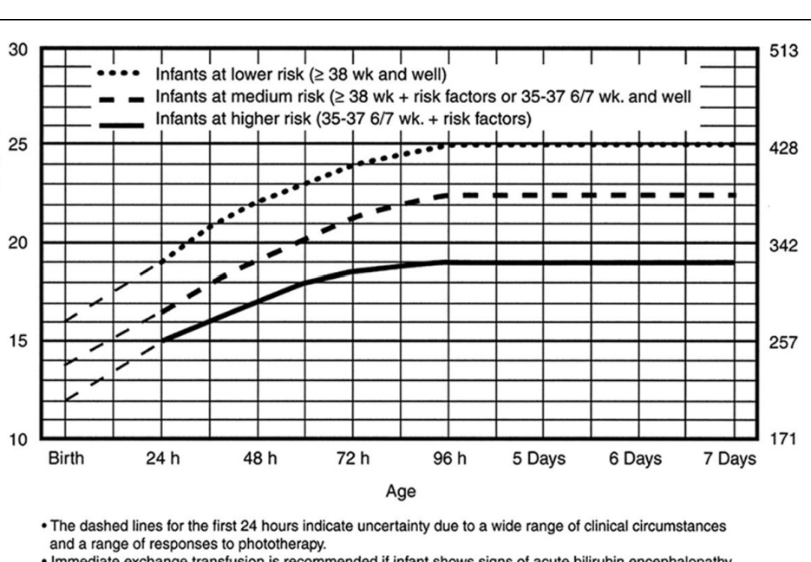

Slide 27
سپاس از شما پزشکان و پرستاران نوزادان
که با دل هایی پرمهر و دستانی توانمند
به آغاز نفس های کوچک،روشنای امید و آرامش می بخشید

