Slide 1
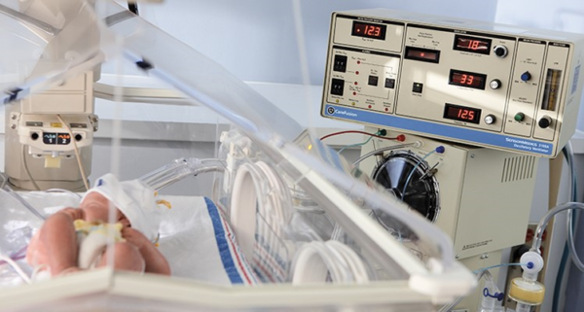
Update On Nasal High Frequency Oscillatory Ventilation (NHFOV)
Dr Naeeme Taslimi Taleghani
Associate Professor of Neonatology
SBMU

Slide 2
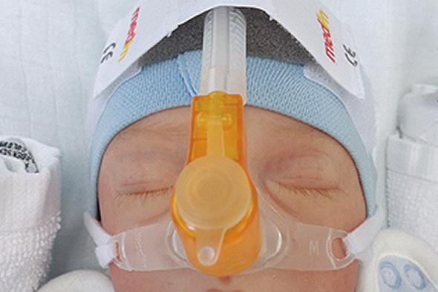
“a non-conventional ventilatory technique with supra physiologic frequencies applied through an external non-invasive interface”
High-frequency Oscillatory Ventilation (HFOV)
High-frequency Flow Interrupters (Hffis)
High-frequency Jet Ventilators(hfjvs)
Also known as high-frequency percussive ventilation (HFPV)
De Luca D, Centorrino R. Nasal high-frequency ventilation. Clin Perinatol. 2021;48 (4):761–782.
Notes:
روشی از تهویه مکانیکی است که در دهه ۱۹۷۰ معرفی شد و مشخصه آن حجم‌های کم و سریع تنفسی بسیار بالا (بین ۲.۵ تا ۲۰ هرتز یا ۱۵۰ تا ۱۲۰۰ بار در دقیقه) است.

Slide 3
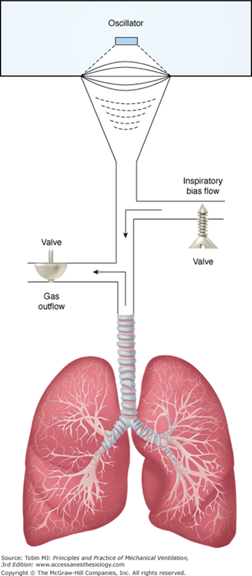
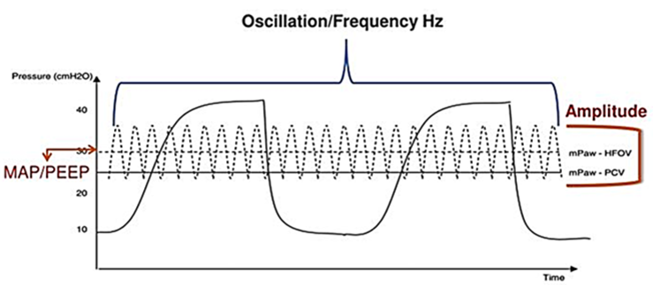
HFOV :
Oscillatory pressure amplitude (∆P)
Around the mean airway pressure (paw)
High-lung volume
Over the functional residual capacity
TVs smaller than the dead space (VThf)
2.4 ml/kg(range 1.0–3.6)
Supraphysiologic frequencies (fr)
3 hz and 20 hz (180–1200 cycles/min)
Active exhalation
Unlike HFJV and HFFI
Sánchez-Luna M, González-Pacheco N, Santos-González M, Tendillo-Cortijo F. High-frequency ventilation. Clinics in Perinatology. 2021 Dec 1;48(4):855-68.

Slide 4
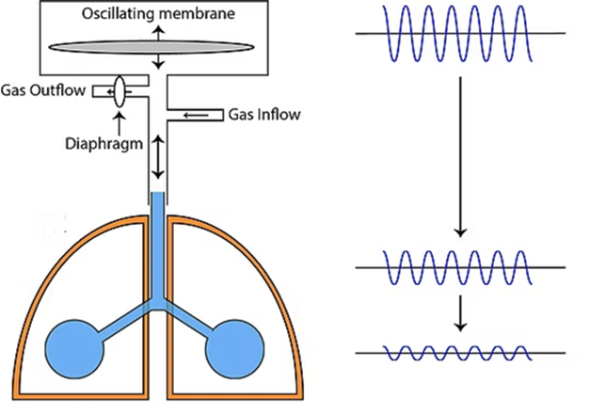
Gas Transport
The volume of gas delivered into or out of the lung becomes a function of flow rate and time.
High frequency
Ventilator Rates Increase
Inspiratory And Expiratory Times Decrease
Inadequate Time For Proximal And Distal Airway Pressures To Equilibrate
Gas Flow Is Continuous
Conditions Are No Longer Static
They Are Dynamic
Convection ( predominantly in the larger airways)
Diffusion (smaller airways and alveoli)
Turbulent flow (the large airways)
Bidirectional flow (asymmetric inspiratory and expiratory velocity profiles leading to bidirectional flow to and from the alveoli)
Pendelluft (asynchronous flow among alveoli due to asymmetries in gas impedance)
Taylor dispersion (radial diffusion associated with laminar flow)
Collateral ventilation between neighbouring alveoli through non-airway connections.

Slide 5
Gas Exchange during NHFOV
A- Oscillatory Pressure Amplitude
pressure leak
Set parameters
Type of device used to produce them
Patient position
Pronation:
Likely improves gas exchange through a better ventilation/perfusion matching
B- Spontaneous tidal volume
C- Structure stiffness
stiffer circuits and airways provide a better oscillation transmission
D- Interfaces
Pressure leaks
Generally, Reduce Gas Exchange Through A Decreased Pressure Transmission
Dampening of oscillations
Patient comfort
Mechanical Factors
De Luca D, Neri C, Centorrino R. Update on nasal high frequency oscillatory ventilation: a living review. InSeminars in Perinatology 2025 Feb 26 (p. 152056). WB Saunders.
Shi B, Yang J, Rudd C. On vibration transmission in oscillating systems incorporating bilinear stiffness and damping elements. Int J Mech Sci. 2019;150: 458–470.
van Genderingen HR, Versprille A, Leenhoven T, Markhorst DG, van Vught AJ, Heethaar RM. Reduction of oscillatory pressure along the endotracheal tube is indicative for maximal respiratory compliance during high-frequency oscillatory ventilation: a mathematical model study. Pediatr Pulmonol. 2001

Slide 6

Interfaces for NHFOV
Clinical studies :
Mainly about CPAP or conventional non- invasive ventilation
Effectiveness (Good Gas Exchange)
Suitability (Easiness Of Use)
Comfort (Risk Of Skin Injury)
It is evident that there is no “one-fits-all” interface:
Severity of respiratory failure
Underlying diseases
Patient comfort
Ventilator parameters
Integrity of skin
The serial change policy of interfaces :
Reduce the risk of skin injury in preterm infants
An increased patient comfort (consistent with adult data )
Fong SYVL. Strategy of interface rotation to reduce nasal trauma in preterm neonates under non-invasive ventilation. J Neonatal Nurs. 2024;30(3):205–213.
Cammarota G, Simonte R, De Robertis E. Comfort during non-invasive ventilation. Front Med. 2022;9

Slide 7
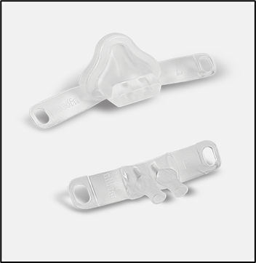
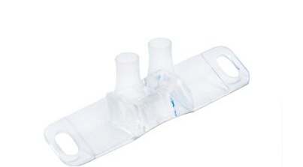
Nasal masks
Several meta-analyses:
Superior to short bi nasal prongs
less leaks compared to short prongs
Moderate Leaks Have Been Demonstrated To Increase CO2 Clearance
The use of softer materials
The larger contact surface
Increasing patient comfort
Reducing skin injury
Dampen The Oscillations
More aggressive NHFOV parameter to provide the same oscillation transmission of short binasal prongs
Short binasal prongs
A greater diameter of binasal prongs is associated with better ventilation
https://www.zealmedical.com/nasal-masks-and-binasal-prongs.php
Prakash R, De Paoli AG, Oddie SJ, Davis PG, McGuire W. Masks versus prongs as interfaces for nasal continuous positive airway pressure in preterm infants. Cochrane Database Syst Rev. 2022;11(11), CD015129
Razak A, Patel W. Nasal mask vs binasal prongs for nasal continuous positive airway pressure in preterm infants: a systematic review and meta-analysis. Pediatr Pulmonol. 2020;55(9):2261–2271
Centorrino R, Dell’Orto V, Gitto E, Conti G, Luca D. Mechanics of nasal maskdelivered HFOV in neonates: a physiologic study. Pediatr Pulmonol. 2019;54(8): 1304–1310. https://doi.org/10.1002/ppul.2435

Slide 8
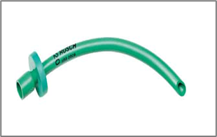
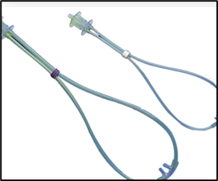
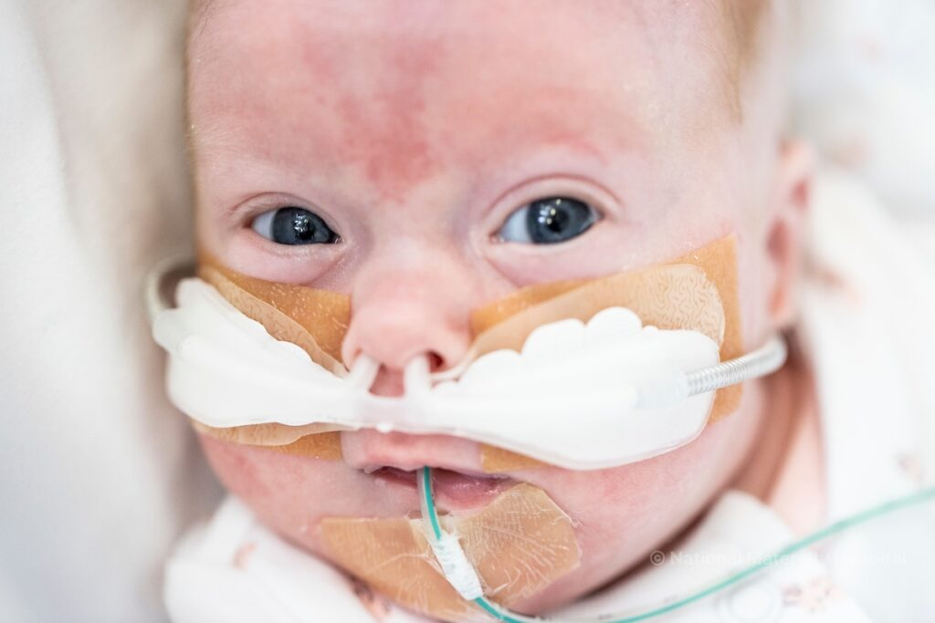

RAM Cannula
NHFOV has been anecdotally delivered by RAM Cannula:
Very soft material
Easily connected to almost any ventilator tubing
Particularly comfortable and suitable
High resistance and increase the WOB (in extremely low birth weight neonates)
RAM Cannula in infants with BPD at risk of reintubation is discouraged.
Relevant leaks(this can be effectively reduced by using larger sizes)
Respiratory failure if nostrils are not occluded for at least ≈80%
Naso-pharyngeal tubes
Single, long, high-resistive naso-pharyngeal tubes should never be used.
Large leaks
Relevant resistive
Worsening the patient WOB
Decreasing the respiratory support effectiveness
https://nmhnicu.ie/reference-information/immunisation-schedule-for-babies

Slide 9
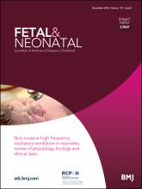


Evidence-based review of clinical data on NHFOV
2016 :
First time for review the clinical data on NHFOV
Consisted of uncontrolled studies only
De Luca D, Dell’Orto V. Non-invasive high-frequency oscillatory ventilation in neonates: review of physiology, biology and clinical data. Arch Dis Child Fetal Neonatal Ed. 2016;101(6):F565–F570
2021
Since 2017 randomized controlled trials on NHFOV started to appear, mainly with parallel designs
De Luca D, Centorrino R. Nasal high-frequency ventilation. Clin Perinatol. 2021;48 (4):761–782. https://doi.org/10.1016/j.clp.2021.07.006.
2025 :
Several new trials have been completed.
Update systematic review of randomized controlled trials
De Luca D, Neri C, Centorrino R. Update on nasal high frequency oscillatory ventilation: a living review. InSeminars in Perinatology 2025 Feb 26 (p. 152056). WB Saunders.
Cross-over Trials
Not free from biases
Only few of them focused on physiological outcomes
Several trials investigated the role of NHFOV on “hard” outcomes.

Slide 10
NHFOV is superior to CPAP in terms of :
Clinical stability (e.G.: Apneas, desaturation and bradycardia)
Lung aeration
CO2 elimination
NHFOV is equivalent to NIPPV in terms of CO2 elimination& hypoxemia
Consistently the largest multicenter trial on NHFOV as primary support showed that it was not superior to CPAP
NHFOV may theoretically be applied with any techniques & ventilator equipped with the HFOV mode
Noise produced by ventilator that often goes beyond safety levels !
Uncertain hemodynamic effects in longtime use of high paw for preterm
Clinical studies :
Demonstrated the basic safety of NHFOV
Not negatively affected by NHFOV :left ventricular output, ejection fraction
7) High paw (such as for instance during high level CPAP) might increase the risk of gas trapping-induced CO2 retention
Clinical studies :
More effective for CO2 removal in newborn:
Transmission is easier when the airway is short and wide without reduction in the airway diameter
Gaertner VD, Waldmann AD, Davis PG, et al. Lung volume distribution in preterm infants on non-invasive high-frequency ventilation. Arch Dis Child Fetal Neonatal Ed. 2022;107(5):551–557
Bergez L, Jourdain G, Ayachi A, De Luca D. Noise produced by various respiratory support techniques during neonatal transportation: simulation study. Respir Care. 2024;69(9):1161–1164
De Luca D, Neri C, Centorrino R. Update on nasal high frequency oscillatory ventilation: a living review. In seminars in Perinatology 2025 Fe 26 (p. 152056). WB Saunders.

Slide 11
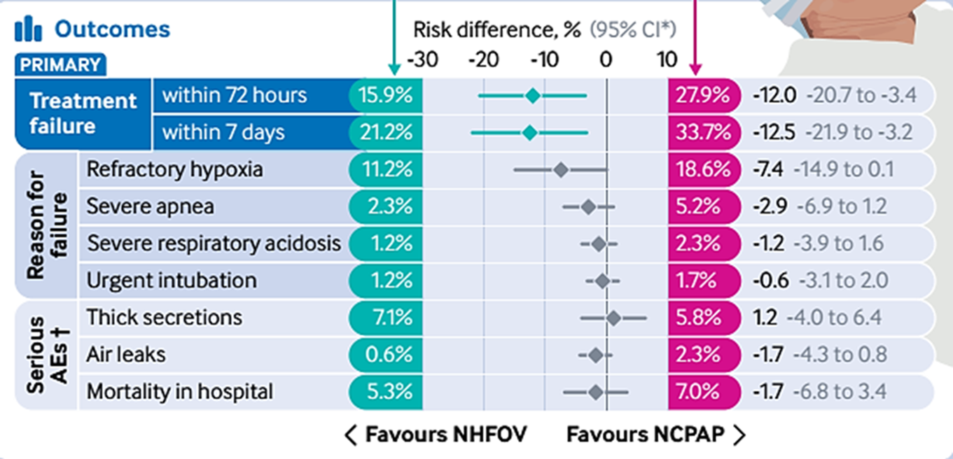

NHFOV for primary respiratory support in extremely preterm infants: multicenter RCT
Future research steps
NHFOV significantly reduced the need for invasive mechanical ventilation within 72 hours and within seven days birth compared with NCPAP when applied as the primary approach to Respiratory Distress Syndrome in extremely preterm infants.
Both respiratory support techniques were equally safe
Li Y, Zhu X, Li LJ, Chen L, Yang Q, Xu L, Liang W, Lin X, Li C, Xue J, Liu L. Non-invasive high frequency oscillatory ventilation for primary respiratory support in extremely preterm infants: multicentre randomised controlled trial. bmj. 2025 Oct 6;391

Slide 12

naeemetaslimi@yahoo.com
naeemetaslimi@gmail.com
naeemetaslimi@sbmu.ac.ir

