Slide 1








Dr.Khs Najib
Associate professor of neonatology
Shiraz University Of Medical sciences, Shiraz,Iran
1404/08/29

Slide 2






Neonatal Seizures:
Etiology & Evaluation

Slide 3




CONTENT
1
Epidemiology & Etiology
2
Spotting the Event
3
Sorting Real from Fake
Clinical Diagnosis
4
5
EEG Monitoring
6
Diagnostic Work-up
7
Quality & Summary
88
8
References

Slide 4




01
PART
Epidemiology & Etiology

Slide 5


Incidence and Risk Factors
Maternal Risk Factors
Maternal risk factors include advanced age, lack of prenatal care, diabetes, and nulliparity. These factors contribute to a higher likelihood of neonatal seizures.
Incidence
Neonatal seizures occur in 1–5 per 1,000 live births, with 60–80% being subclinical. This high rate of subclinical seizures underscores the need for vigilant monitoring.
Intrapartum and Infant Risk Factors
Intrapartum risks include fetal distress, placental abruption, and chorioamnionitis. Infant risks are prematurity, low birth weight, male sex, and post-term birth.

Slide 6
Why Neonatal Seizures Matter
Targeted Treatment
Identifying the cause of seizures allows for targeted treatment, such as therapeutic hypothermia for hypoxic-ischemic encephalopathy, improving survival and reducing morbidity.
Impact on Development
Each hour of untreated seizure activity increases the risk of later epilepsy and neuro-disability. Rapid diagnosis and treatment are essential to mitigate long-term effects.
Long-Term Outcomes
Effective management of neonatal seizures can significantly improve long-term neurological outcomes, reducing the incidence of epilepsy and developmental delays in survivors.

Slide 7


Principal Causes Overview
Acute Symptomatic Seizures
Approximately 80% of neonatal seizures are acute symptomatic, often due to underlying brain injuries like hypoxic-ischemic encephalopathy (HIE), stroke, infection, or metabolic derangements.
Neonatal-Onset Epilepsy
About 13% of neonatal seizures are due to chronic conditions like brain malformations or genetic syndromes, classified as neonatal-onset epilepsy.

Slide 8
02
PART
Spotting the Event

Slide 9






Clinical Hallmarks in Newborn
Myoclonic Seizures
Focal Clonic Seizures
Myoclonic seizures in neonates present as rapid, brief muscle contractions that can be focal, generalized, or fragmentary. These seizures may or may not have an EEG correlate, depending on the origin of the discharge.
Focal clonic seizures in neonates are characterized by rhythmic, repetitive jerking of specific muscle groups, often confined to one limb, the face, or the trunk. These seizures are closely correlated with EEG patterns and cannot be suppressed by restraint.
Focal Tonic Seizures
Epileptic Spasms
Focal tonic seizures involve sustained, asymmetrical posturing of the trunk or extremities, or tonic deviation of the eyes. These seizures are typically associated with focal EEG abnormalities and may indicate underlying brain pathology.
Epileptic spasms are rare in neonates but involve sudden, brief contractions of the trunk and limbs. These spasms often occur in clusters and are associated with significant EEG changes, indicating a more severe underlying condition.

Slide 10




Electrographic-Only Reality
A significant proportion of neonatal seizures are electrographic-only, meaning they have no overt clinical manifestations. These seizures are detected only through EEG monitoring and highlight the importance of continuous EEG in neonatal intensive care units.
Electrographic-Only Seizures

Slide 11

Sequential & Autonomic Signs
Sequential Seizures
Sequential seizures involve a series of different clinical signs occurring within a single seizure event, such as tonic movements followed by clonic jerking. This pattern may suggest a genetic etiology and requires detailed EEG monitoring for accurate diagnosis.
Clinical Implications
Recognizing sequential and autonomic signs in neonatal seizures is crucial for accurate diagnosis and appropriate management. Continuous EEG monitoring is essential to capture these subtle events and guide therapeutic decisions.
Autonomic Signs
Autonomic signs like changes in heart rate, blood pressure, and respiration can occur during seizures but are rarely the sole manifestation. These signs are more commonly associated with other clinical motor phenomena and should prompt further investigation.

Slide 12
03
PART
Sorting Real from Fake

Slide 13







Jitteriness vs. Clonic Seizure
Jitteriness
Jitteriness in neonates is characterized by fine, rapid tremors that can be stopped by gentle restraint or repositioning. It is often stimulus-provoked and lacks an EEG correlate, distinguishing it from true clonic seizures.
Clonic Seizures
True clonic seizures involve rhythmic, repetitive jerking that persists despite restraint and has a consistent temporal relationship with EEG seizure activity. Recognizing this distinction is crucial for accurate diagnosis and appropriate treatment.

Slide 14
Motor Automatisms Explained
Clinical Differentiation
Motor automatisms can be suppressed by gentle restraint or repositioning and usually lack an EEG seizure pattern. Distinguishing these from true seizures helps avoid unnecessary antiseizure medication.
Nature of Motor Automatisms
Motor automatisms in neonates include rhythmic sucking, rowing, swimming, or pedalling movements. These are typically brainstem release phenomena in the context of forebrain depression and are often provoked by stimulation.
Importance of EEG
EEG monitoring is essential to confirm the absence of seizure activity in neonates with motor automatisms, ensuring accurate diagnosis and preventing overtreatment.

Slide 15







Benign Myoclonus of Sleep
Characteristics of Benign Myoclonus
Benign myoclonus of sleep occurs exclusively during active or quiet sleep in otherwise healthy neonates. These fragmentary, distal twitches stop immediately upon awakening, distinguishing them from pathologic myoclonic seizures.

Slide 16
04
PART
Clinical Diagnosis

Slide 17

Subtle and Misleading Signs
Clinical Challenges
Reliable Clinical Marker
Most neonatal seizures lack overt signs, making them difficult to detect clinically. Subtle signs like automatisms, autonomic changes, or behavioral arrest are often missed.
Focal clonic limb activity is the most reliable clinical sign of neonatal seizures. However, clinical observation alone is insufficient for accurate diagnosis.

Slide 18
05
PART
EEG Monitoring

Slide 19

Clinical Misdiagnosis
Trained NICU staff detect fewer than 10% of confirmed electrographic seizures, while 78% of documented non-ictal events lack EEG correlates. This highlights the limitations of bedside clinical observation in diagnosing neonatal seizures.
Why Bedside Guess Fails
Consequences of Misdiagnosis
Role of EEG
Inaccurate diagnosis leads to undertreatment of silent seizures and unnecessary medication exposure for non-ictal events. Continuous EEG monitoring is essential to bridge this diagnostic gap.
EEG is the gold standard for diagnosing neonatal seizures, providing accurate detection and characterization of seizure activity that is often missed by clinical observation alone.

Slide 20

cEEG: Gold Standard
Continuous EEG
Continuous conventional video EEG (cEEG) for at least 24 hours is the gold standard for diagnosing neonatal seizures, capturing subclinical events and quantifying seizure burden.
Electrode Montage
A minimum of 10 electrodes in a standardized neonatal montage, combined with video and ancillary channels, ensures accurate interpretation and artifact rejection.
Clinical Guidance
cEEG guides treatment by confirming seizures, classifying them, assessing seizure burden, and evaluating response to therapy.

Slide 21




aEEG Utility & Limits
Amplitude-Integrated EEG
Amplitude-integrated EEG (aEEG) is a bedside-friendly alternative to cEEG but has lower sensitivity, detecting fewer than 50% of seizures.
Clinical Application
Use aEEG when cEEG is unavailable, but upgrade to cEEG if suspicious patterns are detected to confirm seizure activity.

Slide 22
06
PART
Diagnostic Work-up

Slide 23





Targeted Laboratory Screen
Additional Considerations
Immediate Tests
Consider lumbar puncture, ammonia levels, TORCH infections, metabolic screening, and toxicology tests based on clinical suspicion.
Initial laboratory tests include glucose, electrolytes, calcium, magnesium, arterial blood gas, and sepsis screening to identify reversible causes of seizures.

Slide 24


1
Indications for LP
2
CSF Analysis
Lumbar Puncture Timing
Perform lumbar puncture when infection is suspected or seizures persist without a clear cause. Negative blood cultures do not exclude meningitis, making LP crucial for accurate diagnosis.
CSF analysis for cell counts, lactate, glucose, total protein, amino acids, and neurotransmitter profiling can reveal metabolic or infectious etiologies missed by imaging.
3
Clinical Relevance
4
Technical Considerations
Accurate identification of infectious or metabolic causes through LP guides targeted therapy, improving outcomes and reducing long-term complications.
LP requires skilled technique and appropriate timing to ensure accurate results. It is a valuable tool in the diagnostic workup of neonatal seizures.

Slide 25
Metabolic Second Tier
Refractory Seizures
Refractory seizures despite correction of hypoglycemia or hypocalcemia warrant advanced metabolic testing, including CSF amino acids, urine organic acids, plasma acyl-carnitine, biotinidase, and pyridoxal-phosphate trials.
Targeted Therapy
Targeted metabolic supplementation based on these tests can abort seizures and prevent irreversible injury, emphasizing the importance of comprehensive metabolic evaluation.

Slide 26
When to Order Gene Panel
Indications for Genetic Testing
Consider epilepsy-gene panel or whole-exome sequencing in infants with recurrent seizures, normal imaging, and no acute trigger. Genetic testing is crucial for identifying early epileptic encephalopathies.
High Yield in Genetic Syndromes
Genetic testing yields over 80% in syndromes like KCNQ2, SCN2A, (Benign Familial Neonatal Seizures) or pyridoxine-dependent epilepsy, altering therapy and providing accurate prognosis and counseling.
Clinical Impact
Early identification of genetic etiologies through targeted testing improves management, reduces unnecessary interventions, and enhances long-term outcomes for affected infants.

Slide 27
Genetic Considerations
Genetic Etiologies
Consider genetic causes for seizures starting on days 4–7, with dysmorphisms or family history. Targeted gene panels and whole-exome sequencing are valuable tools.
Multidisciplinary Approach
Involve neurogenetics and genetic counseling for accurate diagnosis and family support, especially in cases of suspected genetic epilepsy.

Slide 28
Cranial Ultrasound
Cranial ultrasound is a bedside tool for detecting hemorrhage and gross malformations but is operator-dependent.
Neuroimaging Strategy
MRI
CT
MRI with diffusion-weighted imaging is the preferred modality, providing detailed visualization of HIE, stroke, and malformations within the first week.
CT is reserved for emergencies when MRI is unavailable, as it exposes neonates to radiation.

Slide 29
07
PART
Quality & Summary

Slide 30
Key Take-Home Messages
Treat the Cause
High Suspicion
Identify and treat the underlying cause of seizures first, as this is crucial for improving outcomes and preventing long-term neurological damage.
Maintain a high index of suspicion for seizures in any encephalopathic neonate and confirm with EEG.
Continuous Monitoring
Interpret EEG Background
Continuous EEG monitoring is essential for accurate seizure detection and quantification, guiding effective treatment decisions.
Interpret EEG background patterns as early predictors of outcome, helping to tailor interventions and improve long-term outcomes.

Slide 31

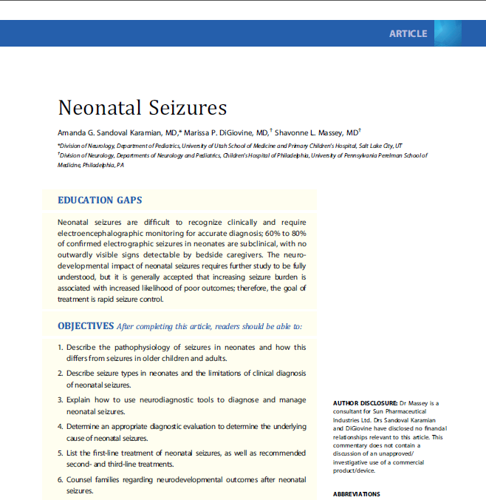
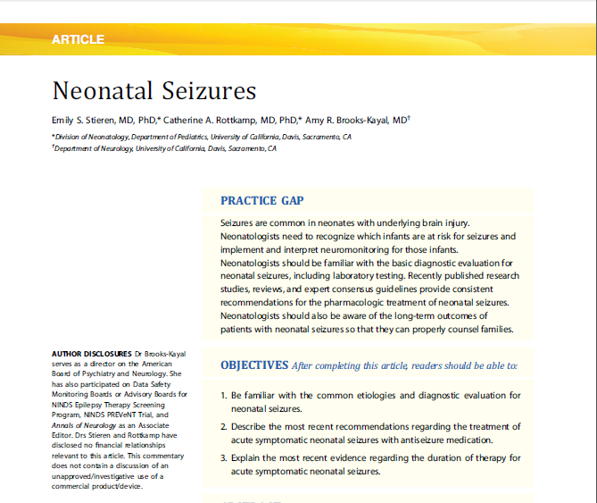
References :
2025/01/01

Slide 32
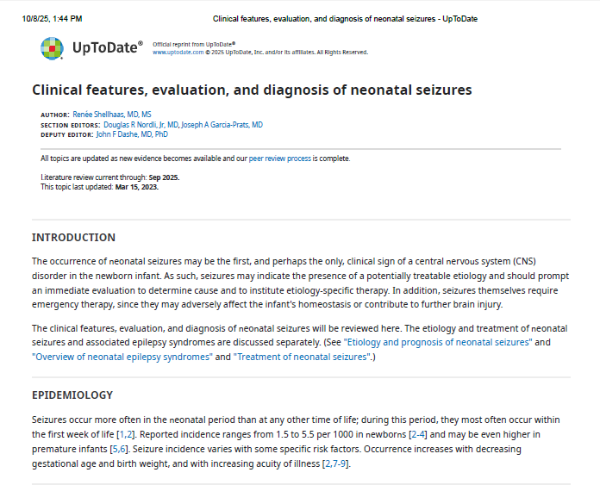
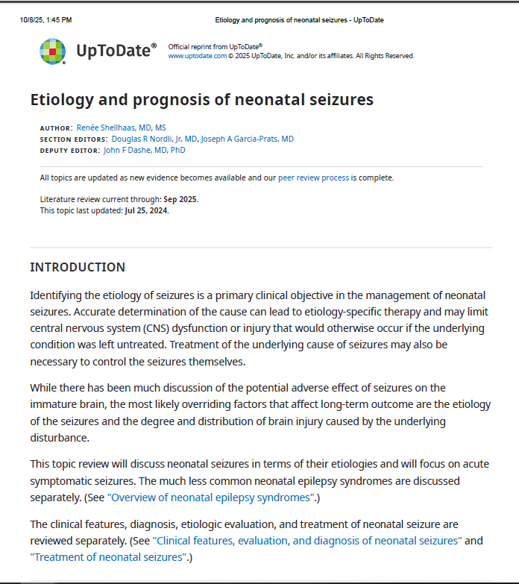
References :

Slide 33

THANK YOU
2025/01/01

