Slide 1
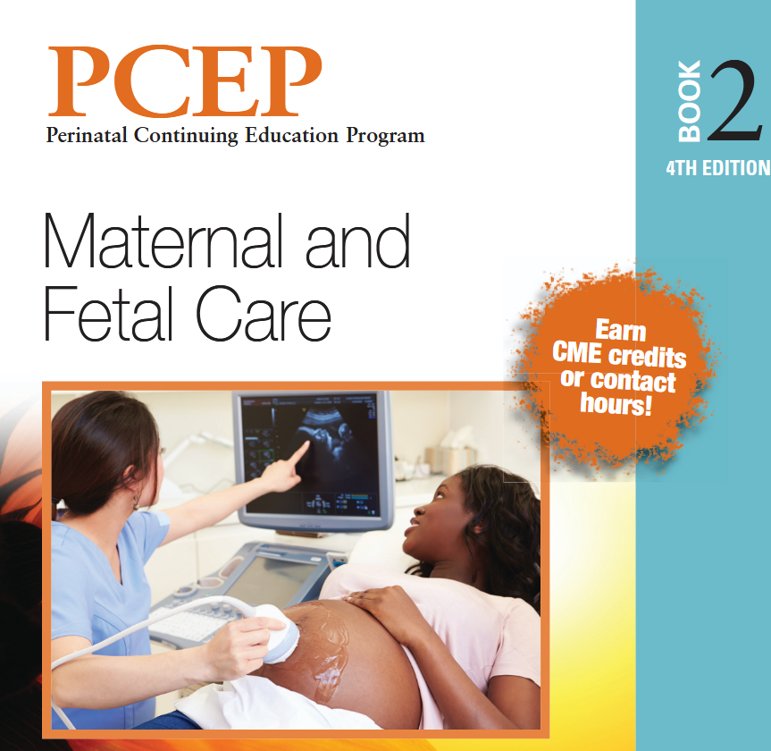
PROM
DR MOHAMMAD TORKAMAN
NEONATOLOGIST
ASSOCIATE PROFESSOR

Slide 2
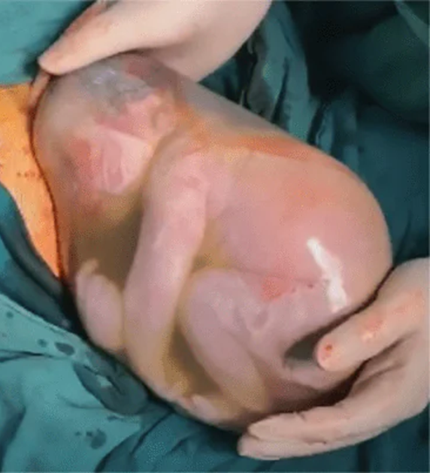
The amniotic (fetal) membranes may rupture before, coincident with, or after the onset of labor
Rupture of the fetal membranes before the onset of labor is termed prelabor ROM
Preterm ROM refers to ROM before 37 weeks’ gestation
The acronym PPROM usually refers to preterm Prelabor ROM
The term prolonged ROM refers to the duration of ruptured membranes, typically defined as being longer than 18 hours

Slide 3
Programmed weakening process
Work in the rat model has demonstrated that collagen remodeling, with activation of matrix metalloproteinases (MMPs), and apoptosis increase markedly in the amnion at end-gestation, suggesting that these processes are involved in fetal membrane weakening
TNF α or interleukin 1β induces the same biochemical markers of membrane weakening and apoptosis seen at the end of gestation.

Slide 4
Etiology
In most cases of PROM, there is
no identifiable risk factor.
Prior preterm delivery, especially if associated with preterm PROM
• Cervical insufficiency and Short cervical length
• Procedures involving the cervix, including cervical cerclage
• Intra-amniotic infection (formerly termed chorioamnionitis)
• Maternal lower genital tract infection, especially Trichomonas, gonorrhea, chlamydia, or bacterial vaginosis
• Uterine overdistension (polyhydramnios, multifetal gestation )
• Vaginal bleeding after 14 weeks of gestation
• Maternal smoking
• Lower socioeconomic status
Nutritional deficiencies of copper and ascorbic acid
Low body mass index
• Bacteriuria, with or without symptoms of UTI
• Amniocentesis (,1% risk for ROM to occur because of the procedure; if ROM occurs, the
amniotic fluid leakage almost always stops spontaneously and the pregnancy continues)

Slide 5
Pathogenesis
Inflammation can activate proteases that degrade collagen within the fetal membranes, weakening and predisposing them to rupture.
Ascending genital infection from bacterial vaginosis can certainly cause an innate inflammatory response, sterile inflammation from bleeding or tobacco use may also weaken the fetal membranes, allowing for microbial invasion
Oxidative stress generates reactive oxygen species, which can target and degrade collagen. Reactive oxygen species are most commonly produced during cellular respiration and when they are released by immune cells during phagocytosis

Slide 6
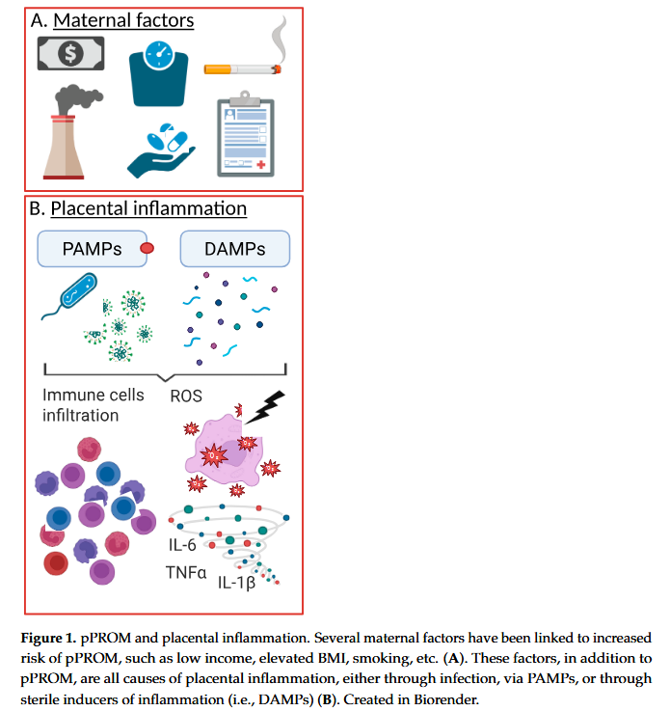
pathogen-associated molecular patterns (PAMPs)
and damage-associated molecular patterns (DAMPs)

Slide 7
Epidemiology
PROM complicates approximately 8% of term pregnancies. After PROM at term, spontaneous labor begins within 24 hours in 60% to 70% of patients and within 72 hours in over 95%.
Preterm PROM is less common, complicating only about 1% of deliveries overall.
Previable and periviable PPROM occurring before 24 weeks gestation occurs in 0.3% to 0.4% of pregnancies

Slide 8
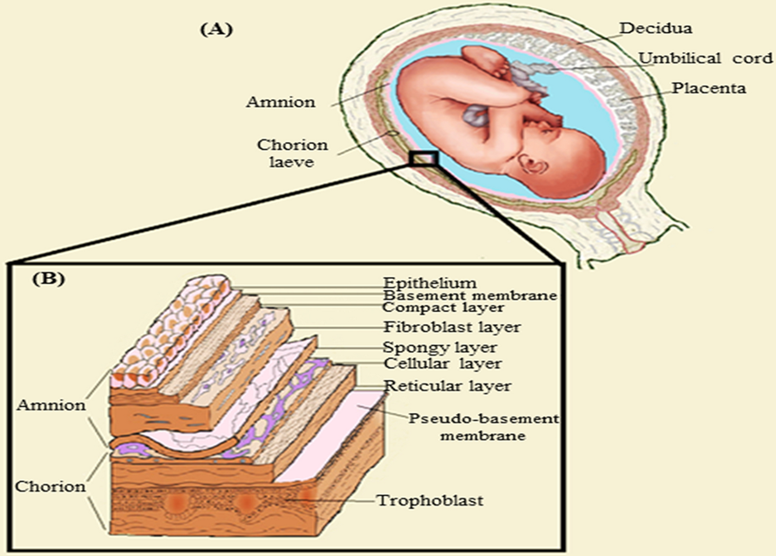
What maternal-fetal risks are affected by PROM?
The intact membranes that surround the amniotic fluid and fetus and the thick cervical mucus provide a physical barrier to infection by organisms ascending from the vagina.
When the membranes rupture,
this protective barrier is broken.
This increases the maternal risk
for an intra-amniotic infection, sepsis,
and postpartum endometritis.

Slide 9
prematurity
PROM is often followed by spontaneous labor and delivery.
If preterm birth occurs, prematurity is the major risk for neonatal morbidity and death even in the absence of intra-amniotic infection
If intra-amniotic infection is present, the risk of neonatal morbidity or death is significantly increased.

Slide 10
Maternal, fetal, or neonatal infection
While infection may be a cause of PROM, infection can also be a consequence of PROM.
Ascending infections from the vagina to the uterus can be caused by normal vaginal flora or by pathogenic organisms.
This also increases the fetal risk for in utero infection, preterm birth, and neonatal sepsis.
Maternal and fetal infection is more common with earlier gestational age at membrane rupture and longer duration of pregnancy (latency period) after ROM has occurred

Slide 11
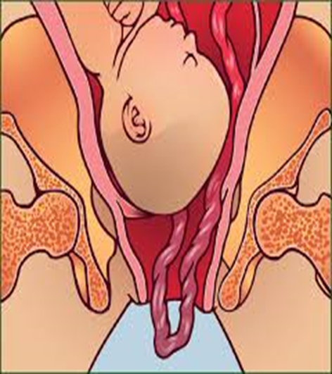
Umbilical cord complications
1. Umbilical cord compression: Leakage of amniotic fluid from the uterus can result in oligohydramnios. When oligohydramnios is present, the umbilical cord can become compressed between the fetus and uterine wall, which may
result in fetal hypoxia or fetal death
in utero, whether or not
labor is present
2.Umblical cord prolapse

Slide 12
Oligohydramnios complications
Prolonged oligohydramnios, particularly if preterm PROM occurs during the second trimester, can result in pulmonary hypoplasia.
Pulmonary hypoplasia may result in chronic lung disease or neonatal death because of respiratory insufficiency.
Deformation of the fetus, with abnormal facies and limb positioning deformations, may also occur because of restriction of fetal growth and movement.

Slide 13
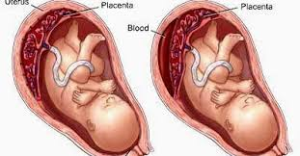
Placental abruption

Slide 14
Neurodevelopmental disorders
The disruption of fetal membrane integrity introduces potential infection and inflammation into the intrauterine environment, triggering immune responses that may affect fetal development.
Placental inflammation plays a pivotal role in mediating these effects, exposing the fetus to cytokines, oxidative stress, and potential microbial insults that contribute to adverse neurodevelopmental outcomes.
This review examines the current evidence of the mechanistic pathways linking pPROM-induced placental inflammation to NDDs, emphasizing the roles of pathogen-associated molecular patterns (PAMPs) and damage-associated molecular patterns (DAMPs) in the inflammatory responses.

Slide 15
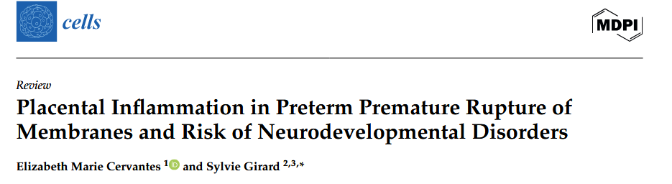
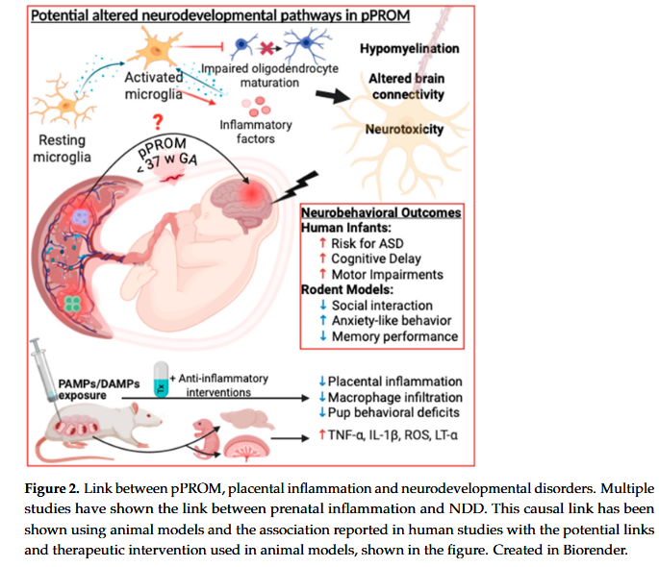
autism spectrum disorder
(ASD),

Slide 16
Fetal death
The risk of fetal death is increased in all cases of PROM.
This risk increases with decreasing gestational age and is highest for fetuses of less than 26 weeks’ gestation.

Slide 17
Management of pregnant women with PROM
When there is evidence of intra-amniotic infection, the woman and fetus may develop serious complications.
The fetus must be delivered, regardless of gestational age.
Antibiotic therapy should be started promptly

Slide 18
Term gestation, no intra-amniotic infection
Term fetus (37 0/7 weeks of gestation or more)
Evaluate the risk for early-onset neonatal GBS sepsis.
— Maternal rectovaginal or urine culture result positive for GBS or a history of having a prior child with early-onset GBS sepsis: Initiate prophylaxis.
— Maternal rectovaginal or urine culture result negative for GBS or nucleic acid amplification (NAAT) result negative for GBS: Prophylaxis not indicated.
— Maternal GBS status unknown: Prophylaxis indicated in the presence of maternal intrapartum fever (38.0°C [.100.4°F]), prolonged ROM (18 hours), NAAT result positive for GBS, or history of GBS colonization in a prior pregnancy.

Slide 19
Preterm gestation
Preterm gestation, 23 0/7 to 36 6/7 weeks of gestation, no evidence of intra-amniotic infection
Maternal rectovaginal or urine culture result positive for GBS or a history of having a prior child with early-onset GBS sepsis: Initiate prophylaxis.
— Maternal rectovaginal or urine culture result negative for GBS or NAAT result negative for GBS: Prophylaxis not indicated.
— Maternal GBS status unknown: Prophylaxis indicated due to preterm gestational age

Slide 20
Even in the absence of labor or clinical evidence of infection, antibiotics given prophylactically have demonstrated several benefits when used for patients with PROM before 35 weeks of gestation, including
• Significantly prolonging pregnancy
• Reducing the incidence of
— Maternal infection (intra-amniotic infection and postpartum endometritis)
— Neonatal sepsis
— Neonatal IVH

Slide 21
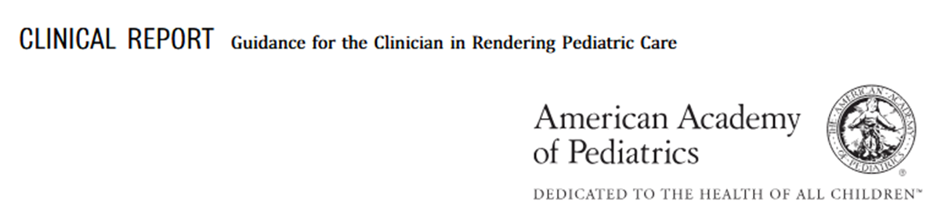
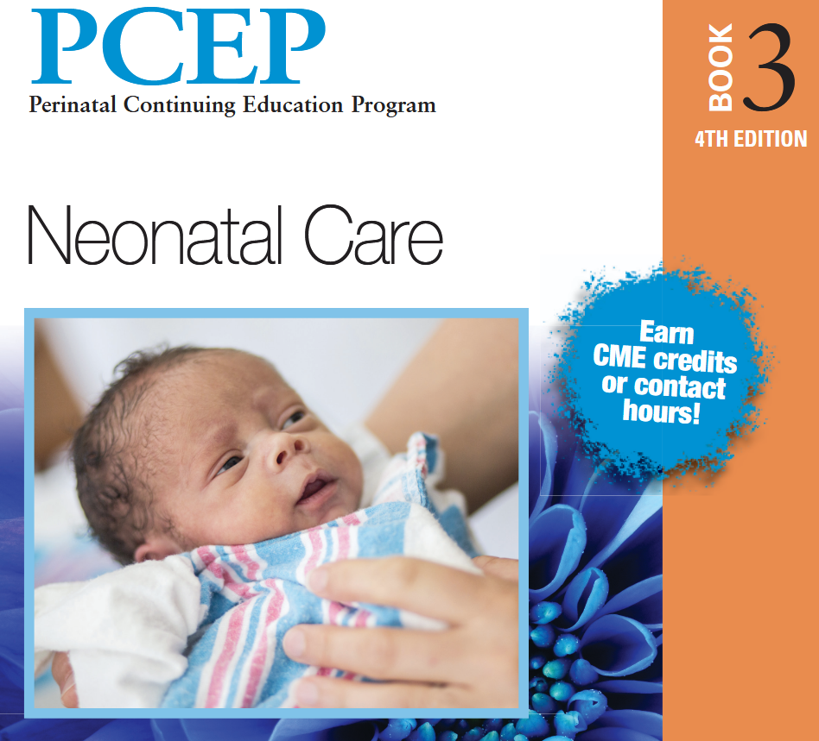
Strongest predictor of GBS EOD
is maternal GBS colonization
Gestational age at birth,
Intraamniotic infection
Duration of ROM

Slide 22
The newborn infant’s condition at birth and evolving condition over the first 12 to 24 hours after birth are strong predictors of early-onset infection attributable to any pathogen
The administration of GBS IAP and the administration of intrapartum antibiotics in response to obstetric concern for intraamniotic infection both decrease this risk.

Slide 23
Newborn clinical illness consisting of abnormal vital signs (eg, tachycardia, tachypnea, and/or temperature instability), supplemental oxygen requirement and/or need for CPAP, MV, or blood pressure support can be used to predict early-onset infection
The routine measurement of complete blood cell counts or inflammatory markers such as C-reactive protein alone in newborn infants to determine risk of GBS EOD is not justified given the poor test performance of these in predicting what is currently a low-incidence disease.

Slide 24



There Are 3 Current Approaches to Risk Assessment Among Infants Born at >35 Weeks’ Gestation
Categorical risk assessment
Multivariate risk assessment (theNeonatal Early-Onset Sepsis Calculator)
Risk assessment based on newborn clinical condition

Slide 25
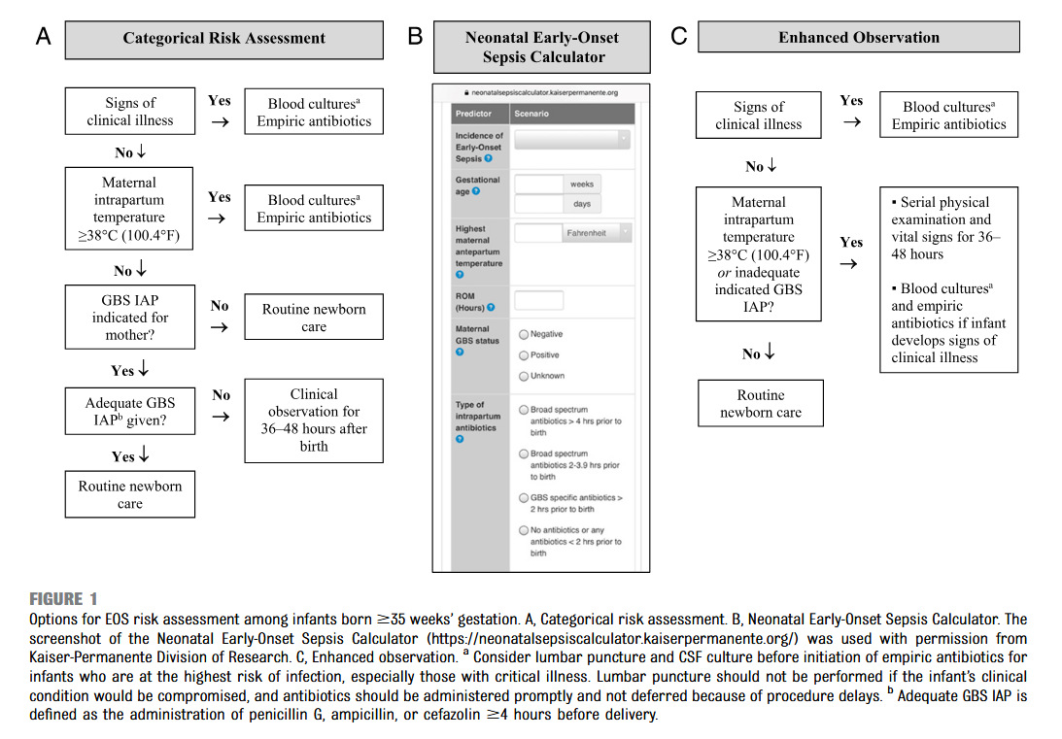

Slide 26
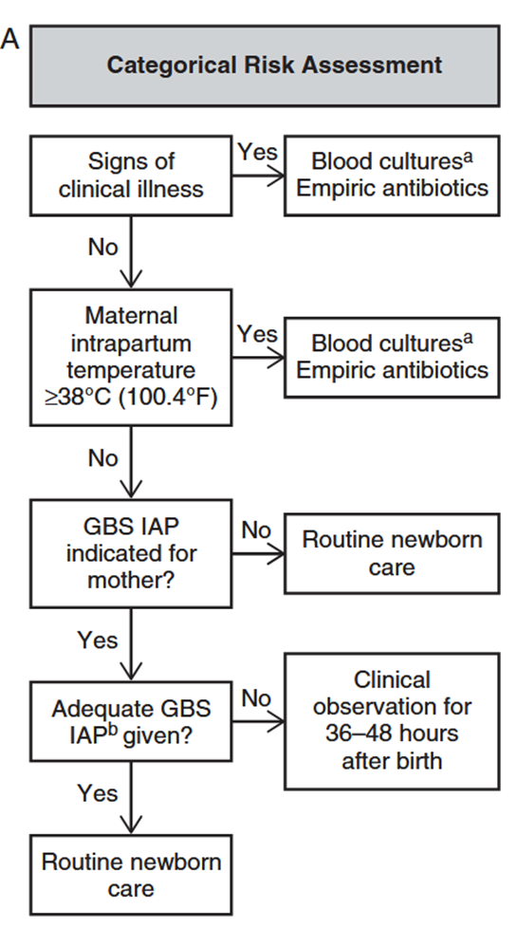
Categorical risk assessment
The administration of penicillin G, ampicillin, or cefazolin
>4 hours before delivery is considered adequate GBS IAP; other
antibiotics or other durations of treatment <,4 hours are considered
inadequate when using this approach
However, the risk is highly variable among the newborn infants recommended to receive empirical treatment in this approach, ranging from slightly lower than the baseline population
risk to significantly higher, depending on the gestational age,
duration of ROM, and timing and content of administered intrapartum antibiotic

Slide 27
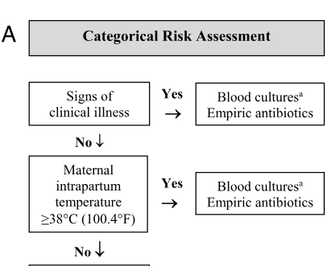
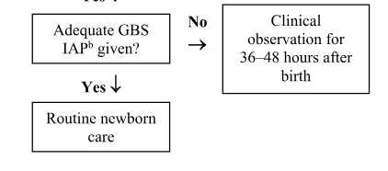

Slide 28
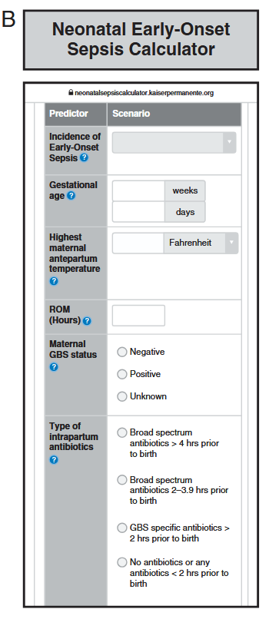
https:// neonatalsepsiscalculator. kaiserpermanente.org
Multivariate risk
assessment integrates the individual
infant’s combination of risk factors
and the newborn infant’s clinical
condition to estimate an individual
infant’s risk of EOS, including GBS
EOD.
Predictive models based on
gestational age at birth, highest
maternal intrapartum temperature,
maternal GBS colonization status,
duration of ROM, and type and
duration of intrapartum antibiotic
therapies have been developed and
validated

Slide 29
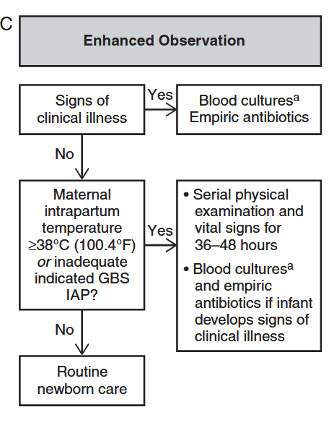
Risk assessment based on newborn clinical condition
Under this approach, infants who appear ill at birth and
those who develop signs of illness over the first 48 hours after birth are treated empirically with antibiotics.

Slide 30
Clinical Monitoring of Well-Appearing Infants Born to Mothers With Chorioamnionitis
This center ultimately administered empirical antibiotics to 5% to 12%
of such infants.
Centers that adopt this approach will need to establish processes to ensure serial, structured, documented physical assessments and develop clear criteria for additional evaluation and empirical antibiotic administration
Conclusions: A management approach using clinical presentation to determine the need for antibiotics in chorioamnionitis-exposed infants was successful in reducing antibiotic exposure and was not associated with any clinically relevant delays in care or adverse outcomes
2018 Apr;141(4):e20172056.
doi: 10.1542/peds.2017-2056.

Slide 31
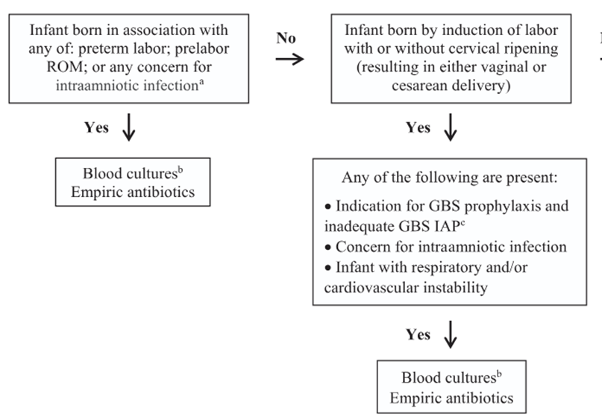
<35 weeks
For infants born at less than 35 weeks’ gestational age, blood cultures should be performed and empirical antibiotics started in the setting of preterm labor, prelabor rupture of membranes, or any concern for intraamniotic infection (such as chorioamnionitis); if there was an indication for GBS IAP but antibiotics were not administered to the mother; or if the infant has any respiratory or cardiovascular instability.

Slide 32
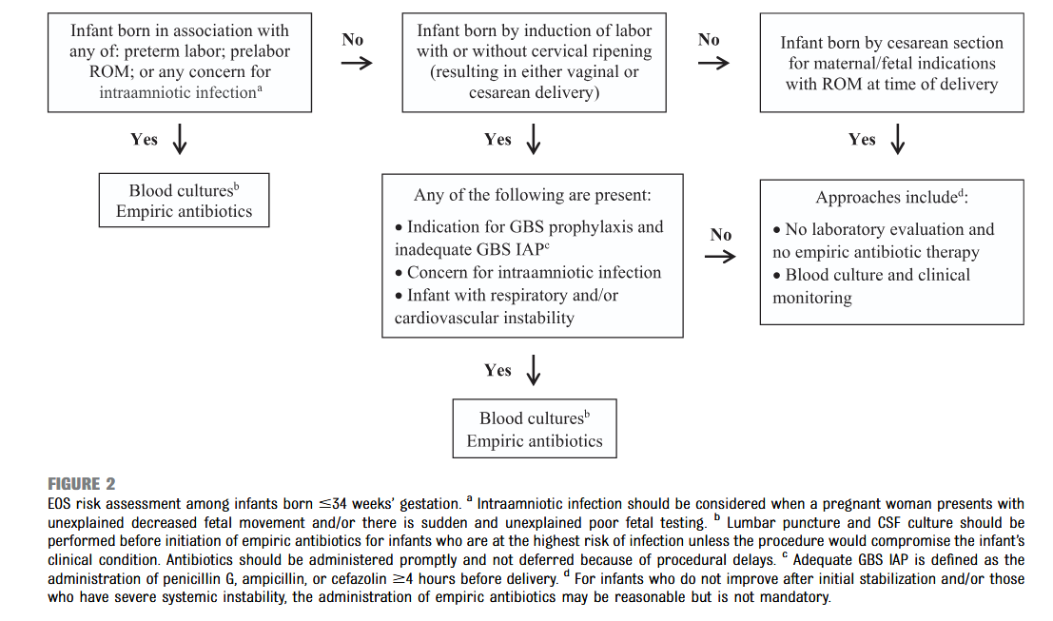

Slide 33
High risk preterm infant
Infants delivered for maternal and/ or fetal indications but who are ultimately born by vaginal or cesarean delivery after efforts to induce labor and/or with ROM before delivery are subject to factors associated with the pathogenesis of GBS EOD.
If the mother has an indication for GBS IAP and adequate IAP (penicillin, ampicillin, or cefazolin <4 hours before delivery) is not given or if any other concern for infection arises during the process of delivery, the infant should be managed as recommended above for preterm infants at higher risk for GBS EOD.

Slide 34
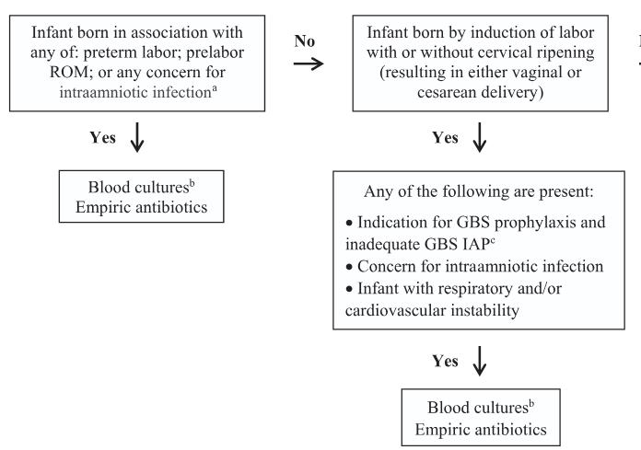
High risk preterm infant
An acceptable approach to these infants is close observation for those infants who are well appearing at birth and to obtain a blood culture and to initiate antibiotic therapy for
infants with respiratory and/or
cardiovascular instability after birth.

Slide 35
Preterm infants at lower risk for EOS
(1) maternal and/or fetal indications for preterm birth (such as maternal preeclampsia or other noninfectious medical illness, placental insufficiency, or fetal growth restriction),
(2) birth by cesarean delivery
(3) absence of labor, attempts to induce labor, or any ROM before delivery.

Slide 36
Preterm infants at lower risk for EOS
Acceptable initial approaches to these infants include
(1) no laboratory evaluation and no empirical antibiotic therapy or
(2) blood culture and clinical monitoring.
For infants who do not improve after initial stabilization and/or those who have severe systemic instability, the administration of empirical antibiotics may be reasonable

Slide 37


