Slide 1
New Diagnostic Frontiers in HIE
Dr. Zahra Vahedi
Neonatologist
Iran University of medical sciences

Slide 2
New Diagnostic Frontiers in HIE
Dr. Zahra Vahedi
Neonatologist
Iran University of medical sciences

Slide 3
Hypoxic Ischemic Encephalopathy (HIE)
1
Main causes of mortality and morbidity in term and near-term infants
2
Long-term neurodevelopmental disabilities
3
The crucial role of early diagnosis and management

Slide 4
TH alone or with Adjuvants
Hypoxic-Ischemic injury
Reduces disability and mortality
Disability or
Death
Phase I HIE
Primary Energy Failure
Phase II HIE
Secondary Energy Failure
Inflammation & Dysfunction
Normal Brain
Phase III HIE
Brain Damage and Dysfunction
Resolution
Latent Period

Slide 5
Introduction
(The Diagnostic Imperative)
1
The Diagnostic Challenge: Maximizing the Six-Hour Window
2
HIE treatment (TH) efficacy is critically dependent on initiation within the strict 6-hour window

Slide 6
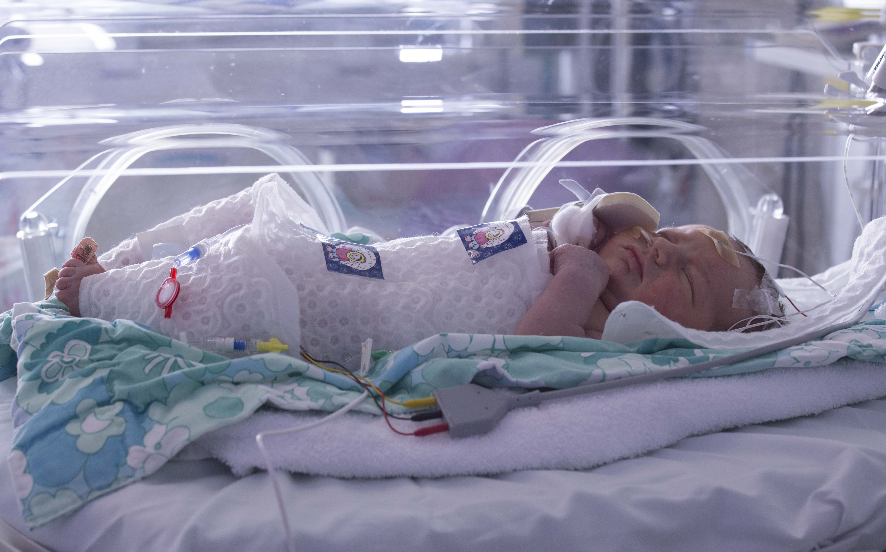
1
2
3

Slide 7
Introduction
(The Diagnostic Imperative)
Classic Sarnat Staging is subjective and clinical signs often develop late, challenging timely enrollment.
2
This delay leads to inconsistent care and missed opportunities for neuroprotection.
3

Slide 8

The ACOG/AAP Triad Definition
(All must be met for Severe HIE)
1. Severe Acidemia: Cord or first hour blood gas with pH > 7 AND Base Deficit > 12 mEq/L.
3. Multi-Organ Involvement: Evidence of Multi-System Organ Dysfunction/Failure (e.g., AKI, LFT derangement).
2. Clinical Encephalopathy: Presence of Moderate to Severe NE (Sarnat Stage II or III).

Slide 9
The ACOG/AAP Triad Definition
(All must be met for Severe HIE)
1. Severe Acidemia: Cord or first hour blood gas with pH < 7 AND Base Deficit < -12 mEq/L.
3. Multi-Organ Involvement: Evidence of Multi-System Organ Dysfunction/Failure (e.g., AKI, LFT derangement).
2. Clinical Encephalopathy: Presence of Moderate to Severe NE (Sarnat Stage II or III).

Slide 10
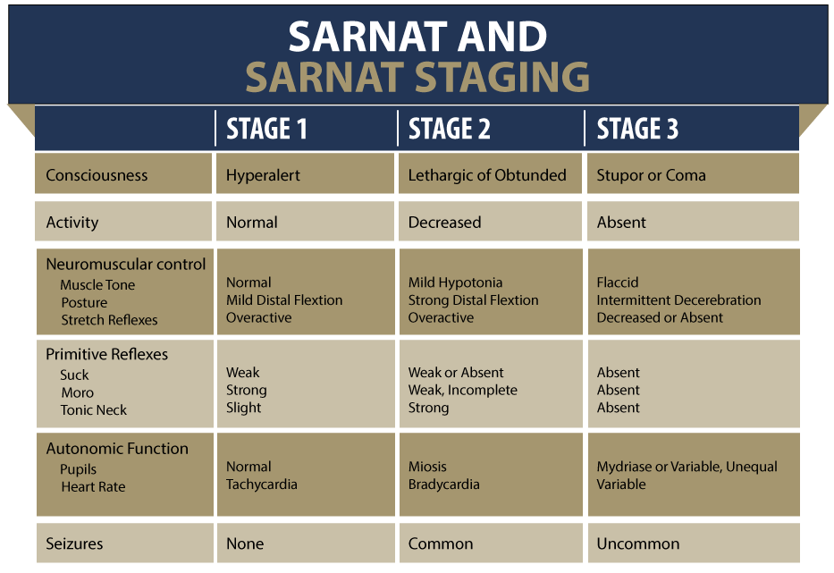

Slide 11
The Goal
To review objective, early, and multimodal tools for accurate diagnosis and streamlined decision-making.

Slide 12
Biochemical Markers
Biomarkers provide objective evidence of injury prior to clinical deterioration.
Systemic Biomarkers
Neuro Biomarkers

Slide 13
Biochemical Markers
Systemic Biomarkers
Neuro Biomarkers
CK-BB
NRBC
Lactate
IL-6
GFAP
NfL
Protein S100B
(high Negative Predictive Value)
NSE
Netrin-1

Slide 14
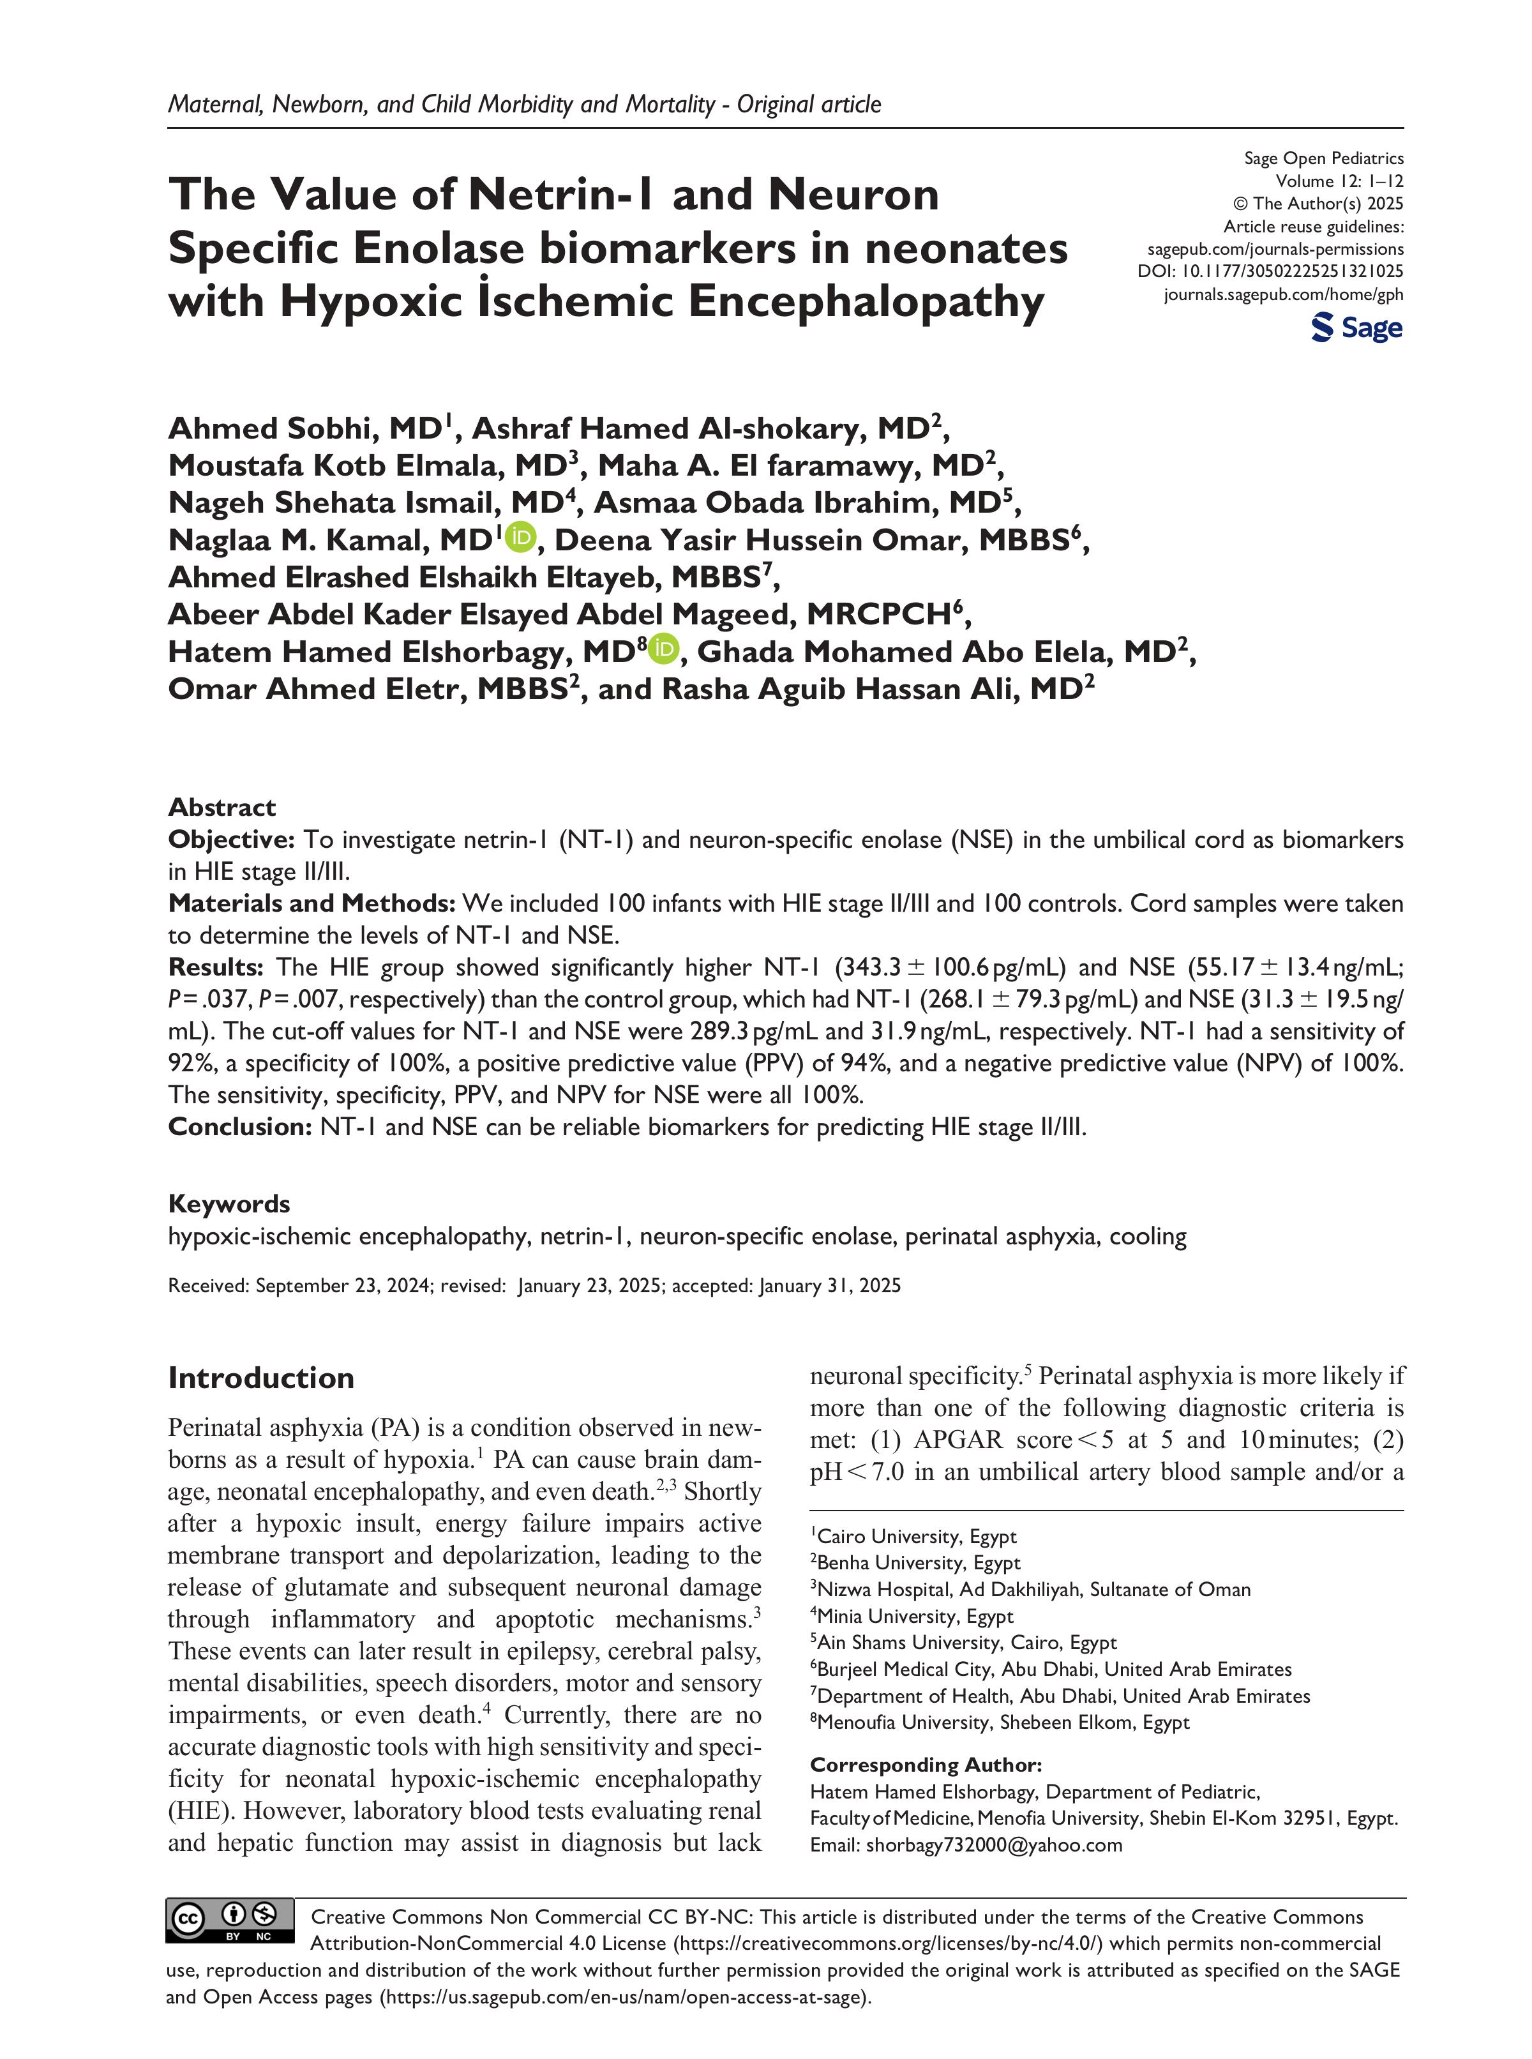

Slide 16
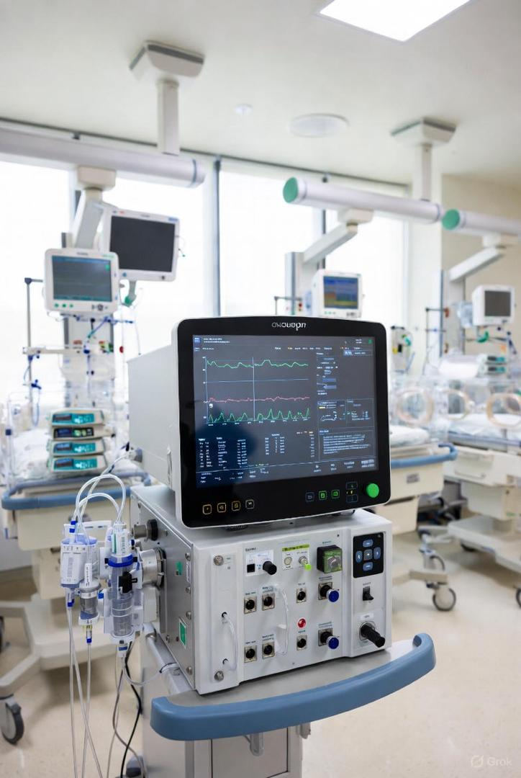
HRMS (high resolution mass spectrometry)
It is a laboratory technique used to discover new biomarkers and molecular patterns for the very rapid diagnosis of HIE in cord blood and serum.
R/O DDx

Slide 17
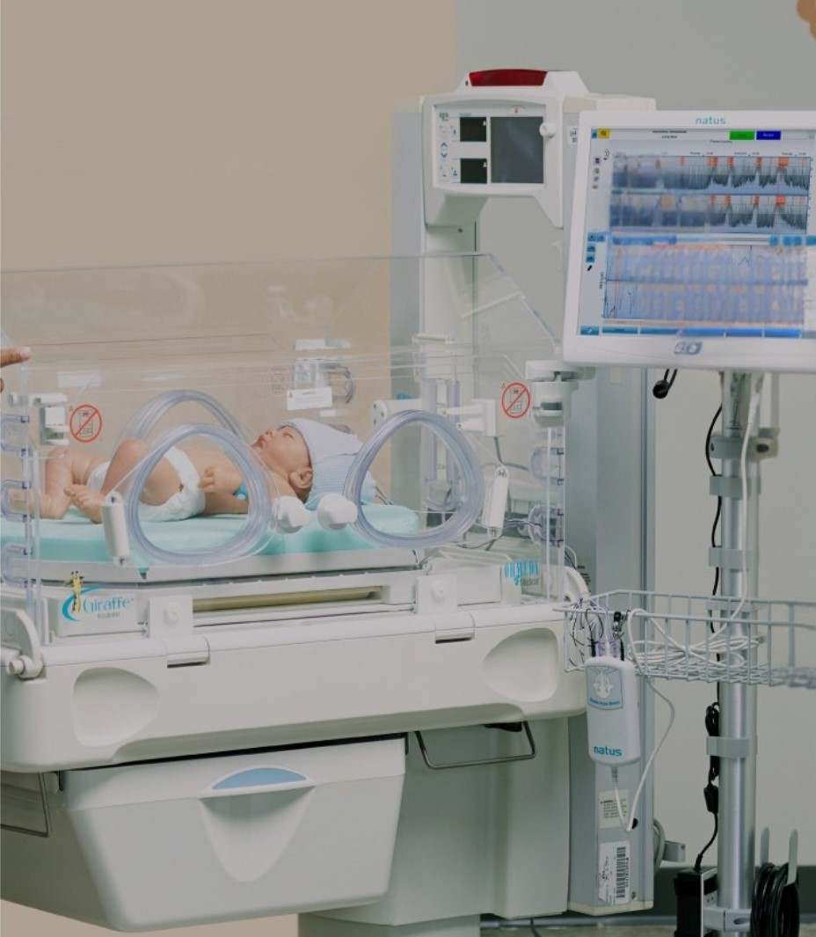
Amplitude-integrated EEG (aEEG)
  The most reliable bedside predictor of outcome, essential for confirming TH eligibility.
  Severely Abnormal Traces (Low Voltage or Burst Suppression) strongly predict poor outcome.
  Absence of Sleep Wake Cycling (SWC) after 24 hours is a critical warning sign.

Slide 18
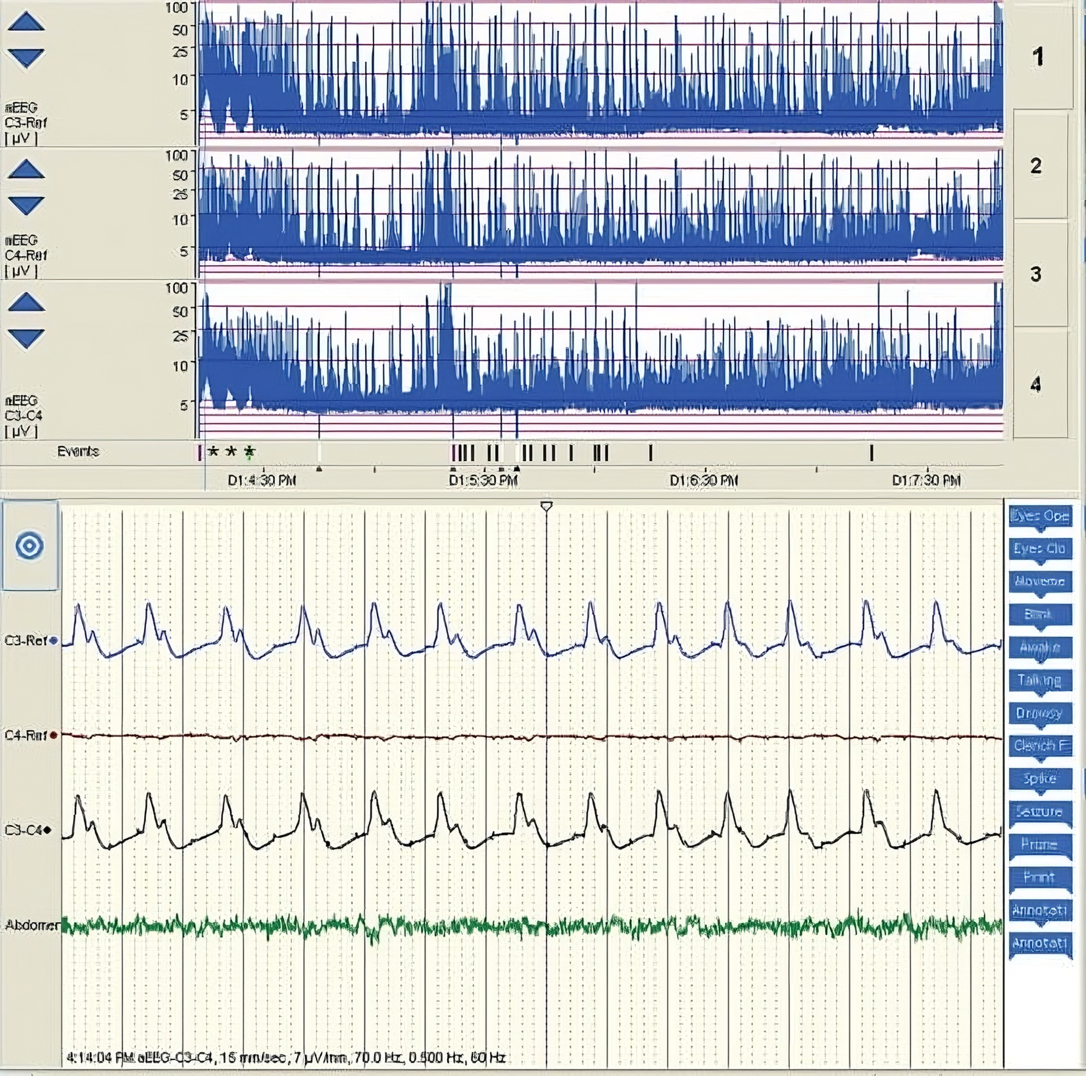

Slide 19
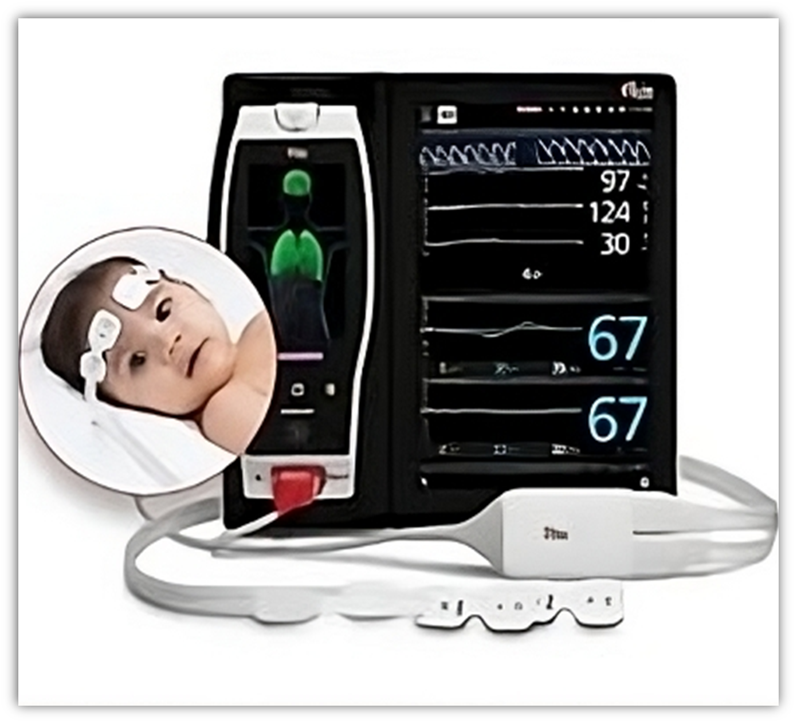
Near-Infrared Spectroscopy (NIRS)
  Monitors regional cerebral oxygen (%rSO2) saturation continuously.
  Identifies periods of critical cerebral hypoperfusion or hyper perfusion, guiding targeted hemodynamic management during the acute phase.

Slide 20
Near-Infrared Spectroscopy (NIRS)
  Monitors regional cerebral oxygen (%rSO2) saturation continuously.
  Identifies periods of critical cerebral hypoperfusion or hyper perfusion, guiding targeted hemodynamic management during the acute phase.

Slide 21


DWI-MRI
  The Gold Standard for quantifying injury extent, typically performed Day 3-7 (post-re-warming).
  Basal Ganglia/Thalamic Injury (acute, profound asphyxia) vs. Cortical/Watershed Injury (prolonged/partial asphyxia).

Slide 22
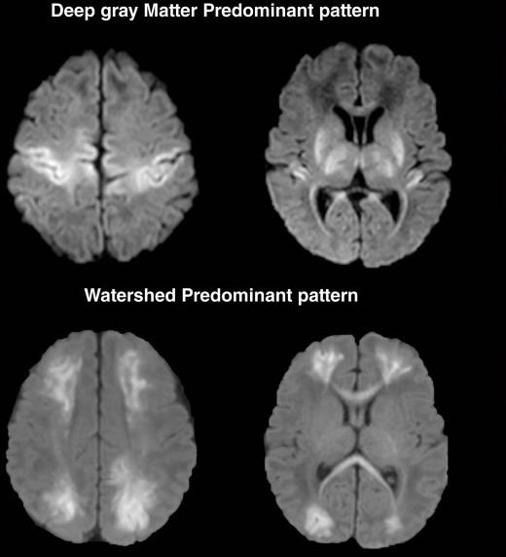

Deep gray matter predominant pattern
Watershed predominant pattern

Slide 23
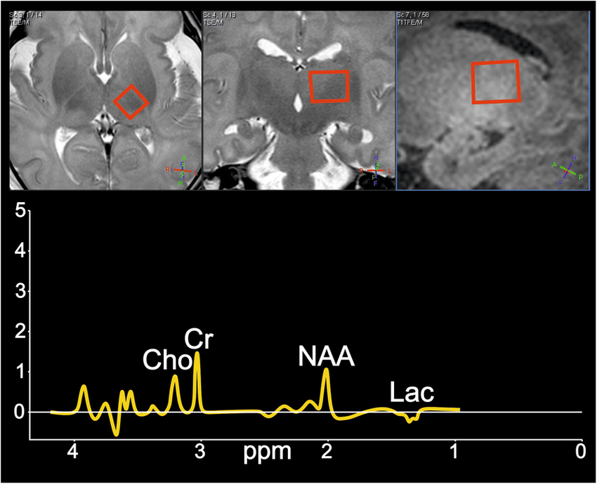
High-Resolution Prognostication (MRS)
An elevated Lactate/NAA ratio > 0.3 - 0.5 in the basal ganglia/thalamus is the strongest predictor of poor long-term NDI.
This ratio often provides higher prognostic accuracy than {DWI} alone.

Slide 24
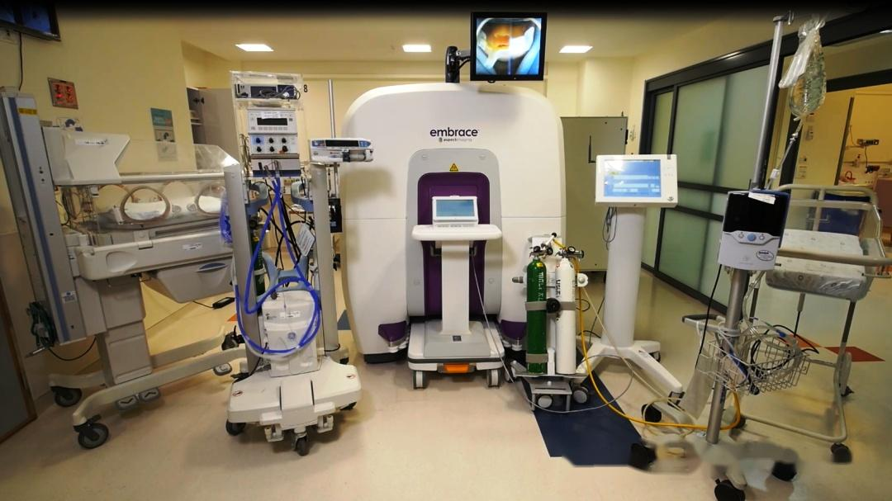
  Point of care MRI

Slide 25

AI and Machine Learning:
  AI models can automatically analyze and classify raw aEEG data and complex MRI features.
  Multimodal AI models integrate clinical, lab, and imaging data to generate a comprehensive risk score for NDI at 2 years, aiding family counseling

Slide 26
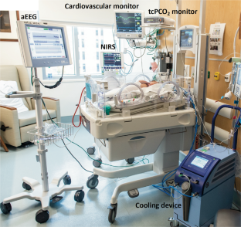

  A Multimodal Diagnostic Strategy
  (Clinical + Gas + aEEG + Early
  Biomarkers) is required to maximize TH enrollment within 6 hours.
1
  Phenotyping: Advanced diagnostics (AI,
  Metabolomics) allow us to phenotype
  subgroups of HIE based on specific molecular and cellular injury patterns.
2

Slide 27
  A Multimodal Diagnostic Strategy
  (Clinical + Gas + aEEG + Early
  Biomarkers) is required to maximize TH enrollment within 6 hours.
1
  Phenotyping: Advanced diagnostics (AI,
  Metabolomics) allow us to phenotype
  subgroups of HIE based on specific molecular and cellular injury patterns.
2

Slide 28
Precision Diagnosis for Personalized Care
  Personalized Neuroprotection: This precise phenotyping will guide the use of Adjuvant Neuroprotective Agents (e.g., Erythropoietin, Stem Cells) to specific patients who are most likely to benefit, shifting our focus to targeted therapeutic interventions.

Slide 29
THANK YOU
روشن نمی‌شود به چراغی جهان، ولی
یادآور حقیقت پیدای نور باش.
Do you have any questions?
vahedizahra1395@gmail.com

Slide 30
THANK YOU
روشن نمی‌شود به چراغی جهان، ولی
یادآور حقیقت پیدای نور باش.
Do you have any questions?
vahedizahra1395@gmail.com

